Slide 1
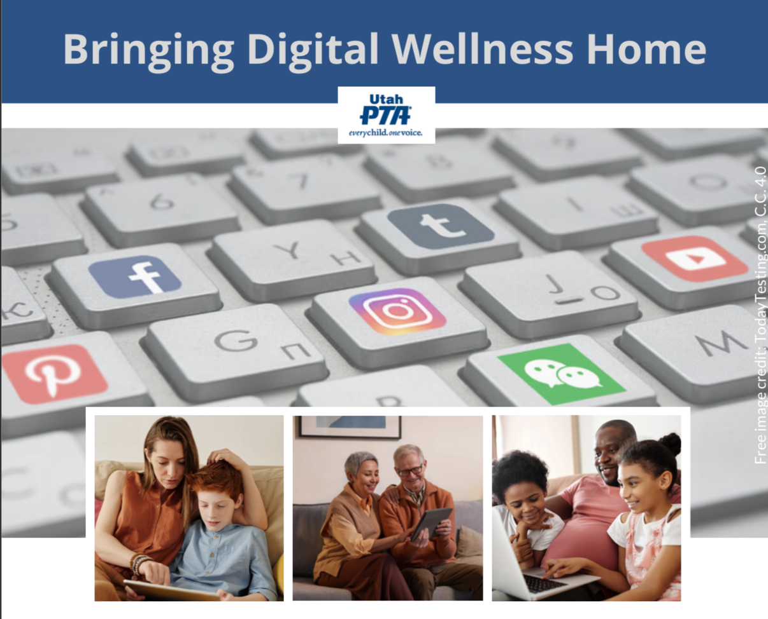
Note: All material in this series is for educational and informational purposes only, and is not meant to be exhaustive or used as a replacement for professional health support. Also, any sharing of resources doesn't imply full endorsement of all of that person or group's work. We share what we find helpful, but invite you to use your media literacy skills in all your study and research.
Notes:
Note: All material in this series is for educational and informational purposes only, and is not meant to be exhaustive or used as a replacement for professional health support. Sharing resources doesn't imply EPIK's endorsement of the individuals or organizations, or endorsement of said entities. Also, the presentation is best viewed in slideshow format, as some of the slides are animated, but we have also included notes for many of the slides that you might want to review as well. Whatever works best for you.
NOTE: Portions of this work first appeared in or are derived or adapted from the Digital
Wellness Certificate Program. Those portions are Copyright © 2021, Digital Wellness Institute.

Slide 2
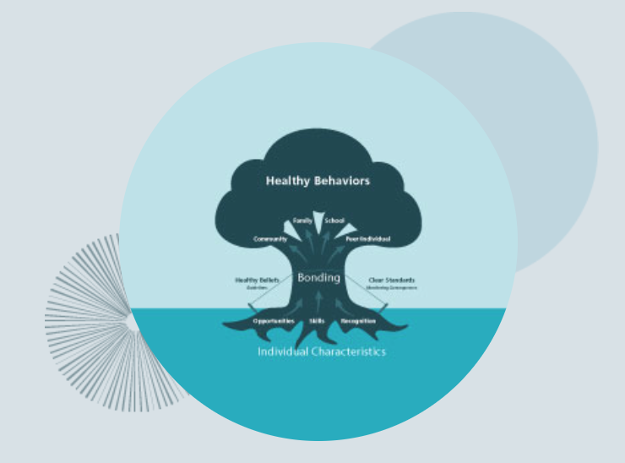
Discussion #9 Social Development Strategy +
Insights & Reflections from the Series
Bringing Digital Wellness Home
Notes:
In this week's folder, we've included a collaborative white paper that was written as part of the 2017 Digital Citizenship Summit that EPIK hosted. It attempted to explore connections between reducing risks through filters/monitoring software (the monitoring company that helped write the paper is located in the UK). I also noticed when reviewing it again that the final copy does not clearly mark some of the direct quotes. We did not do the final layout, but I should have caught that in final editing processes. My apologies. We were very thorough in our footnoting, however, so we encourage exploring the footnotes for more detailed exploration of the different topics. White papers are a snapshot in time, so we would include different things now than we did then, and would not repeat having a product company co-sponsor a document. We liked the processes that Impero helped schools develop, but we do not endorse one particular product over another.

Slide 3
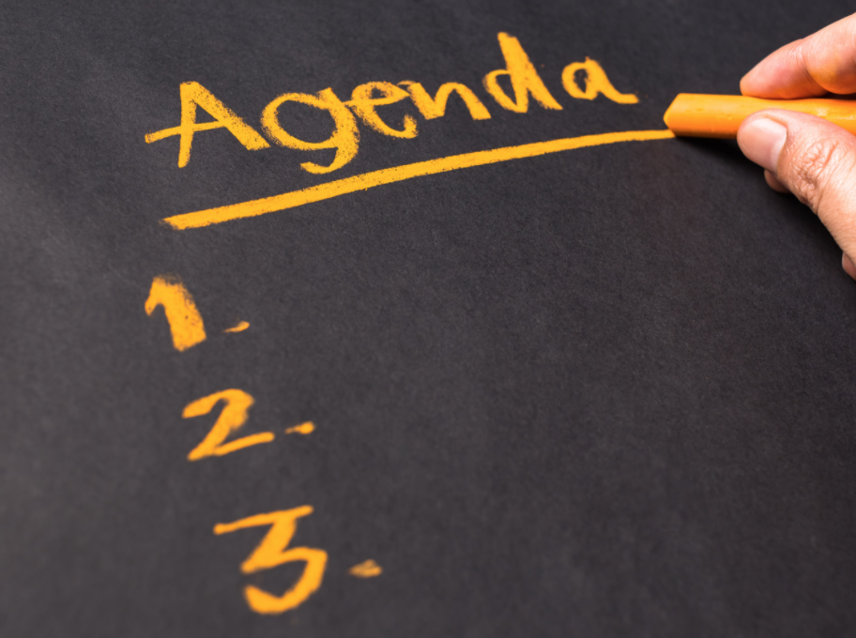
Agenda
Check-in
Content/Concept Sharing
Connection/Discussion
Request/Invitation

Slide 4
Agenda
Check-in
Content/Concept Sharing
Connection/Discussion
Request/Invitation

Slide 5
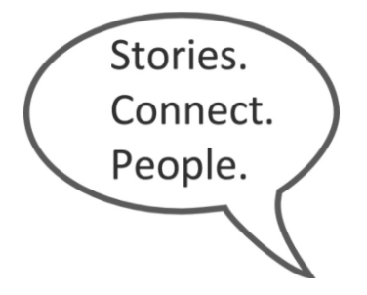
Think, Write, Share Activity
"The closest distance between two people is a story." Jared Stewart
Notes:
Once again, see more question prompts in the Stories Connect People document we've included in this week's Google Folder. https://docs.google.com/document/d/1y3maM8RyDPhuStiR_wN2MR98rJ2V8QBMo2D4I7DxuBk/edit?usp=sharing
We’ll take a few minutes to share stories with each other.
Here's a little history about the internal company research by Tribalry, a local company that taught us about this methodology. The founders, from a family of 10 children, learned through these simple exercises that even with the people closest to you, you often don’t know what’s inside of them, what their stories are. Taking time for each others’ stories is critical to building relationships and trust, whether that be in close relationships or in business relationships. And taking time for conversation can help relationships grow from weak ties to stronger bonds. Stories connect people! Or, as Jared Stewart, co-founder of Tribalry says, "The shortest distance between two people is a story."

Slide 6
Think about a fun meal tradition in your sphere
OR
Think about the most unusual thing you have eaten
Notes:
Once again, see more question prompts in the Stories Connect People document we've included in this week's Google Folder. https://docs.google.com/document/d/1y3maM8RyDPhuStiR_wN2MR98rJ2V8QBMo2D4I7DxuBk/edit?usp=sharing
We’ll take a few minutes to share stories with each other.
Here's a little history about the internal company research by Tribalry, a local company that taught us about this methodology. The founders, from a family of 10 children, learned through these simple exercises that even with the people closest to you, you often don’t know what’s inside of them, what their stories are. Taking time for each others’ stories is critical to building relationships and trust, whether that be in close relationships or in business relationships. And taking time for conversation can help relationships grow from weak ties to stronger bonds. Stories connect people! Or, as Jared Stewart, co-founder of Tribalry says, "The shortest distance between two people is a story."

Slide 7
Share:
What is a story behind one of these questions?
In your breakout rooms, you will each have one minute to share a story around your food tradition or unusual food experience
Remember the rules for engagement:
Everyone gets a full minute…no less, no more. The idea here is to give everyone equal opportunity to have a voice. If you finish early, others can ask you a question so you can share more and use up the rest of your time.*
Follow alphabetical order of first names for ease of flow.
Please self-time (or ask someone in your group to time for you).
If you are the one sharing and the timer goes off, please just say, “And, I’m done!” or "Thank you, I pass" even if you are in the middle of a sentence. ☺
Notes:
Stories Connect People document is included in this week's Google Folder. And this slide can help you with rules of engagement if you would like to try a Think, Write, Share activity in your own sphere of influence. https://docs.google.com/document/d/1y3maM8RyDPhuStiR_wN2MR98rJ2V8QBMo2D4I7DxuBk/edit?usp=sharing
Here's a little history about the internal company research by Tribalry, a local company that taught us about this methodology. The founders, from a family of 10 children, learned through these simple exercises that even with the people closest to you, you often don’t know what’s inside of them, what their stories are. Taking time for each others’ stories is critical to building relationships and trust, whether that be in close relationships or in business relationships. And taking time for conversation can help relationships grow from weak ties to stronger bonds. Stories connect people! Or, as Jared Stewart, co-founder of Tribalry says, "The shortest distance between two people is a story."

Slide 8
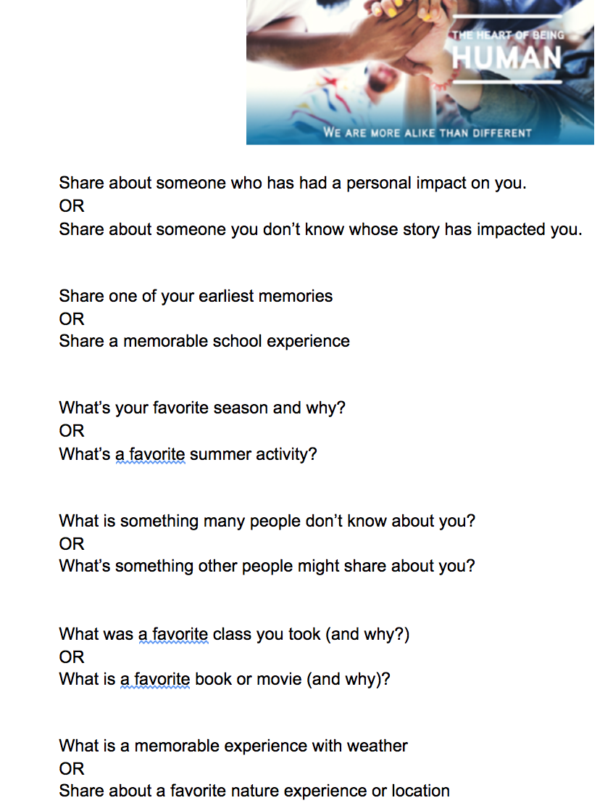
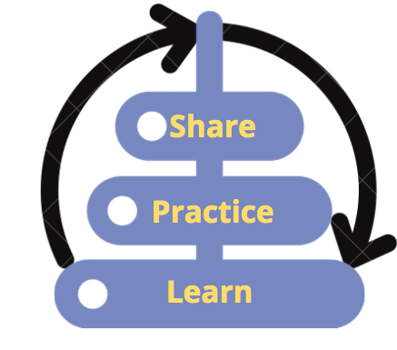
A reminder about "Stories Connect People"
"The closest distance between two people is a story." -Jared Stewart
Shared again in this week's folder: https://docs.google.com/document/d/1y3maM8RyDPhuStiR_wN2MR98rJ2V8QBMo2D4I7DxuBk/edit?usp=sharing
Notes:
https://docs.google.com/document/d/1y3maM8RyDPhuStiR_wN2MR98rJ2V8QBMo2D4I7DxuBk/edit?usp=sharing

Slide 9
Agenda
Challenge
Check-in
Content/Concept Sharing
Connection/Discussion

Slide 10
Finally! We're going to talk about protecting our kids! :)
Notes:
We've spent a lot of time during this series talking about putting on our own oxygen masks first, but ultimately, we hope our individual efforts toward Digital Wellness can mean we have more capacity to do some good in the world, to be influencers for good. There is perhaps no more important place for that to happen than with our direct interactions with children and youth in our own spheres of influence – in our homes, in classrooms, in community service settings.

Slide 11
From Week 1:
Increasing the Positives, Decreasing the Negatives
Notes:
In our first week, we used this image to talk about how it's easy to feel like "the bad" is winning. (We use the black/white image in the metaphorical sense…the things that worry us (predators, bad actors, harmful content) are the villains we may want to protect children against. And sometimes even one big villain can feel to overwhelm our concerns.)

Slide 12
Decreasing the Negatives
Notes:
When we talk about helping children, we want to reduce the villians in their lives, reduce access to them, etc. (Again, this is all metaphorical.)

Slide 13
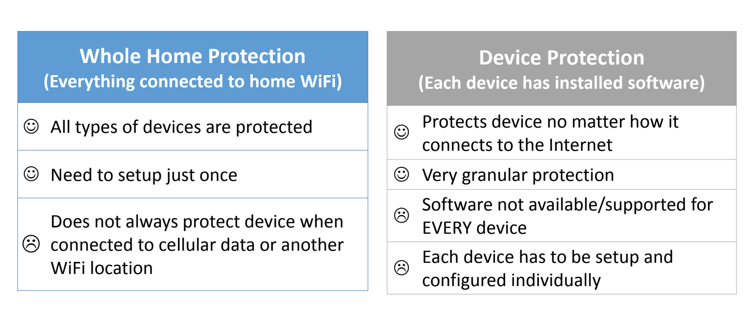
Decreasing the Negatives, e.g.,
This presentation by Ken Knapton, internet safety expert, can be found in this week's folder. [Note: Was created for a Latter-day Saint audience. Shared with permission. https://drive.google.com/file/d/1J0H8EV0zBF4TmgZt5Xi9ozCuAaYOYOGU/view?usp=sharing
Notes:
https://drive.google.com/file/d/1J0H8EV0zBF4TmgZt5Xi9ozCuAaYOYOGU/view?usp=sharing

Slide 14
Decreasing the Negatives, e.g., "Wait until 8th"
Notes:
https://www.waituntil8th.org/

Slide 15
…or longer?
Notes:
https://www.youtube.com/watch?v=M6U_-zjhckg
See more #UseTech4Good Youth Extravanganza stories here: https://www.youtube.com/watch?v=kDxcDZcanHQ

Slide 16
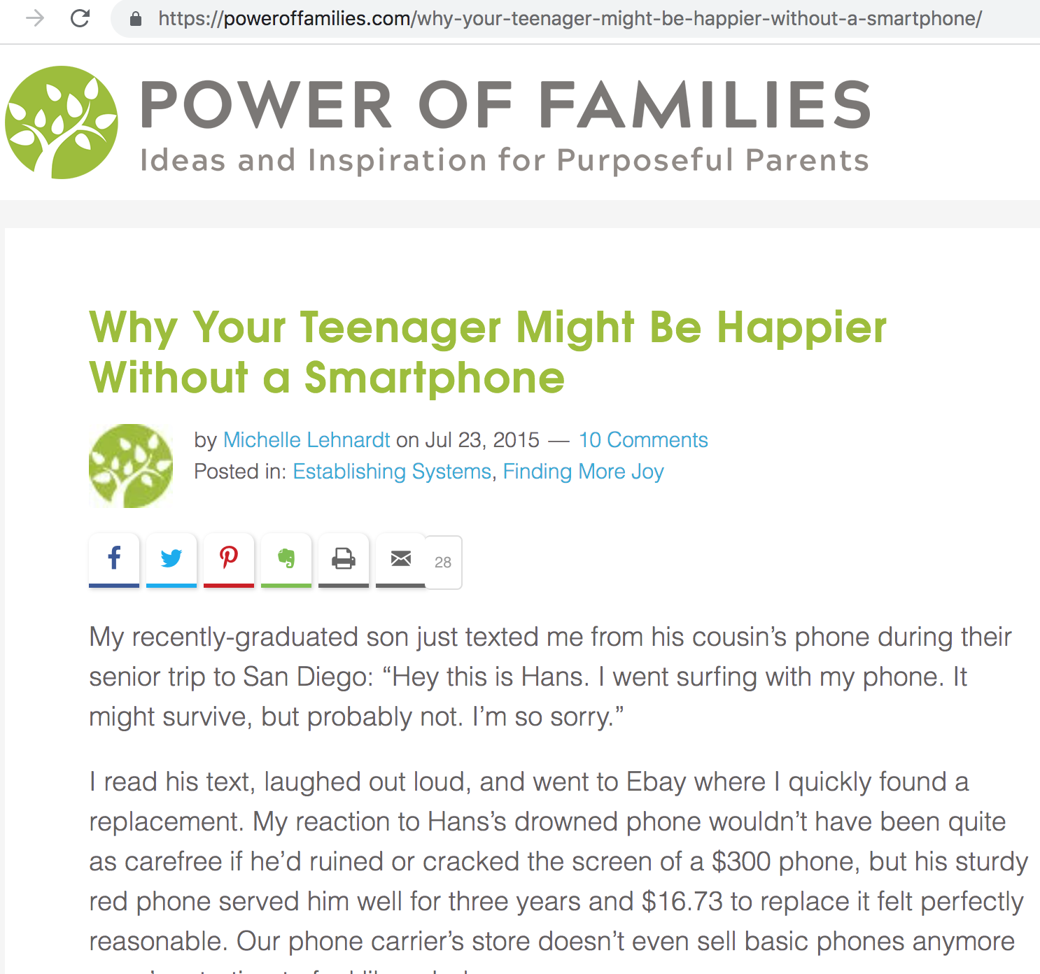
Notes:
https://poweroffamilies.com/why-your-teenager-might-be-happier-without-a-smartphone/

Slide 17
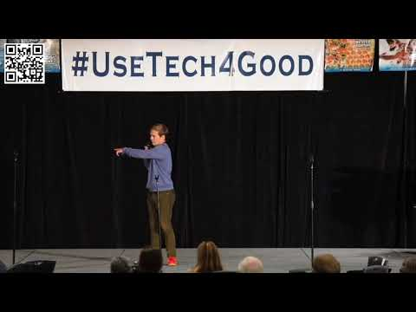
Notes:
See more #UseTech4Good Youth Extravanganza stories here: https://www.youtube.com/watch?v=kDxcDZcanHQ

Slide 18
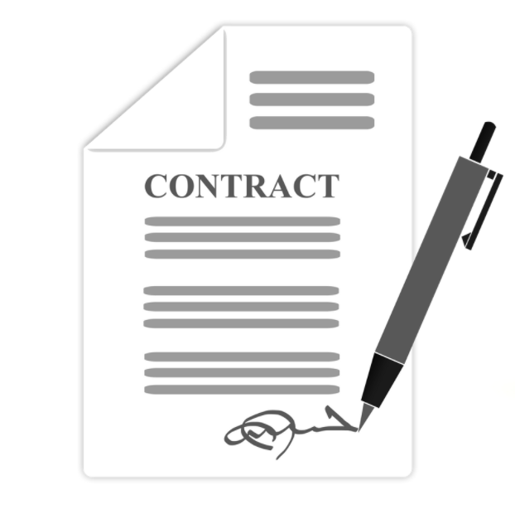
Remember, from Week 3:
Pacts alone usually don't work
Notes:
We've spent a lot of time during this series talking about putting on our own oxygen masks first, but ultimately, we hope our individual efforts toward Digital Wellness can mean we have more capacity to do some good in the world, to be influencers for good. There is perhaps no more important place for that to happen than with our direct interactions with children and youth in our own spheres of influence – in our homes, in classrooms, in community service settings.

Slide 19
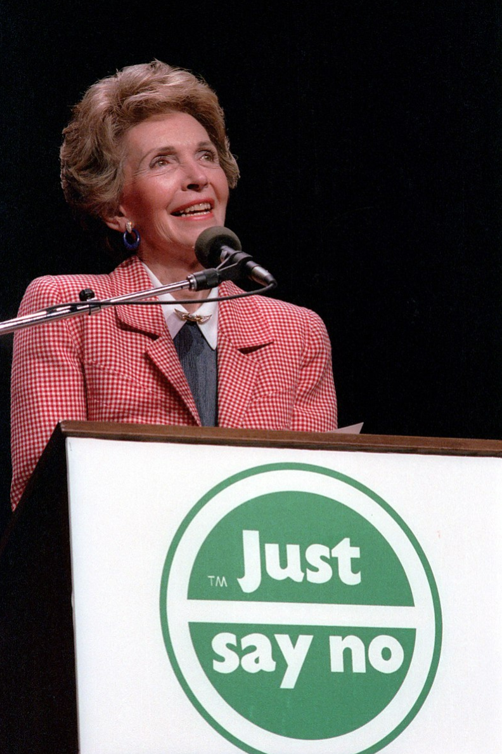
"Just Say No" didn't work either (and sometimes makes things worse e.g.,"Don't think of the elephant")
Notes:
We've spent a lot of time during this series talking about putting on our own oxygen masks first, but ultimately, we hope our individual efforts toward Digital Wellness can mean we have more capacity to do some good in the world, to be influencers for good. There is perhaps no more important place for that to happen than with our direct interactions with children and youth in our own spheres of influence – in our homes, in classrooms, in community service settings.

Slide 20
Prevention Science:
Increasing Positives, Decreasing Negatives
Notes:
We want to reduce the bad, and increase the good around our children. Still going with the chess theme here.

Slide 21
Increasing Protective Factors
Reducing Risk Factors
Notes:
These are the terms used in prevention science to increase positives (increase protective factors) and reduce negatives (risk factors)

Slide 22
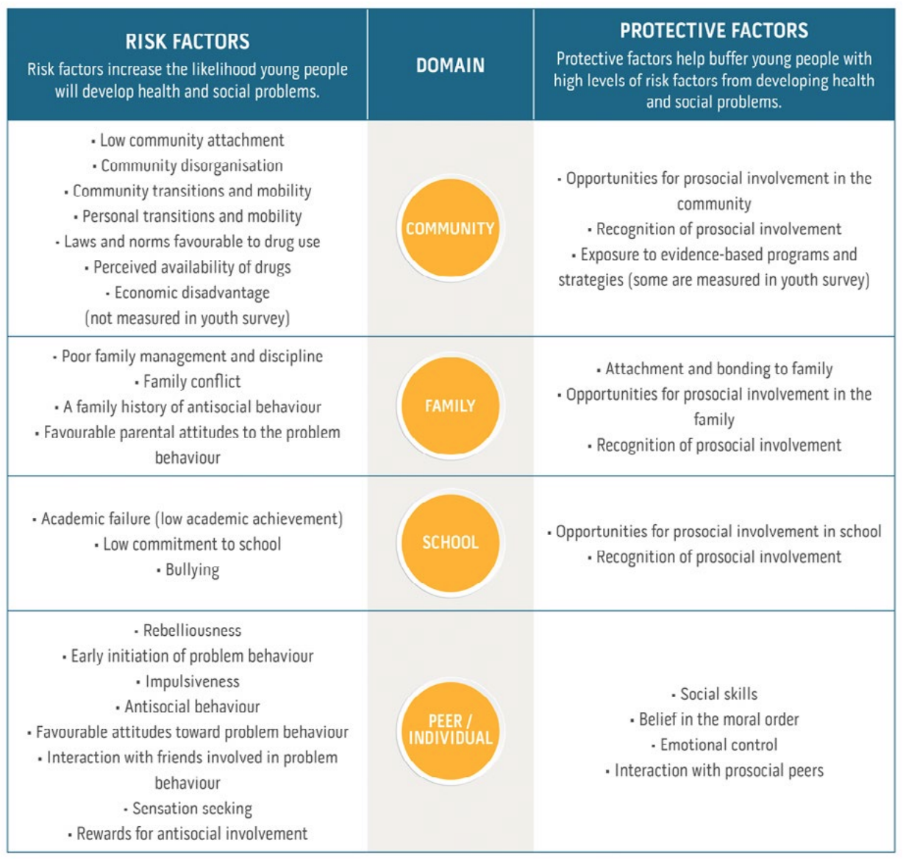
Notes:
https://www.communitiesthatcare.org.au/how-it-works/risk-and-protective-factors

Slide 23
Increasing Protective Factors
= Social Development Strategy
See the white paper, Unleashing the Power of Prevention:https://nam.edu/wp-content/uploads/2015/06/DPPowerofPrevention.pdf and
https://www.communitiesthatcare.net/
Notes:
Social Development Strategy folds in principles and patterns that experts in the Behavioral Health space have discovered can work across multiple behavioral issues, from substance abuse to suicide risk to school dropout issues to violence to unhealthy sexual behaviors, and more. See the white paper, Unleashing the Power of Prevention:https://nam.edu/wp-content/uploads/2015/06/DPPowerofPrevention.pdf and
https://www.communitiesthatcare.net/

Slide 24
Social Development Strategy = 5 elements
Notes:
We've spent a lot of time during this series talking about putting on our own oxygen masks first, but ultimately, we hope our individual efforts toward Digital Wellness can mean we have more capacity to do some good in the world, to be influencers for good. There is perhaps no more important place for that to happen than with our direct interactions with children and youth in our own spheres of influence – in our homes, in classrooms, in community service settings.

Slide 25
Notes:
See the white paper, Unleashing the Power of Prevention:https://nam.edu/wp-content/uploads/2015/06/DPPowerofPrevention.pdf and
https://www.communitiesthatcare.net/

Slide 26
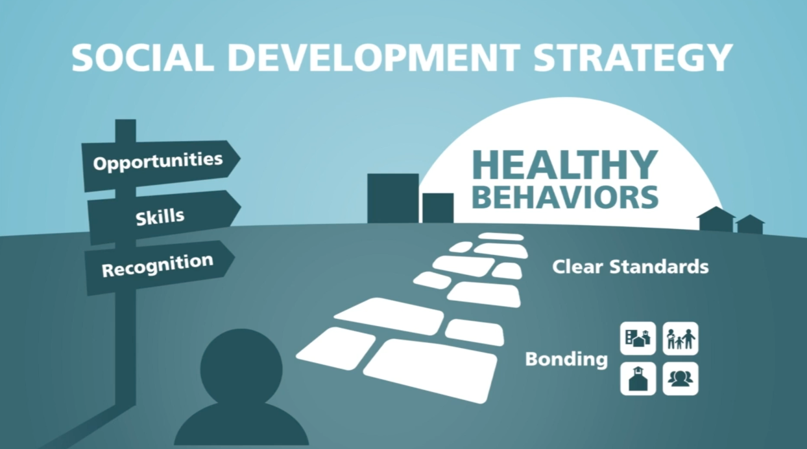
For evidence-based programs that are connected to Prevention Science and Youth Development Research, see Blueprints for Healthy Youth Development: https://www.blueprintsprograms.org/
Notes:
See the white paper, Unleashing the Power of Prevention:https://nam.edu/wp-content/uploads/2015/06/DPPowerofPrevention.pdf and
https://www.communitiesthatcare.net/

Slide 27
Notes:
See the white paper, Unleashing the Power of Prevention:https://nam.edu/wp-content/uploads/2015/06/DPPowerofPrevention.pdf and
https://www.communitiesthatcare.net/

Slide 28
Notes:
See the white paper, Unleashing the Power of Prevention:https://nam.edu/wp-content/uploads/2015/06/DPPowerofPrevention.pdf and
https://www.communitiesthatcare.net/

Slide 29
Notes:
See the white paper, Unleashing the Power of Prevention:https://nam.edu/wp-content/uploads/2015/06/DPPowerofPrevention.pdf and
https://www.communitiesthatcare.net/

Slide 30
OPPORTUNITIES for
Participation
Interaction
SKILLS
RECOGNITION
for effort, progress, successes
Notes:
See the white paper, Unleashing the Power of Prevention:https://nam.edu/wp-content/uploads/2015/06/DPPowerofPrevention.pdf and
https://www.communitiesthatcare.net/

Slide 31
Notes:
See the white paper, Unleashing the Power of Prevention:https://nam.edu/wp-content/uploads/2015/06/DPPowerofPrevention.pdf and
https://www.communitiesthatcare.net/

Slide 32
Notes:
See the white paper, Unleashing the Power of Prevention:https://nam.edu/wp-content/uploads/2015/06/DPPowerofPrevention.pdf and
https://www.communitiesthatcare.net/

Slide 33
Notes:
We've spent a lot of time during this series talking about putting on our own oxygen masks first, but ultimately, we hope our individual efforts toward Digital Wellness can mean we have more capacity to do some good in the world, to be influencers for good. There is perhaps no more important place for that to happen than with our direct interactions with children and youth in our own spheres of influence – in our homes, in classrooms, in community service settings.

Slide 34
Agenda
Check-in
Content/Concept Sharing
Connection/Discussion
Request/Invitation
Notes:
We had a great discussion about Social Development Strategy and ended with a Think, Write, Share activity (next slide)

Slide 35
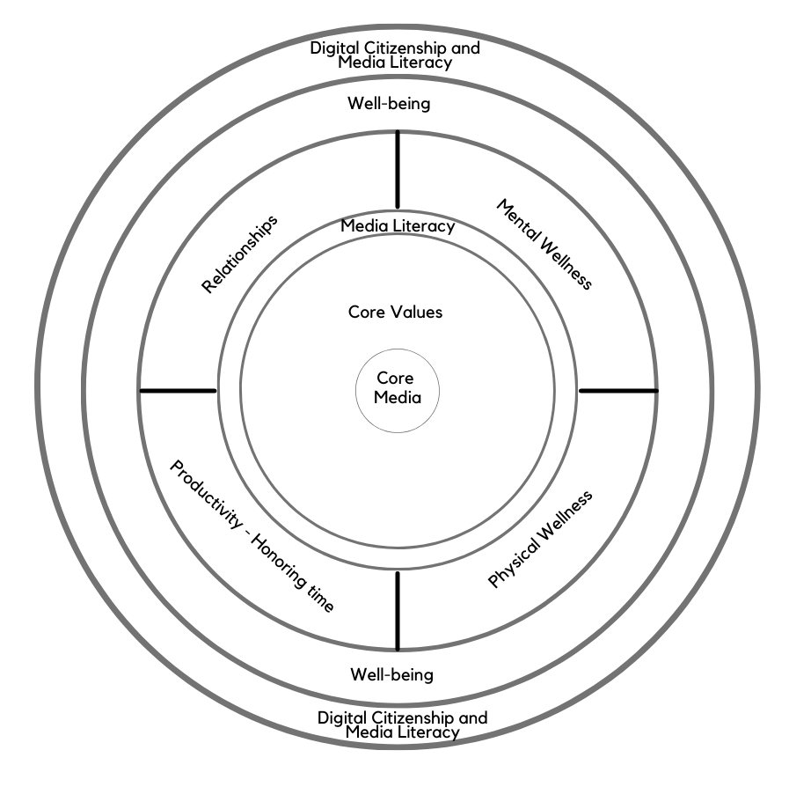
Think, Write, Share Activity
Notes:
This is the typical way that EPIK likes to begin its meetings – with a "Stories Connect People" activity. [See more question prompts in the Stories Connect People document we've included in this week's Google Folder. https://docs.google.com/document/d/1hSOj0ozMSzQ11HNUY9v0BstRopf9SD7JrYxnbIhvSrU/edit?usp=sharing)
We’ll take a few minutes to share stories with each other.
Here's a little history about the internal company research by Tribalry, a local company that taught us about this methodology. The founders, from a family of 10 children, learned through these simple exercises that even with the people closest to you, you often don’t know what’s inside of them, what their stories are. Taking time for each others’ stories is critical to building relationships and trust, whether that be in close relationships or in business relationships. And taking time for conversation can help relationships grow from weak ties to stronger bonds. Stories connect people! Or, as Jared Stewart, co-founder of Tribalry says, "The shortest distance between two people is a story."

Slide 36
Think, Write, Share Activity
Think & Write about the most valuable takeaways you will take with you from this series
OR
Think & Write about how you would describe this series to a friend
Notes:
This is the typical way that EPIK likes to begin its meetings – with a "Stories Connect People" activity. [See more question prompts in the Stories Connect People document we've included in this week's Google Folder. https://docs.google.com/document/d/1hSOj0ozMSzQ11HNUY9v0BstRopf9SD7JrYxnbIhvSrU/edit?usp=sharing)
We’ll take a few minutes to share stories with each other.
Here's a little history about the internal company research by Tribalry, a local company that taught us about this methodology. The founders, from a family of 10 children, learned through these simple exercises that even with the people closest to you, you often don’t know what’s inside of them, what their stories are. Taking time for each others’ stories is critical to building relationships and trust, whether that be in close relationships or in business relationships. And taking time for conversation can help relationships grow from weak ties to stronger bonds. Stories connect people! Or, as Jared Stewart, co-founder of Tribalry says, "The shortest distance between two people is a story."

Slide 37
We wish you well(ness)!

