Slide 1
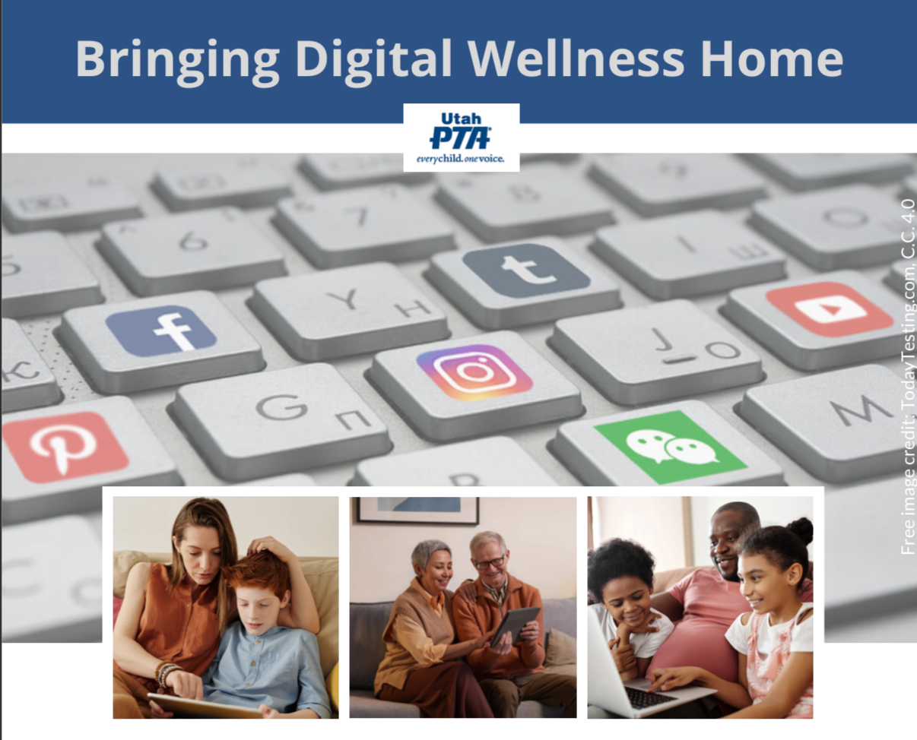
Note: All material in this series is for educational and informational purposes only, and is not meant to be exhaustive or used as a replacement for professional health support.
Notes:
Note: All material in this series is for educational and informational purposes only, and is not meant to be exhaustive or used as a replacement for professional health support. Also, the presentation is best viewed in slideshow format, as some of the slides are animated, but we have also included notes for many of the slides that you might want to review as well. Whatever works best for you!
NOTE: Portions of this work first appeared in or are derived or adapted from the Digital
Wellness Certificate Program. Those portions are Copyright © 2021, Digital Wellness Institute.

Slide 2
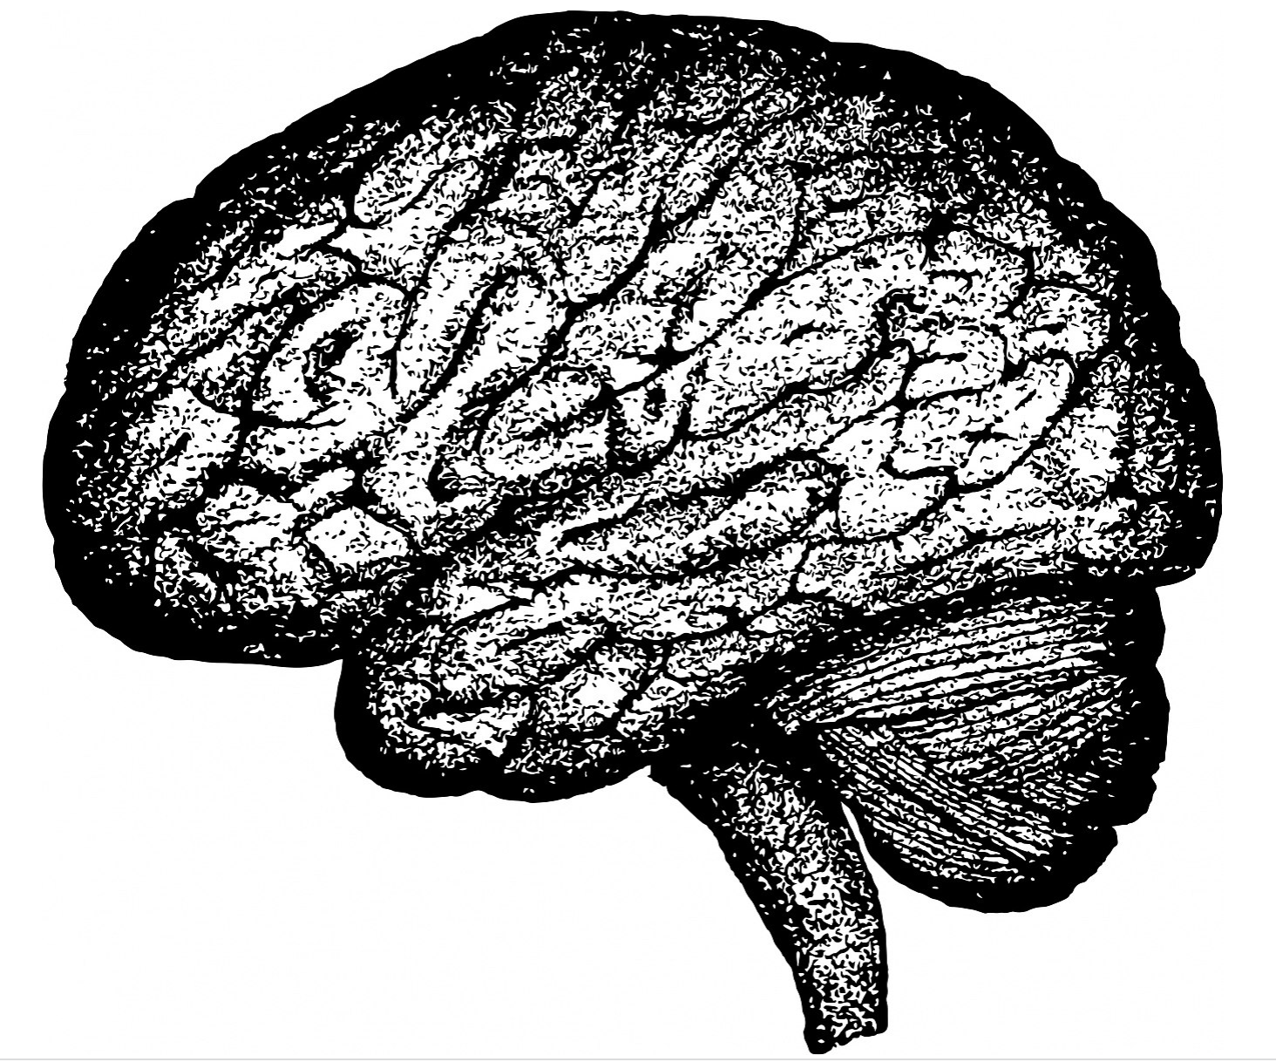
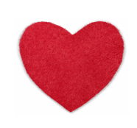
Magical Morning Activity
Notes:
We've added a bonus mini-module on two simple ways to start with your center in the morning. See the Google folder for details.

Slide 3
Magical Morning Activity
Imagine that you have 100% control over your
morning routine. What does your ideal look like?

Slide 4
Magical Morning Activity
Imagine that you have 100% control over your
morning routine. What does your ideal look like?
1 Minute: Think & Write

Slide 5
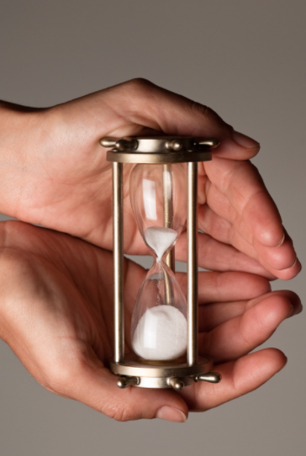
Discussion #5 Honoring Time
Bringing Digital Wellness Home

Slide 6
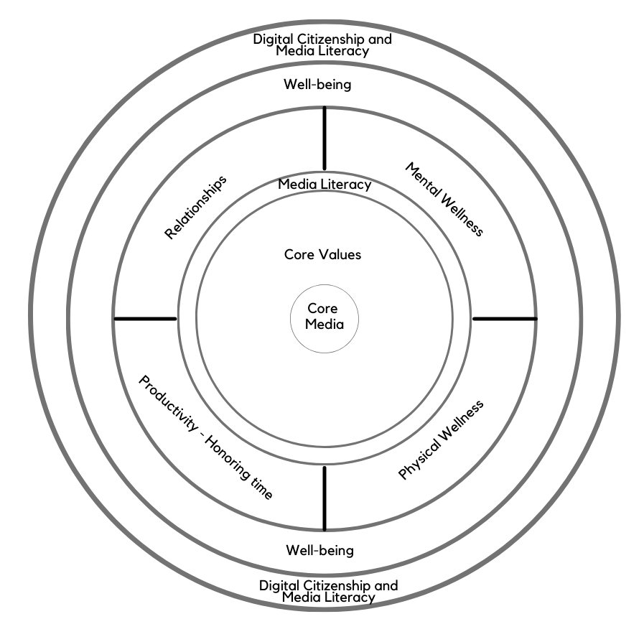
Today’s topic: Productivity, or
Honoring Time
"In the attention economy,
mindfulness is activism."
~Jay Vidyarthi
Note: EPIK’s Digital Centeredness model is adapted from the Digital Wellness Institute’s six-pronged model that aligns with DWI’s original survey
Notes:
As we discussed last week, you will see throughout the series that concepts in each module interrelate to other modules. Similarly, although this is a series on Digital Wellness, many concepts we explore relate to Wellness in general. As we progress through the series, consider discussing with someone the overlaps and patterns that you are seeing across modules, or insights that are coming that help you connect concepts at a deeper level.

Slide 7
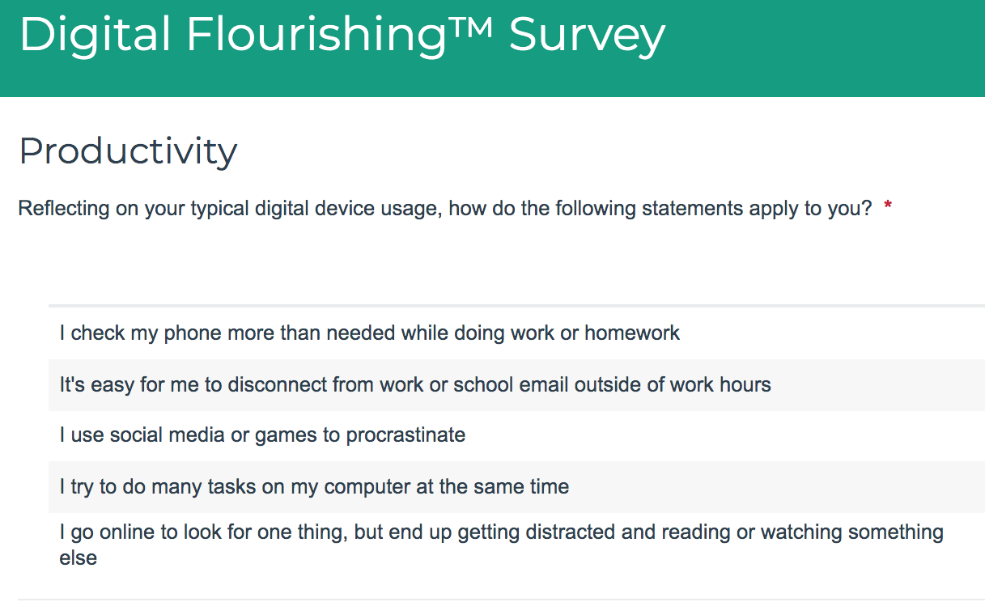
More Introspection
1
2
3
4
5
Notes:
If and as you use the DWI self-assessment, feel free to add questions that may come to mind for you around each topic.

Slide 8
Honoring Time:
Part 1:
Some simple tips and practices…
Notes:
We've created a separate mini-module where we usually start this discussion – with the morning. We wanted to spend more time explaining time boxing, so check this week's Google folder for the mini-module on mornings if that is of interest.

Slide 9
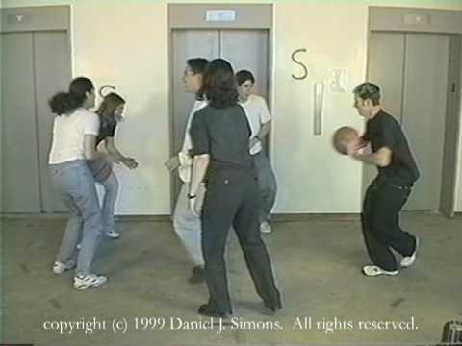
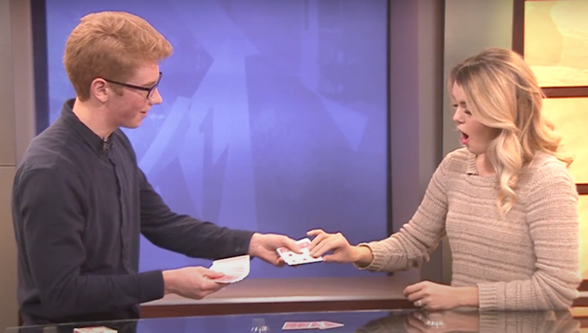
Remember: Our brains are easily distracted
Notes:
We covered some of this in the Mental Wellness module, but it can be helpful to remember concrete examples of how easily distractible we humans are.

Slide 10
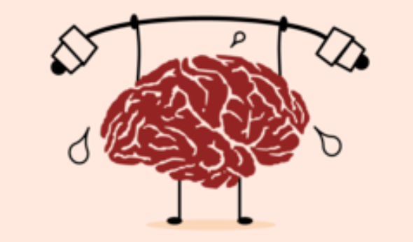
We need two volunteers…
Notes:
We only did 2 and 3 in our live gathering.
1) counting from 1 to 20
2) Reading the list of 20 words
3) Reading each word and saying the associated number (e.g., "cat 1, apple 2, ball 3,..." etc. or "1 cat, 2 apple, 3 ball,..." etc.)

Slide 11
Cat Apple Ball Tree Square
Head House Door Box Car
King Hammer Milk Fish Book
Tape Flower Arrow Key Shoe
Notes:
Three timed activities that illustrate the concept of cognitive load limits:
1) Counting from 1 to 20 (this task, buried deep in memory for most, usually takes less time than reading the list)
2) Reading the list of 20 words
3) Reading each word and saying the associated number (e.g., "cat 1, apple 2, ball 3,..." etc. or "1 cat, 2 apple, 3 ball,..." etc.)

Slide 12
Cognitive Load
Cat Apple Ball Tree Square
Head House Door Box Car
King Hammer Milk Fish Book
Tape Flower Arrow Key Shoe
Notes:
Three timed activities that illustrate the concept of cognitive load limits:
1) counting from 1 to 20
2) Reading the list of 20 words
3) Reading each word and saying the associated number (e.g., "cat 1, apple 2, ball 3,..." etc. or "1 cat, 2 apple, 3 ball,..." etc.)

Slide 13
Costs of task switching
~1 to 23 minutes to mentally reset
App switching at work can happen up to 260x/day
23 minutes to 5980 minutes
(there are 1440 minutes in a day)
We don't have work days -- we have work minutes that last all day.
~Gloria Mark (paraphrased by Gallup)
Notes:
See, for example, research discussed by Gloria Mark, who puts 23 minutes as an average, not the high end....
https://news.gallup.com/businessjournal/23146/too-many-interruptions-work.aspx, https://www.fastcompany.com/944128/worker-interrupted-cost-task-switching
https://www.ics.uci.edu/~gmark/chi08-mark.pdf
https://www.ics.uci.edu/~gmark/CHI2005.pdf
https://news.gallup.com/businessjournal/23146/too-many-interruptions-work.aspx
https://affect.media.mit.edu/pdfs/16.Mark-CHI_Email.pdf
http://blog.idonethis.com/distractions-at-work/
https://scholar.google.com/citations?user=aoZCW38AAAAJ&hl=en, https://www.apa.org/research/action/multitask

Slide 14
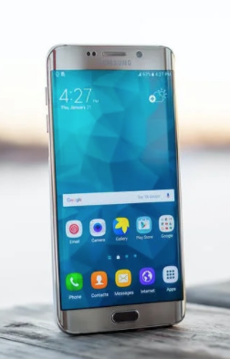
Costs of task switching
“I’m just going to check one thing”
=
adding 25 minutes to your day
from “The Cost of Interrupted Work:
More Speed and Stress”
https://www.ics.uci.edu/~gmark/chi08-mark.pdf
Notes:
See, for example, research discussed by Gloria Mark, who puts 23 minutes as an average, not the high end....
https://news.gallup.com/businessjournal/23146/too-many-interruptions-work.aspx, https://www.fastcompany.com/944128/worker-interrupted-cost-task-switching
https://www.ics.uci.edu/~gmark/chi08-mark.pdf
https://www.ics.uci.edu/~gmark/CHI2005.pdf
https://news.gallup.com/businessjournal/23146/too-many-interruptions-work.aspx
https://affect.media.mit.edu/pdfs/16.Mark-CHI_Email.pdf
http://blog.idonethis.com/distractions-at-work/
https://scholar.google.com/citations?user=aoZCW38AAAAJ&hl=en, https://www.apa.org/research/action/multitask

Slide 15
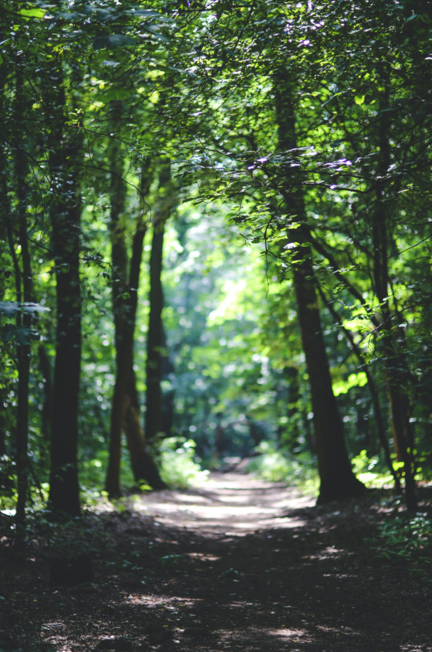
Tip: Practice Single-tasking (Try even for 5 minutes to start)
Can reduce stress
Can build brain’s ability to focus
Can boost creativity
Can increase productivity (get more done!)
“Single tasking feels like taking a walk in the forest”
Notes:
Single-tasking (or single-tabbing, or single-apping, if on technology) is a simple (but not necessarily easy) way to practice Digital Wellness (or just wellness in general). As someone in a brain plasticity course I am taking said, after our challenge to try single-tasking for a week, "Single-tasking feels like taking a walk in the forest." Although it feels counterintuitive, we can also increase our productivity (and accuracy of the work we do) if we don't try to multitask.

Slide 16
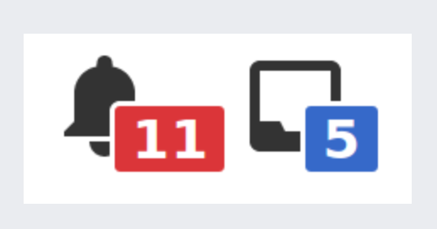
Tip: Say no to defaults! Reduce Notifications
NOTE: Bonus materials include many specifics about how to turn off notifications!
Notifications are ON as a default by tech companies: say no to defaults
2/3 of people don't turn off notifications (Nir)
Ask yourself:
“Are notifications serving me? Are they heading me toward what I want to be doing, being, becoming?"
“Get notifications from people, not products.”
No notifications during time boxing (more on time boxing later in this discussion)
Notes:
We have several slides in the Bonus section about ways to reduce notifications. And I thought I had finally figured out how to turn off the email dinger…but now I'm not so sure. I created a slide to share that tip, because changing notification settings in settings did not change anything.

Slide 17
We can check our cell phones around 100 times a day! https://www.bankmycell.com/blog/smartphone-addiction/
This music video captures the challenges of living in a "Check Your Phone" culture:
https://www.youtube.com/watch?v=sVaw2ggTydc
Notes:
It's pretty sobering how conditioned we become to checking our phones.

Slide 18
The "Mere Presence" Phenomenon
“[T]he "mere presence" of a cell phone may be
sufficiently distracting to produce diminished attention
and deficits in task-performance,
especially for tasks with greater attentional and cognitive demands.”
Notes:
https://repositories.lib.utexas.edu/bitstream/handle/2152/64130/braindrain.pdf?sequence=2: “Working memory capacity” (WMC) reflects the availability of attentional resources, which serve the “central executive” function of controlling and regulating cognitive processes across domains (Baddeley and Hitch 1974; Miyake and Shah 1999; Engle 2002; Baddeley 2003). “Fluid intelligence” (Gf ) represents the ability to reason and solve novel problems, independent of any contributions from acquired skills and knowledge stored in “crystallized intelligence” (Cattell 1987). Similar to WM, Gf stresses the ability to select, store, and manipulate information in a goal-directed manner. Also similar to WM, Gf is constrained by the availability of attentional resources (e.g., Engle et al. 1999; Halford et al. 2007). Crucially, the limited capacity of these domaingeneral resources dictates that using attentional resources for one cognitive process or task leaves fewer available for other tasks; in other words, occupying cognitive resources reduces available cognitive capacity.

Slide 19
Tip: Practice Social Distancing from your phone!
https://repositories.lib.utexas.edu/bitstream/handle/2152/64130/braindrain.pdf?sequence=2
Notes:
https://repositories.lib.utexas.edu/bitstream/handle/2152/64130/braindrain.pdf?sequence=2: “Working memory capacity” (WMC) reflects the availability of attentional resources, which serve the “central executive” function of controlling and regulating cognitive processes across domains (Baddeley and Hitch 1974; Miyake and Shah 1999; Engle 2002; Baddeley 2003). “Fluid intelligence” (Gf ) represents the ability to reason and solve novel problems, independent of any contributions from acquired skills and knowledge stored in “crystallized intelligence” (Cattell 1987). Similar to WM, Gf stresses the ability to select, store, and manipulate information in a goal-directed manner. Also similar to WM, Gf is constrained by the availability of attentional resources (e.g., Engle et al. 1999; Halford et al. 2007). Crucially, the limited capacity of these domaingeneral resources dictates that using attentional resources for one cognitive process or task leaves fewer available for other tasks; in other words, occupying cognitive resources reduces available cognitive capacity.

Slide 20
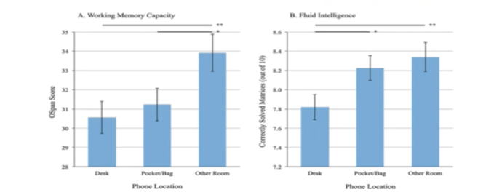
More info about Mere Presence
Working Memory: resources for “controlling and regulating cognitive processes across domains”
Fluid Intelligence: ”ability to reason and solve novel problems” and manage cognitive processes for goal-oriented tasks
https://repositories.lib.utexas.edu/bitstream/handle/2152/64130/braindrain.pdf?sequence=2
Notes:
https://repositories.lib.utexas.edu/bitstream/handle/2152/64130/braindrain.pdf?sequence=2: “Working memory capacity” (WMC) reflects the availability of attentional resources, which serve the “central executive” function of controlling and regulating cognitive processes across domains (Baddeley and Hitch 1974; Miyake and Shah 1999; Engle 2002; Baddeley 2003). “Fluid intelligence” (Gf ) represents the ability to reason and solve novel problems, independent of any contributions from acquired skills and knowledge stored in “crystallized intelligence” (Cattell 1987). Similar to WM, Gf stresses the ability to select, store, and manipulate information in a goal-directed manner. Also similar to WM, Gf is constrained by the availability of attentional resources (e.g., Engle et al. 1999; Halford et al. 2007). Crucially, the limited capacity of these domaingeneral resources dictates that using attentional resources for one cognitive process or task leaves fewer available for other tasks; in other words, occupying cognitive resources reduces available cognitive capacity.

Slide 21
Reduce “brain drain” = “Mere Presence” Phenomenon
Practice social distancing from your phone!
“’Working memory capacity’ (WMC) reflects the availability of attentional resources, which serve the ‘central executive’ function of controlling and regulating cognitive processes across domains (Baddeley and Hitch 1974; Miyake and Shah 1999; Engle 2002; Baddeley 2003). ‘Fluid intelligence’ (Gf ) represents the ability to reason and solve novel problems… (Cattell 1987). Similar to WM, Gf stresses the ability to select, store, and manipulate information in a goal-directed manner. Also similar to WM, Gf is constrained by the availability of attentional resources (e.g., Engle et al. 1999; Halford et al. 2007). Crucially, the limited capacity of these … resources dictates that using attentional resources for one cognitive process or task leaves fewer available for other tasks; in other words, occupying cognitive resources reduces available cognitive capacity.”
https://repositories.lib.utexas.edu/bitstream/handle/2152/64130/braindrain.pdf?sequence=2
Notes:
https://repositories.lib.utexas.edu/bitstream/handle/2152/64130/braindrain.pdf?sequence=2: “Working memory capacity” (WMC) reflects the availability of attentional resources, which serve the “central executive” function of controlling and regulating cognitive processes across domains (Baddeley and Hitch 1974; Miyake and Shah 1999; Engle 2002; Baddeley 2003). “Fluid intelligence” (Gf ) represents the ability to reason and solve novel problems, independent of any contributions from acquired skills and knowledge stored in “crystallized intelligence” (Cattell 1987). Similar to WM, Gf stresses the ability to select, store, and manipulate information in a goal-directed manner. Also similar to WM, Gf is constrained by the availability of attentional resources (e.g., Engle et al. 1999; Halford et al. 2007). Crucially, the limited capacity of these domaingeneral resources dictates that using attentional resources for one cognitive process or task leaves fewer available for other tasks; in other words, occupying cognitive resources reduces available cognitive capacity.

Slide 22
Adobe study: > 5 hours a day (work & personal)
Notes:
You can find more resources on email in the Bonus section and in the resources document, but here are a couple more links:
https://blog.adobe.com/en/publish/2019/09/08/if-you-think-email-is-dead--think-again.html
See also https://www.slideshare.net/adobe/2019-adobe-email-usage-study

Slide 23
Each email sent can produce four more!
“Emails don't die - they spawn like zombies from the walking dead!” Amy Blankston
Notes:
You can find more resources on email in the Bonus section and in the resources document, but here are a couple more links:
https://blog.adobe.com/en/publish/2019/09/08/if-you-think-email-is-dead--think-again.html
See also https://www.slideshare.net/adobe/2019-adobe-email-usage-study

Slide 24
Tip: Schedule time for email (Some recommend only 2x day,
touching email 1x)
See more research and tips in the following bonus slides
Notes:
You can find more resources on email in the Bonus section and in the resources document, but here are a couple more links:
https://blog.adobe.com/en/publish/2019/09/08/if-you-think-email-is-dead--think-again.html
See also https://www.slideshare.net/adobe/2019-adobe-email-usage-study

Slide 25
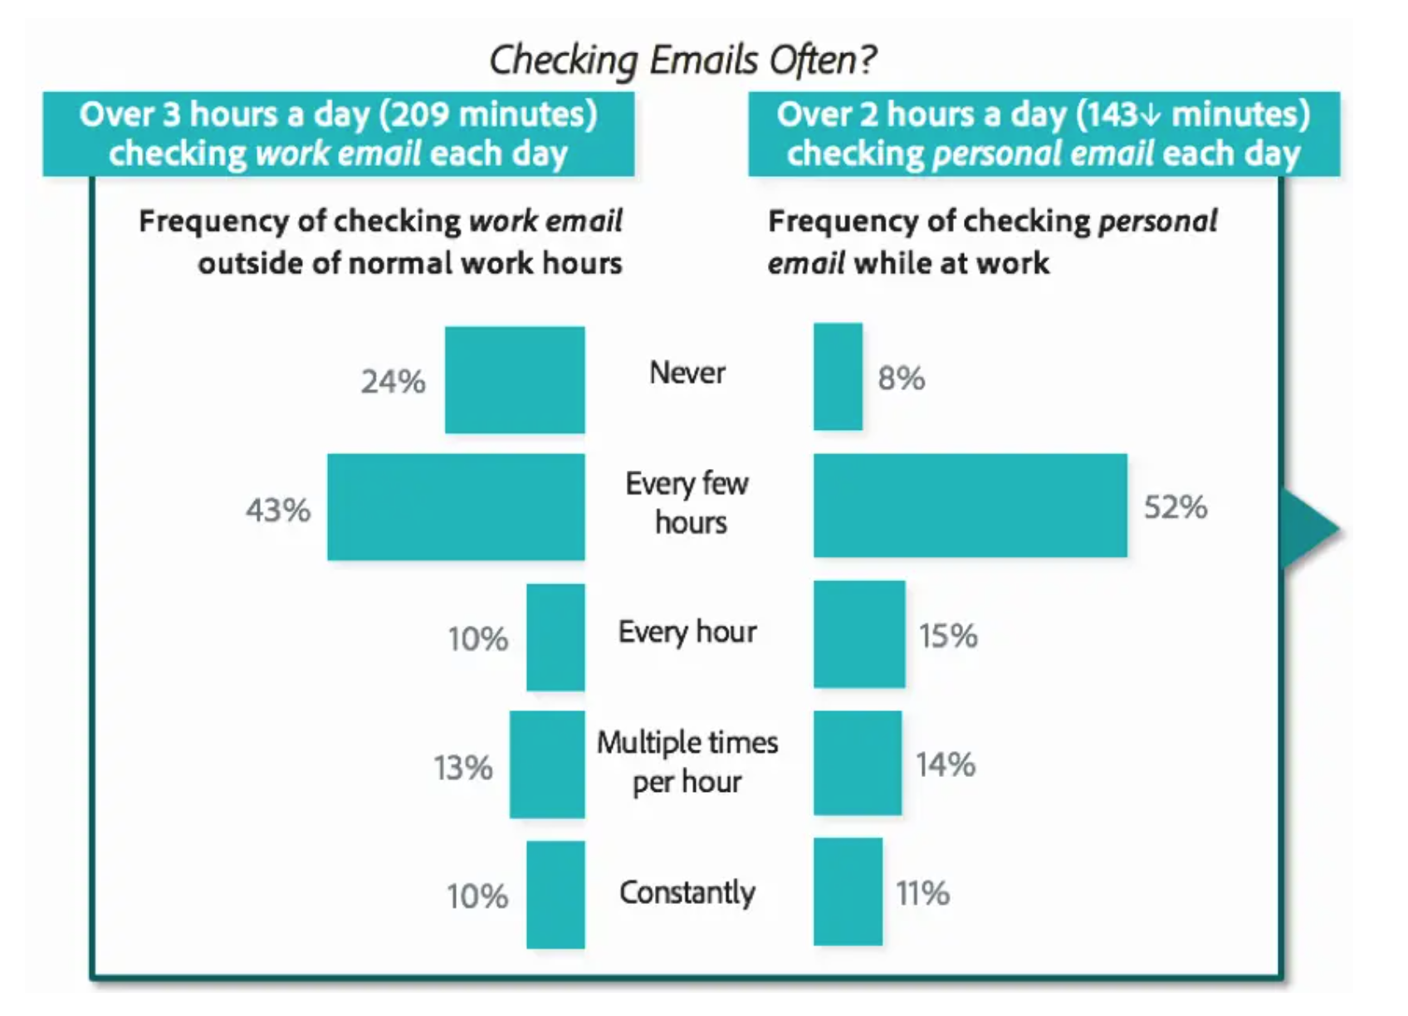
Adobe study: > 5 hours a day (work & personal)
https://blog.adobe.com/en/publish/2019/09/08/if-you-think-email-is-dead--think-again.html
See also https://www.slideshare.net/adobe/2019-adobe-email-usage-study
Notes:
You can find more resources on email in the Bonus section and in the resources document, but here are a couple more links:
https://blog.adobe.com/en/publish/2019/09/08/if-you-think-email-is-dead--think-again.html
See also https://www.slideshare.net/adobe/2019-adobe-email-usage-study

Slide 26
Some research about email
Adobe study: First tech touch of the day
 | Checking in bed | Checking during breakfast/getting ready | Checking during commute
Work email | 13% | 25% | 15%
Personal email | 15% | 42% | 16%
Social media | 26% | 25% | 11%
https://blog.adobe.com/en/publish/2019/09/08/if-you-think-email-is-dead--think-again.html
See also https://www.slideshare.net/adobe/2019-adobe-email-usage-study

Slide 27
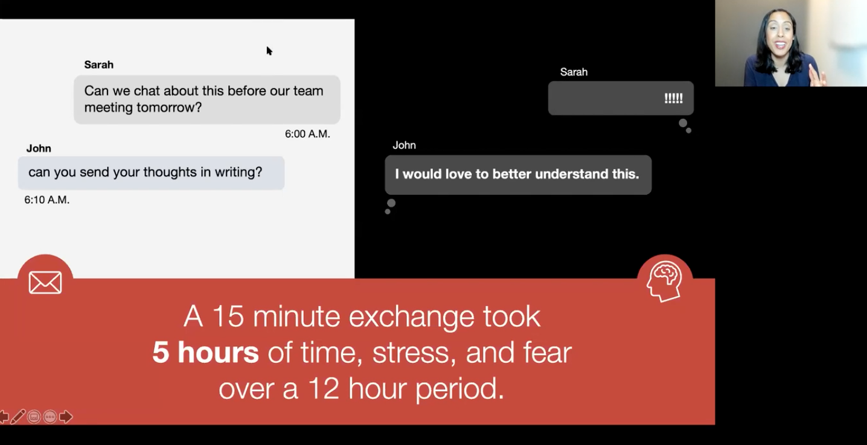
Some research about email
Emails can unwittingly surrender your time to someone else’s values or priorities (this can be true of any electronic media, including social media feeds and news feeds)
Each email sent can produce four more:
“Emails don't die - they spawn like zombies from the walking dead!” Amy Blankston
Email can consume hours of one’s day (some research estimates 2.5 hours lost on average). Adobe's research showed even higher numbers.
Even one email can cost a lot in internal distraction (Erica Dawahn: see image below)
https://summit.digitalwellnessday.com/talks/how-to-read-digital-body-language/

Slide 28
Some thoughts about email
"Email is a constant distraction that prevents us from engaging in proper, meaningful thinking. Lightening your email load allows you to get [traction] into important work, rather than just managing minutiae." https://www.forbes.com/sites/annabelacton/2017/07/13/innovators-challenge-how-to-stop-wasting-time-on-emails/?sh=536d6bec9788
see also https://blog.adobe.com/en/publish/2019/09/08/if-you-think-email-is-dead--think-again.html
See also https://www.slideshare.net/adobe/2019-adobe-email-usage-study

Slide 29
If you have to start the day with email, here's a 2-minute tip
Michelle Gielan: Start your day by priming the positive. Instead of checking email or news first thing, if you have to check email early, take 2 minutes to send a positive [message] to someone you care about. “It will change how you process your day and how you process your email at 2 o’clock in the afternoon,” she says. https://www.cnbc.com/2016/12/30/checking-email-as-soon-as-you-wake-up-could-be-ruining-your-day.html
see also https://blog.adobe.com/en/publish/2019/09/08/if-you-think-email-is-dead--think-again.html
See also https://www.slideshare.net/adobe/2019-adobe-email-usage-study

Slide 30
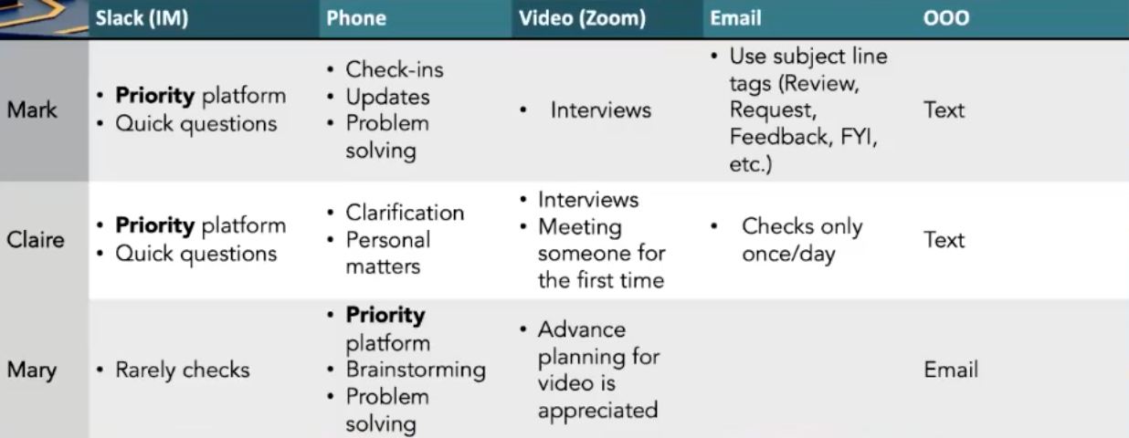
Some ideas for managing communications
Disrupt your habits to respect morning, mealtime, evening, and bedtime routines
Some people like to go for zero emails (+/-) [
Some people do batch email engagement (+/-)
Others set specific times in the day to check email
Nir Eyal and others – don’t start the day with email
James Clear (author of Atomic Habits): “Don’t open email until noon” https://jamesclear.com/productivity [that page is a gold mine of information]
Communications charters can help
E.g., What tools work best for each person?
What can family/ team agree on to ID urgent tasks and create time and space around others and/or protect important times of the day and create a culture where “always on” is not rewarded/encouraged?
Graphic credit: Chris Flack
Notes:
(https://www.mindtools.com/pages/article/developing-communications-charter.htm)
https://www.forbes.com/sites/darrenmenabney/2021/03/14/to-have-better-remote-meetings-create-a-team-communication-charter/?sh=51e802a68182

Slide 31
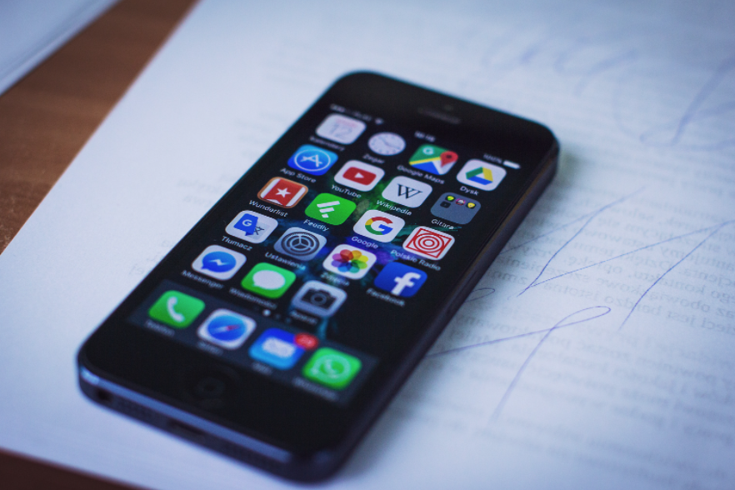
Tip: Increase friction with your digital devices
”Make that next source of information [or app]
a little bit more difficult to reach….”
Dr. Adam Gazzaley M.D. Ph.D. - https://wellbeing.google/get-started/focus-your-time-with-tech/
more information on this concept can be found in the bonus section
Notes:
Tech companies design tools to be frictionLESS – so that we can move seamlessly between tools…for as long as possible. This frictionless design can have its upsides, but the cost is that we often end up using our devices more than we intended. Little things like adding more steps between you and your weak-spot tools can help keep you more mindful.

Slide 32
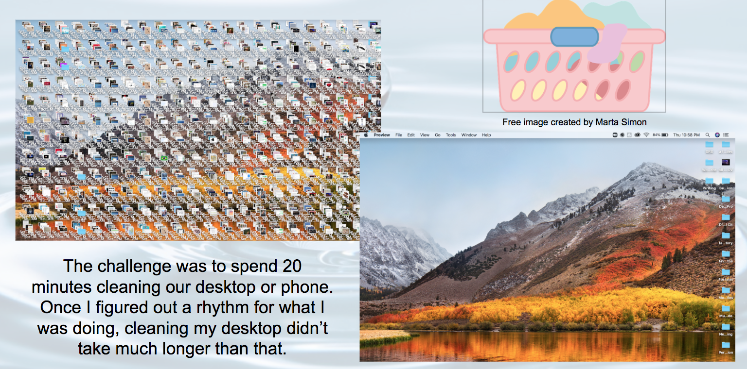
Tip: Do some digital laundry

Slide 33
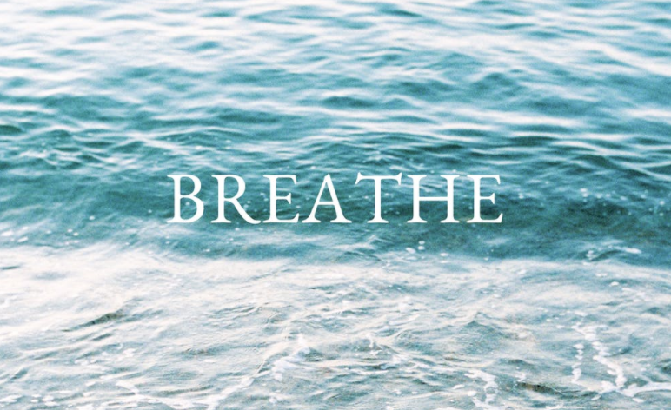
~~~ Blink and Breathe Break ~~~
Notes:
There is a lot of information about this practice online, but here are a few links as examples (see also resource links in the Physical Wellness resource document in our shared folder: https://docs.google.com/document/d/1M6jJ3MJfQ4DT85jJDdUvqsUV2GqsyNRl_90yONAoobU/edit?usp=sharing
https://www.optometrytimes.com/view/deconstructing-20-20-20-rule-digital-eye-strain
https://www.healthline.com/health/eye-health/20-20-20-rule
https://www.theeyesight.com/2016/10/24/the-20-20-20-rule-how-to-lessen-the-effects-of-digital-eye-strain/

Slide 34
Honoring Time:
Part 2: Addressing Distraction
from the Inside Out

Slide 35
“If I know how you spend your time…then I know what might become of you.”
Johann Wolfgang von Goethe

Slide 36
"Real strategy – in companies and in our lives – is created through hundreds of everyday decisions about where we spend our resources. As you're living your life from day to day, how do you make sure you're heading in the right direction? Watch where your resources flow. If they're not supporting the strategy you've decided upon, then you're not implementing that strategy at all."
"In other words, how you allocate your resources is where the rubber meets the road."
Clayton Christensen, How Will You Measure Your Life? p. 62
Notes:
Another book that has some great ideas along the lines of our topic today is Essentialism: The Disciplined Pursuit of Less by Greg McKeown – mentioned by one of our participants. Thanks, Tina!

Slide 37
Adding a few quotes from the book Essentialism, which was mentioned in the chat by one of our participants
“Remember that if you don’t prioritize your life someone else will.”
“Essentialism is not about how to get more things done; it’s about how to get the right things done. It doesn’t mean just doing less for the sake of less either. It is about making the wisest possible investment of your time and energy in order to operate at our highest point of contribution by doing only what is essential.”
― Greg Mckeown, Essentialism: The Disciplined Pursuit of Less

Slide 38
“Today, technology has lowered the barrier for others to share their opinion about what we should be focusing on. It is not just information overload; it is opinion overload.”
“The way of the Essentialist means living by design, not by default. Instead of making choices reactively, the Essentialist deliberately distinguishes the vital few from the trivial many, eliminates the nonessentials, and then removes obstacles so the essential things have clear, smooth passage.”
“Essentialism: only once you give yourself permission to stop trying to do it all, to stop saying yes to everyone, can you make your highest contribution towards the things that really matter.”
― Greg Mckeown, Essentialism: The Disciplined Pursuit of Less

Slide 39
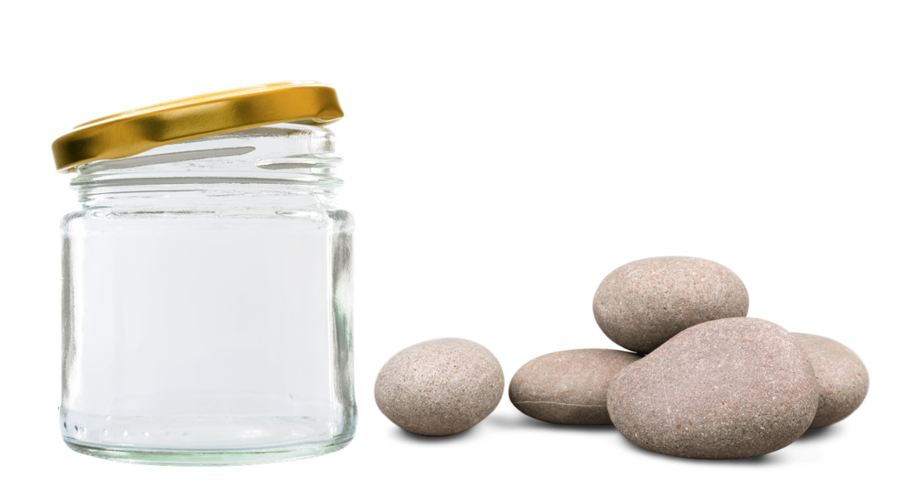
Put the big rocks in first:
Plan your life and your days so that who you want to be and how you want to show up in the world is visible in how you schedule and use your time.
Notes:
We had a reflection and writing activity around this idea. This concept is also good for financial management. In fact, these images come from a financial management course, Personal Finances for Self-Reliance. https://bit.ly/3rUnytC

Slide 40
Think & Write: What are your "big rocks"?
Notes:
We had a reflection and writing activity around this idea. This concept is also good for financial management. In fact, these images come from a financial management course, Personal Finances for Self-Reliance. https://bit.ly/3rUnytC

Slide 41
“[The goal is to]...get in front of distractions, to get in front of all the potential that we might be missing today.”
- Brian Solis (from module 1)
Notes:
We discussed a Brian Solis quote in module 1, where he talks about how Digital Wellness is really about how we manage our day-to-day life. And I can't get this part of the quote out of my head. Here's the WHAT – getting ahead of distraction to help reach our potential. But HOW? That's what we discussed today.

Slide 42
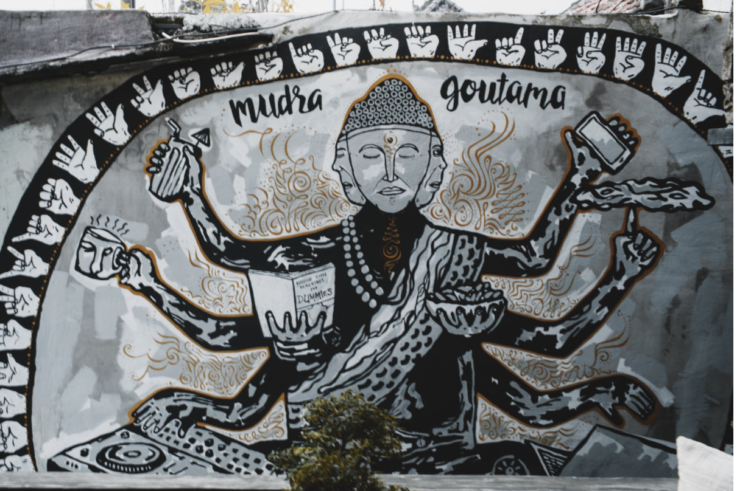
"The best way to understand what distraction is
is to know what it is not."
Nir Eyal
Notes:
This is a quote from Nir Eyal. I would highly recommend reading some of his materials, e.g., https://www.nirandfar.com/opposite-of-distraction, https://www.nirandfar.com/todo-vs-schedule-builder/ https://www.nirandfar.com/your-calendar/,

Slide 43
Said another way:
We can consider the difference between
being in motion
and movement.
Notes:
This thought was from one of the participants in the Winter 2022 PTA Digital Wellness series

Slide 44
…or the difference between being busy
and practicing centered, deliberate action.

Slide 45
So what is the opposite of distraction?
Notes:
Most people say something like "focus" – and that is how most people – even experts – talk about it. But let's look at it a little more closely.
This concept comes from Nir Eyal, author of Indistractable. https://www.nirandfar.com/opposite-of-distraction/ We can be focused on things that aren't in alignment with our values and goals. Traction is when where and how we spend our time matches with our core values and key priorities.

Slide 46
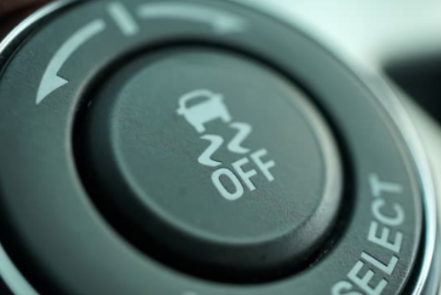
What is the opposite of dis-traction?
If you are interested in etymology, both words come from the Latin trahere.
Notes:
When we break up the word, it's more clear what the opposite of distraction is!

Slide 47
"A distraction is something we do that moves us away from what we really want."
"Traction is an action that moves us towards what we really want."
Notes:
Emphasis is added in these quotes. This concept comes from Nir Eyal, author of Indistractable. https://www.nirandfar.com/opposite-of-distraction/ We can be focused on things that aren't in alignment with our values and goals. Traction is when where and how we spend our time matches with our core values and key priorities. He has many other blog posts that explore more around building traction.

Slide 48
"You can't call something a distraction unless you know what it's distracting you from."
"Any action can be either a distraction or traction depending on what you intend to do with your time."
Notes:
This concept comes from Nir Eyal, author of Indistractable. https://www.nirandfar.com/opposite-of-distraction/ Emphasis added.
We can be focused on things that aren't in alignment with our values and goals. Traction is when where and how we spend our time matches with our core values and key priorities. He has many other blog posts that explore more around building traction.

Slide 49
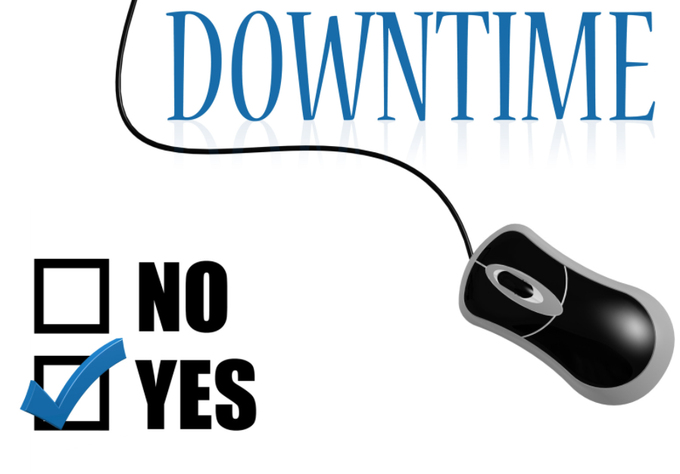
"It’s fine to watch a video, scroll social media, daydream, or take a nap, as long as that’s what you planned to do…. Taking a break can be good for you. It’s when you do things unintentionally that you get into trouble."
-Nir Eyal (emphasis added)
**We would argue that there is some content on these tools that can be inherently harmful, and there are some video games that also could be categorized as inherently harmful, but that's a different conversation. And a values-centered approach to tech use can also cover those realities.
Notes:
This concept comes from Nir Eyal, author of Indistractable. Quote is a combo quote taken from two sources: https://www.nirandfar.com/opposite-of-distraction/ and https://podcasts.apple.com/ie/podcast/how-to-get-the-most-out-of-your-calendar-nir-far/id1210590811?i=1000488382607
We can be focused on things that aren't in alignment with our values and goals, but we can also choose to build in time for using social media or other tools. They aren't inherently bad in and of themselves. Wellness is about deliberateness, integrity, and alignment.

Slide 50
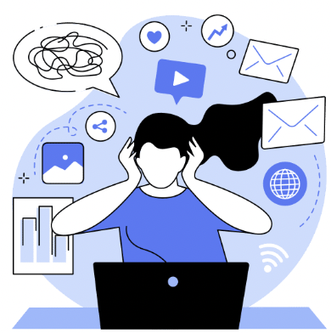
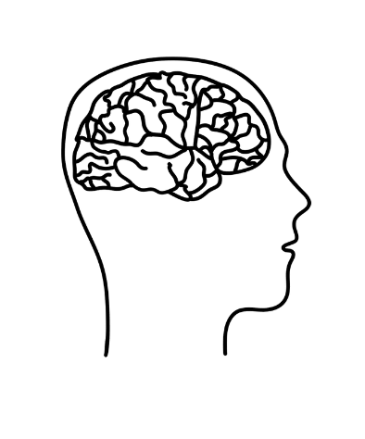
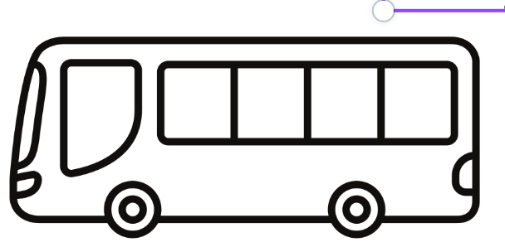
"The difference between traction and distraction is forethought."
REACTOR
ACTOR
Notes:
In essence, here we are again at some of the basic ideas we have been talking about – the difference between living in reaction, or driving our own bus as an actor, taking intentional action. Using our brains to think about what we really want to be doing with our time, energy, lives.

Slide 51
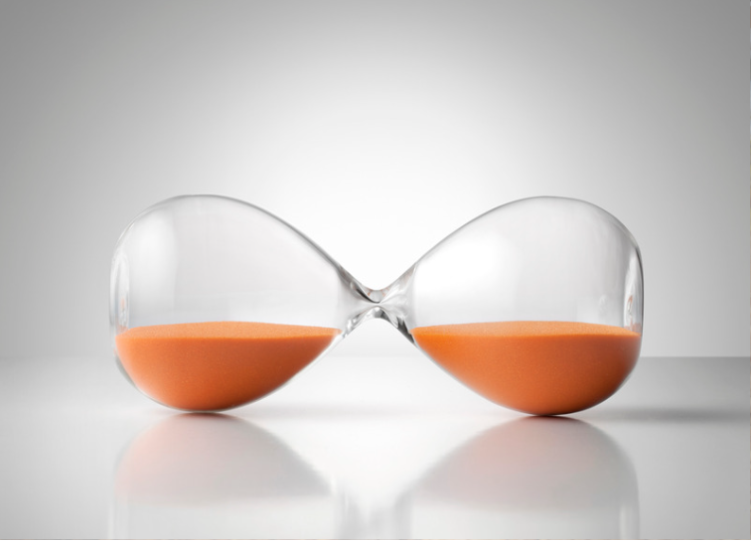
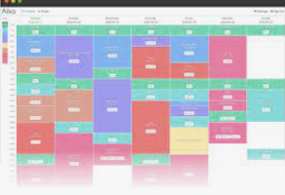
This slide is best viewed in slideshow mode - it is an animated slide.
Notes:
As we have been discussing for the past few weeks now, we can practice the pause, ask questions, and point and name – and in context of today's topic, time boxing is a tool that allows us to practice these things.

Slide 52
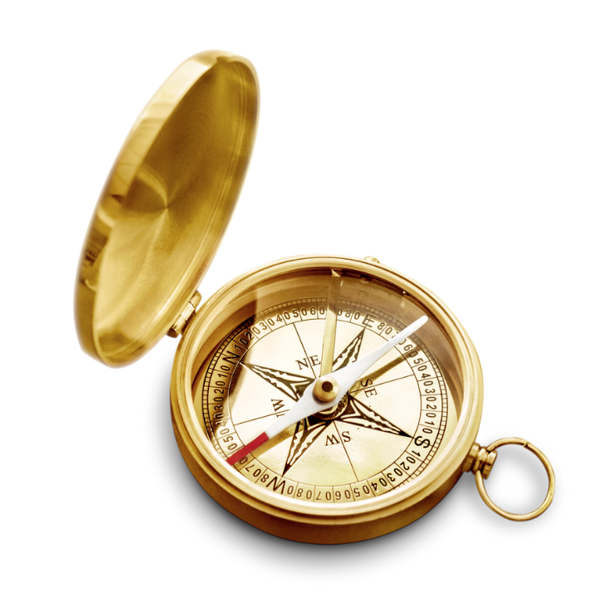
"Turning values into time."
Notes:
Nir talks about how time boxing can help turn values into time. We hope by the end of this module, you'll have more clarity about how this is true.
This concept of connecting time boxing with values comes from Nir Eyal. He sees time boxing as a technique that can help us turn values into time. See, .e.g., https://www.nirandfar.com/plan-your-time-or-someone-else-will/, https://www.nirandfar.com/your-calendar/, https://www.youtube.com/watch?v=KaVG0uTfEqk, https://forge.medium.com/you-dont-know-your-values-here-s-why-that-s-hurting-you-52b02a43e869

Slide 53
"Turning values into time."
“We never achieve our values any more than finishing a painting would let us achieve being creative. A value is like a guiding star; it’s the fixed point we use to help us navigate our life choices.”
― Nir Eyal, Indistractable: How to Control Your Attention and Choose Your Life
Notes:
This concept comes from Nir Eyal. He sees time boxing as a technique that can help us turn values into time. See, .e.g., https://www.nirandfar.com/plan-your-time-or-someone-else-will/, https://www.nirandfar.com/your-calendar/, https://www.youtube.com/watch?v=KaVG0uTfEqk, https://forge.medium.com/you-dont-know-your-values-here-s-why-that-s-hurting-you-52b02a43e869

Slide 54
NOTE: The original scenario read in our gathering was written by Nir Eyal. You can find it here:
https://www.nirandfar.com/schedule-maker/
or https://www.linkedin.com/pulse/how-more-productive-focus-free-schedule-maker-nir-eyal
Notes:
https://www.linkedin.com/pulse/how-more-productive-focus-free-schedule-maker-nir-eyal
See also https://www.nirandfar.com/schedule-maker/

Slide 55
"Of course, other people love the fact that you pivot to their priorities and away from your own. Your employer loves knowing you’ll respond to every email, even if it means working long nights and weekends. Also, your family loves knowing you will do things for them they could have done themselves. And finally, your daughter could look for her own shirt and your little one could deal with the fact that it’s eggs today. As for the technology companies, oh boy are they happy! Facebook and Twitter love the fact you’ll drop everything every time a notification pops up."
Nir Eyal
Notes:
https://www.nirandfar.com/schedule-maker/ or
https://www.linkedin.com/pulse/how-more-productive-focus-free-schedule-maker-nir-eyal

Slide 56
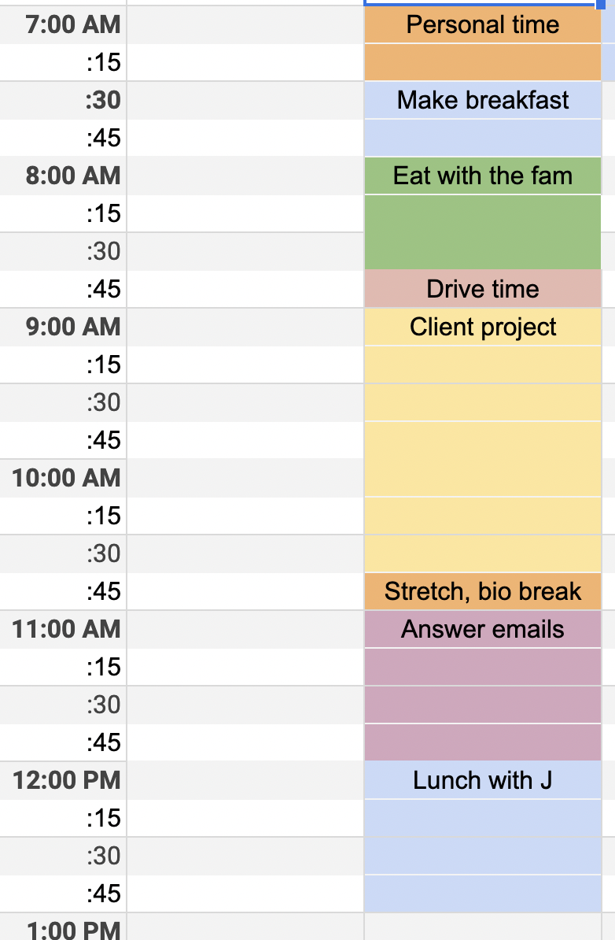
Notes:
Using Nir's free schedule maker (it's just a spreadsheet), I created this sample time box to show how the chaos of the previous example (something likely familiar to all/most of us) can be transformed with time boxing). (I get nothing for sharing this – just is a tool I know about, but there are many different Time Boxing tools out there – just search to see the options. He has a sample of a time-boxed schedule in his Schedule Maker.)

Slide 57
An adapted version of Nir's example, written by Michelle to match with the time boxing example on the previous slide:
Your plan was to wake up and pray or meditate. Your daughter comes into your room in a panic. She can't find the shirt she wanted to wear today. "I love you, and it's meditation time for me," you say gently. "Good luck finding something else to wear. I'm sure you will look great no matter what you choose." You gently close the door behind you as you start your meditation.
After getting dressed, you make breakfast (today is eggs day!). Your toddler cries that he wants oatmeal instead of eggs. You give him a hug and sit down next to him to eat. "How about we have oatmeal tomorrow? Today is eggs day. Would you like orange juice or milk to drink?"
Everyone gets off to their various locations for the day, and when you get to work, you take a drink of water and a deep breath before sitting down to tackle the client proposal you already blocked time off for in your personal planning session on Friday afternoon. [Personal planning for about 15 minutes is recommended as part of a weekly rhythm.]
DING. Ah, drat, you think, I forgot to turn off my FB notifications. No matter, I'll check social later today after the kids are in bed.
Then you hear a friendly tap on the doorframe of your office. It's J, asking how your weekend went. (Ah, I knew I should have closed my door for this block of time.) "Hey there! you say, it's great to see you and I'd love to talk. I have blocked off a good chunk of time for lunch today. Would you like to join me?"
Notes:
Time boxing can help us stay in traction, stay committed to what we said we would do. This doesn't mean that sometimes we won't make on-the-spot decisions to do something differently (sometimes one big rock supplants another in a moment)...but just because a request comes from someone we care about does not often mean it has to be done RIGHT NOW.

Slide 58
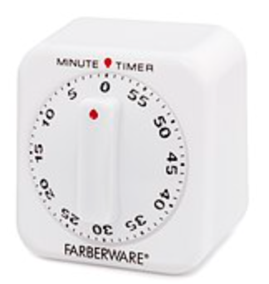
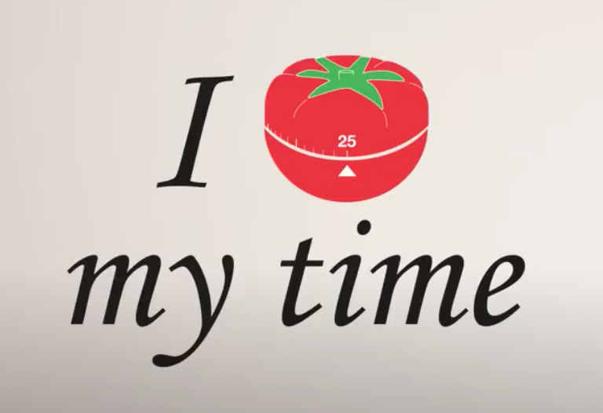
Time Boxing, another version: The Pomodoro® Technique
1 Pomodoro = 25 minutes
Notes:
Another way to think about time boxing is to adopt the Pomodoro technique – breaking things into about 25-minute chunks. One reason this can be helpful is that something that is hard, something we may put off naturally, can be tackled in small chunks. Often, beginning a hard task is the most difficult thing, and setting a timer for 25 minutes helps the brain know that it's not going to last forever. Or having a limit of some sort helps it feel more do-able. That's just another benefit of time-boxing
https://www.youtube.com/watch?v=dnt2lTdcn8g, https://francescocirillo.com/pages/pomodoro-technique

Slide 59
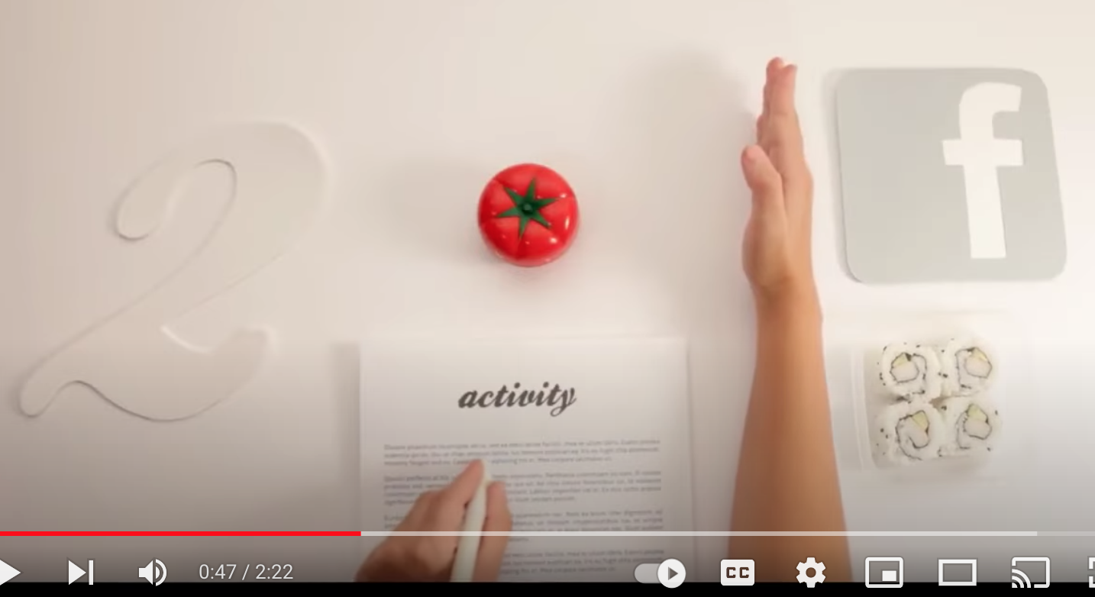
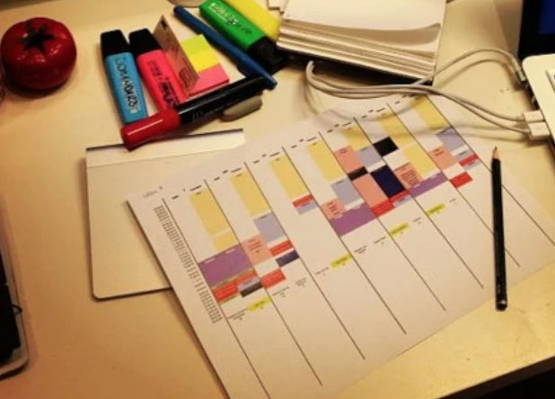
Time Boxing: The Pomodoro® Technique
1 Pomodoro = 25 minutes
Budget and protect “Pomodoros”
CREDITS: Snapshots from video and post at: https://francescocirillo.com/pages/pomodoro-technique
Notes:
https://www.youtube.com/watch?v=dnt2lTdcn8g, https://francescocirillo.com/pages/pomodoro-technique

Slide 60
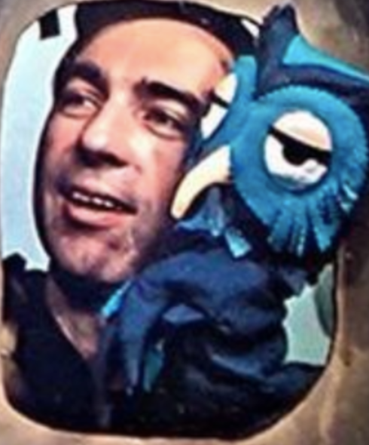
Time Boxing: The Pomodoro® Technique
Back in the day, parents might have said, “This will take one Mister Rogers” ☺
photo credit, in the public domain as listed here:
https://commons.wikimedia.org/wiki/File:Fred_Rogers_and_X_the_Owl_Look_Magazine_photo_1969.png
Notes:
https://www.youtube.com/watch?v=dnt2lTdcn8g, https://francescocirillo.com/pages/pomodoro-technique

Slide 61
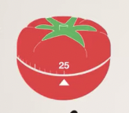
Notes:
In Nir's spreadsheet, two slots are close to one Pomodoro. :)

Slide 62
Instead of measuring by what I got done, try measuring by this metric from Nir Eyal:
"Did I do what I said I would do for as long as I said I would, without distraction?”
Notes:
Last week, we touched on the intersection point of technology and the start of our day. So we'll start at the beginning of a day to talk about honoring time. :)

Slide 63
When you have planned for traction, you can "Point and Name" both 1) what your values & priorities are, and 2) the distractions that could pull you off center
Notes:
Last week, we touched on the intersection point of technology and the start of our day. So we'll start at the beginning of a day to talk about honoring time. :)

Slide 64
*NOTE*
Nir notes is important to use time boxing like a scientist would – with curiosity and calm – not like
a drill sergeant.
And of course there will be times when adaptation is needed.
Notes:
Last week, we touched on the intersection point of technology and the start of our day. So we'll start at the beginning of a day to talk about honoring time. :)

Slide 65
grounded
centered
calm
connected
intentional
responsible
responsive
boundaried
Notes:
It was interesting to reflect even on this fictitious situation to see what values could be associated with even these simple time boxed activities. What other values do you see here? What values do you want your schedule to reflect? We can schedule in a way that helps us toward our intentions to be the people we want to be, and to show up in our spheres of influence in ways that we want to show up. Being distracted definitely doesn't help us align with our values, and could undermine them.

Slide 66
Like Dave Ramsey's envelope system: "Telling your money (time & energy) where to go, instead of wondering where it (they) went."
-John Maxwell
Notes:
https://www.ramseysolutions.com/budgeting/how-to-take-control-of-your-money

Slide 67
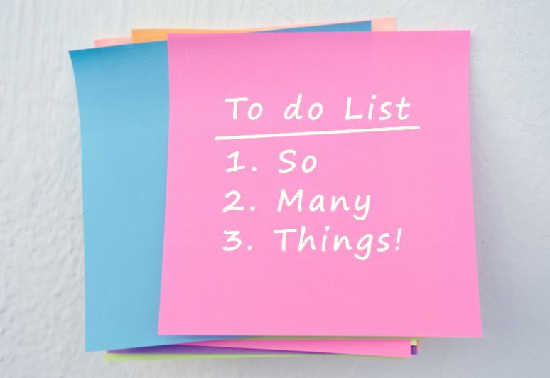
Notes:
How does to-do listing compare with time boxing?

Slide 68
Benefits of time boxing vs. to-do-listing
(or migrating to-dos to time boxes)
“What if we stopped celebrating being busy as a measurement of importance? What if instead we celebrated how much time we had spent listening, pondering, meditating, and enjoying time with the most important people in our lives?”
― Greg McKeown, Essentialism: The Disciplined Pursuit of Less
Notes:
This concept comes from Nir Eyal, author of Indistractable. Quote is from https://www.nirandfar.com/opposite-of-distraction/ We can be focused on things that aren't in alignment with our values and goals, but we can also choose to build in time for using social media or other tools. They aren't inherently bad in and of themselves. Wellness is about deliberateness, integrity, and alignment.

Slide 69
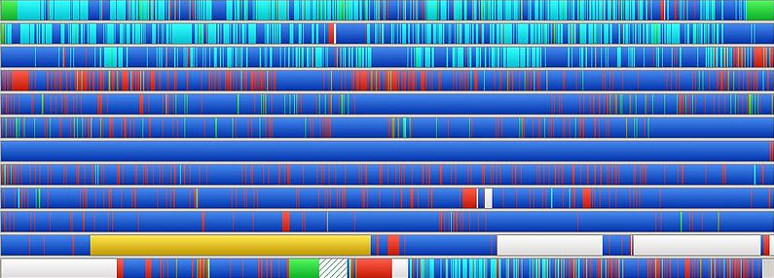
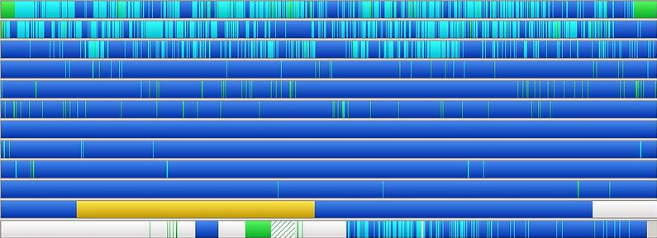
From to-do listing to time boxing -
like defragging your life!
Notes:
We shared a variety of "synonyms" to the principles behind time boxing in these slides so that if it is a new concept you can see parallel patterns in other settings.

Slide 70
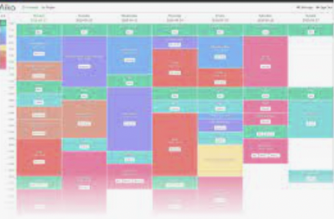
These three slides are best viewed in slideshow mode - they are animated slides.
Outcome-based (centered on doing)
Input-based (centered on values and priorities)
No constraints, endless options
Constraints are built in to protect precious time
Not connected to time
Considers time needed & time available
Often focused on short-term issues
Can connect to longer-term vision & commitments
Nothing built in to address distractions
Intentional allocating of time shields from distractions
Notes:
This concept comes from Nir Eyal, author of Indistractable. Quote is from https://www.nirandfar.com/opposite-of-distraction/ We can be focused on things that aren't in alignment with our values and goals, but we can also choose to build in time for using social media or other tools. They aren't inherently bad in and of themselves. Wellness is about deliberateness, integrity, and alignment.

Slide 71
Easy to procrastinate harder tasks
Supports building in time for harder tasks (& breaking harder tasks down into time chunks)
Task-switching risk is high
Builds capacity to stay committed to a task
Hard to use for collaboration
Can facilitate collaboration & healthier cultures
Things can feel out of control
Fosters discipline and a sense of control
Lists can get lost
Creates a record
Notes:
This concept comes from Nir Eyal, author of Indistractable. Quote is from https://www.nirandfar.com/opposite-of-distraction/ We can be focused on things that aren't in alignment with our values and goals, but we can also choose to build in time for using social media or other tools. They aren't inherently bad in and of themselves. Wellness is about deliberateness, integrity, and alignment.

Slide 72
How do you know if you are off track-tion?
You know immediately if you are off track-tion
It's easy to give self a "pass" on wasted time
Helps with self-honesty and accountability
Task-switching risk is high
Builds capacity to stay committed to a task
Disconnected from time
Considers both time available and time needed or desired; helps one assess the time things really take
Notes:
This concept comes from Nir Eyal, author of Indistractable. Quote is from https://www.nirandfar.com/opposite-of-distraction/ We can be focused on things that aren't in alignment with our values and goals, but we can also choose to build in time for using social media or other tools. They aren't inherently bad in and of themselves. Wellness is about deliberateness, integrity, and alignment.

Slide 73
Invitation for the week:
Use time boxing to plan a half of a day (or you can time box a day that has already past).
Or even time box an hour or two.
Are you planning time for things that match your values and priorities?

Slide 74
Thank you for taking 2-3 minutes to fill out the feedback & reflection form
https://forms.gle/zcpQP7nwvBx5quWz7

Slide 75
We wish you well(ness)!
"We but mirror the world. All the tendencies present in the outer world are to be found in the world of our body. If we could change ourselves, the tendencies in the world would also change. … We need not wait to see what others do.”
~ Mahatma Gandhi
“In the attention economy, mindfulness is activism.”
-Jay Vidyarthi, Mindful Tech designer and consultant

Slide 76
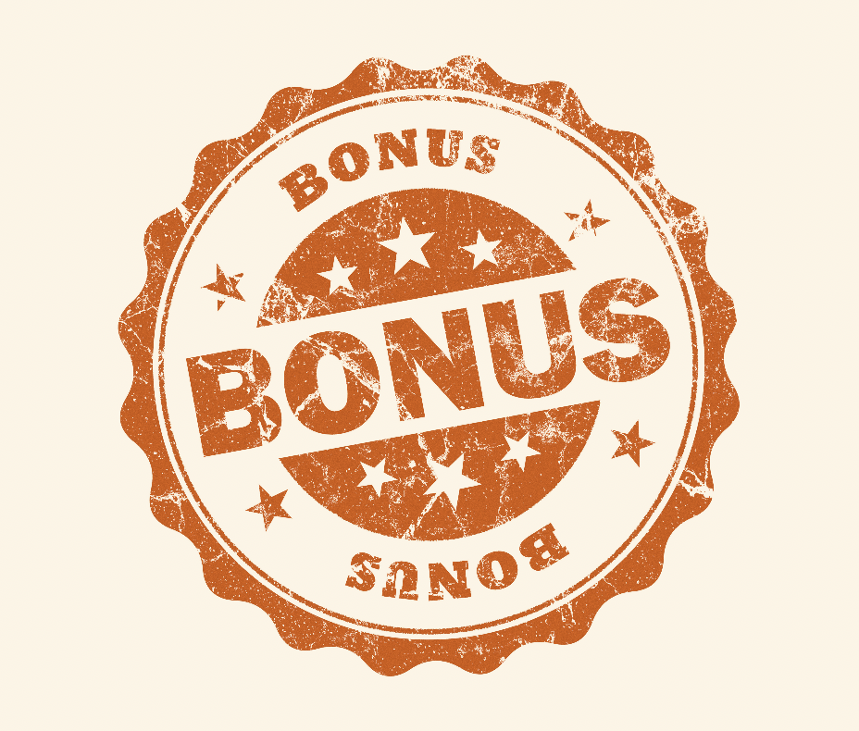
Bonus Material
See more resources, research, and information in the Honoring Time Resource document in the PTA folder https://docs.google.com/document/d/11eEX7B4lTEQtrCUN9qGFVVkxaPjV_9CnhVeymEIUeGs/edit?usp=sharing

Slide 77
Bonus Material
A few more quotes
Two tips for better mornings
Productivity and Privacy tips
Increasing friction with tech
More on Time Boxing
See more resources, research, and information in the Honoring Time Resource document in the PTA folder https://docs.google.com/document/d/11eEX7B4lTEQtrCUN9qGFVVkxaPjV_9CnhVeymEIUeGs/edit?usp=sharing

Slide 78
Bonus Material
A few more quotes
Two tips for better mornings
Productivity and Privacy tips
Increasing friction with tech
More on Time Boxing
See more resources, research, and information in the Honoring Time Resource document in the PTA folder https://docs.google.com/document/d/11eEX7B4lTEQtrCUN9qGFVVkxaPjV_9CnhVeymEIUeGs/edit?usp=sharing

Slide 79
"How different our lives are when we really know what is deeply important to us, and keeping that picture in mind, we manage ourselves each day to be and to do what really matters most.”
– Stephen R. Covey, The 7 Habits of Highly Effective People: Powerful Lessons in Personal Change

Slide 80
“TRY THIS: AUDIT YOUR TIME Spend a week tracking how much time you devote to the following: family, friends, health, and self. (Note that we’re leaving out sleeping, eating, and working. Work, in all its forms, can sprawl without boundaries. If this is the case for you, then set your own definition of when you are “officially” at work and make “extra work” one of your categories.) The areas where you spend the most time should match what you value the most. Say the amount of time that your job requires exceeds how important it is to you. That’s a sign that you need to look very closely at that decision. You’re deciding to spend time on something that doesn’t feel important to you. What are the values behind that decision? Are your earnings from your job ultimately serving your values?”
― Jay Shetty, Think Like a Monk: Train Your Mind for Peace and Purpose Every Day
Notes:
Some more thoughts from Jay Shetty

Slide 81
“No matter what you think your values are, your actions tell the real story. What we do with our spare time shows what we value. For instance, you might put spending time with your family at the top of your list of values, but if you spend all your free time playing golf, your actions don’t match your values, and you need to do some self-examination.”
― Jay Shetty, Think Like a Monk: Train Your Mind for Peace and Purpose Every Day
“A very small shift in direction can lead to a very meaningful change in destination”
― James Clear, Atomic Habits: An Easy & Proven Way to Build Good Habits & Break Bad Ones
Notes:
Some more thoughts from Jay Shetty

Slide 82
“It is easy to get bogged down trying to find the optimal plan for change: the fastest way to lose weight, the best program to build muscle, the perfect idea for a side hustle. We are so focused on figuring out the best approach that we never get around to taking action. As Voltaire once wrote, “The best is the enemy of the good.” I refer to this as the difference between being in motion and taking action. The two ideas sound similar, but they’re not the same. When you’re in motion, you’re planning and strategizing and learning. Those are all good things, but they don’t produce a result. Action [TRACTION], on the other hand, is the type of behavior that will deliver an outcome. If I outline twenty ideas for articles I want to write, that’s motion. If I actually sit down and write an article, that’s action.”
― James Clear, Atomic Habits: An Easy & Proven Way to Build Good Habits & Break Bad Ones
Notes:
Some more thoughts from Jay Shetty

Slide 83
“If motion doesn’t lead to results, why do we do it? Sometimes we do it because we actually need to plan or learn more. But more often than not, we do it because motion allows us to feel like we’re making progress without running the risk of failure. Most of us are experts at avoiding criticism. It doesn’t feel good to fail or to be judged publicly, so we tend to avoid situations where that might happen. And that’s the biggest reason why you slip into motion rather than taking action: you want to delay failure.”
― James Clear, Atomic Habits: An Easy & Proven Way to Build Good Habits & Break Bad Ones
Notes:
Some more thoughts from Jay Shetty

Slide 84
from Amy Blankston, co-founder of Digital Wellness Institute:
"I was reading recently [a] blog about how we have...time blocks in our lives that if you count up the number of blocks of time you have until you die, which is a little bit morbid, you begin to realize, I have X number of dinners with my family. I have this much time to write this book. I have that much time to learn a new instrument and all of a sudden time, the value of time really rises to the surface of, we begin to say, okay, yes, I want to check that, but what's best for me right now, who I want to be is the person who can find balance amidst all of that temptation and say this is what I needed to do. It's developing that discipline that is adjusting to the new era that we're living in."
https://findingbrave.org/wp-content/uploads/2017/08/Transcript-FInding-Brave-Episode-39-Amy-Blankson-How-to-Leverage-Technology-to-Increase-Your-Happiness.pdf
Notes:
Some more thoughts from Jay Shetty

Slide 85
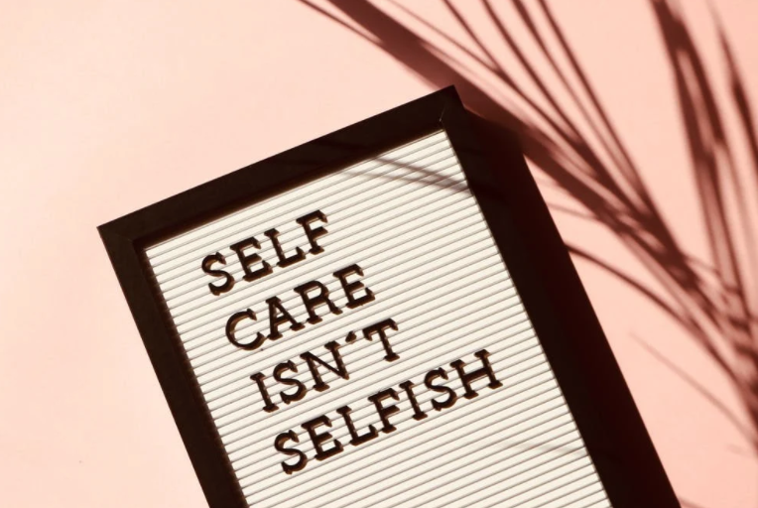
More quotes and thoughts re: Caring for Self
Honoring time with self: Overcoming solitude deprivation
“We aren’t taught to value taking time out to [consider] what matters to us…[so we can be more deliberate about]…how to focus on what matters."-Elisha Goldstein (from his blog, https://elishagoldstein.com)
“A lack of silence and solitude leads to anxiety, which leads to demonization based on differences, which leads to conflict, which leads to violence.” And “A leader needs to have presence, to show up to the moment grounded in one’s self, as centered as one can be, ready to hear, to listen, to discern.” from Lead Yourself First
“How much we know and understand ourselves is critically important, but there is something that is even more essential to living a Wholehearted life: loving ourselves.” Brené Brown (The Gifts of Imperfection)
"Solitude is where you find yourself so that you can reach out to other people and form real attachments." ~Sherry Turkle https://www.ted.com/talks/sherry_turkle_connected_but_alone/transcript?language=en
"We but mirror the world. All the tendencies present in the outer world are to be found in the world of our body. If we could change ourselves, the tendencies in the world would also change. … We need not wait to see what others do.” Mahatma Gandhi
Notes:
=

Slide 86
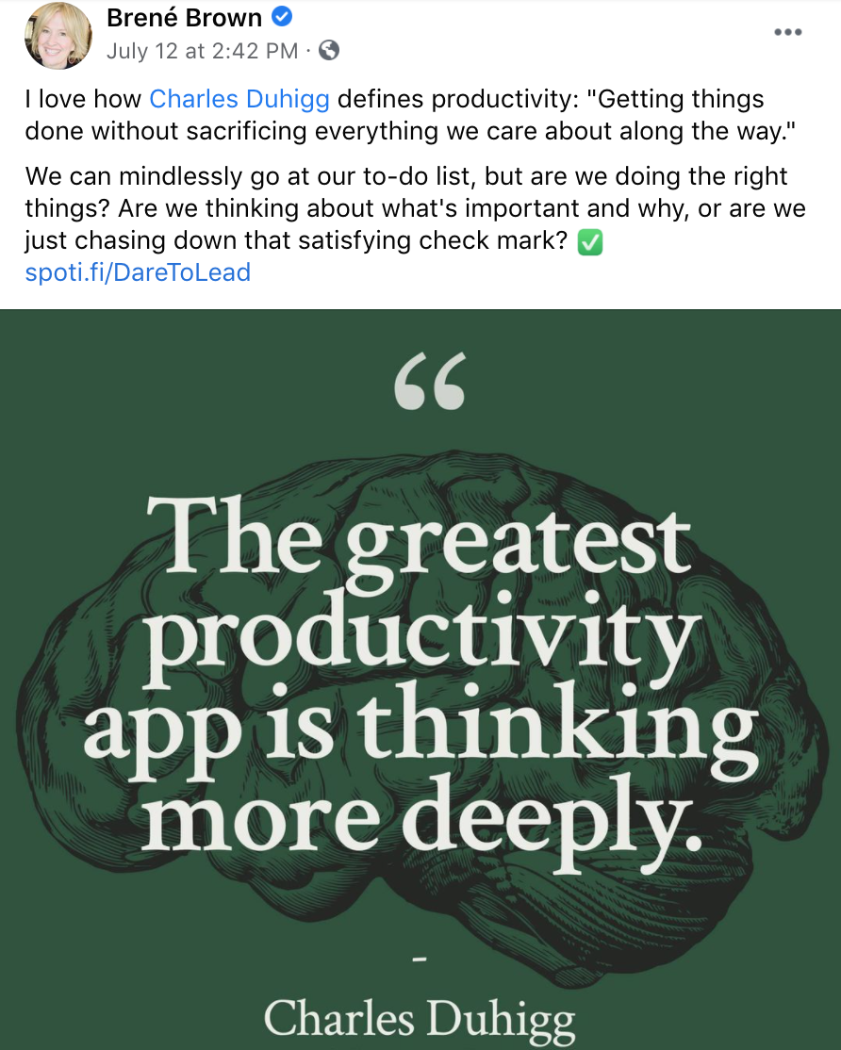
Productivity through various lenses
What resonates with you?
Productivity: “Getting things done without sacrificing everything we care about along the way.” -Charles Duhigg
https://brenebrown.com/podcast/brene-with-charles-duhigg-on-habits-and-productivity/
In this interview with Brené Brown, Duhigg also talks about constantly revisiting what productivity means at any given moment, even reassessing your calendar during the week to be sure what you are doing is in alignment with what you really want to be doing.
https://www.facebook.com/brenebrown/posts/371566174333723

Slide 87
Productivity through various lenses
What resonates with you?
Beware of tools that promise to help you do things that run counter to what you really want/need to be doing!
Notes:
https://www.brainyquote.com/quotes/peter_drucker_105338

Slide 88
Productivity through various lenses
What resonates with you?
“Where focus goes, energy flows. And if you don't take the time to focus on [and be mindful/intentional/deliberate about] what matters, then you're living a life of someone else's design.”
~Tony Robbins
This idea of “where your focus goes, your energy flows” shows up often in wellness/meditation/motivation spaces.

Slide 89
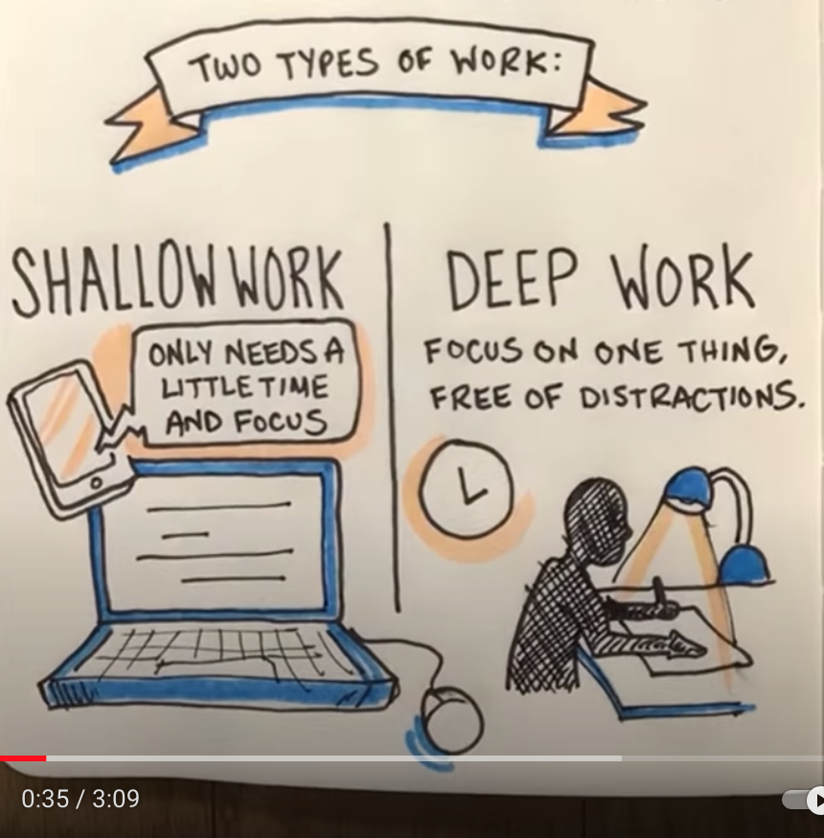
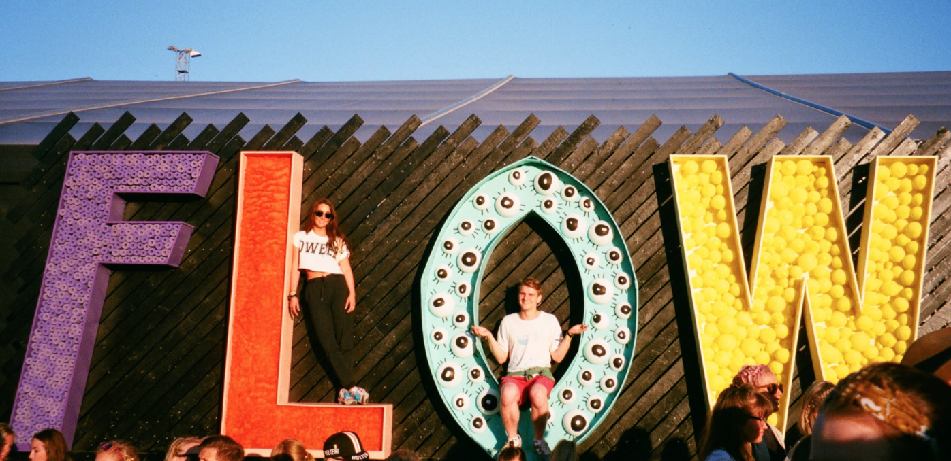
Productivity through various lenses
What resonates with you?
Flow: “a state in which people are so involved in an activity that nothing else seems to matter; the experience is so enjoyable that people will continue to do it even at great cost, for the sheer sake of doing it.” (Mikal Cskikszentmihalyi, 1990)
Illustrating concepts in Cal Newport’s book, Deep Work
https://www.youtube.com/watch?v=_RMtnDaxmPw

Slide 90
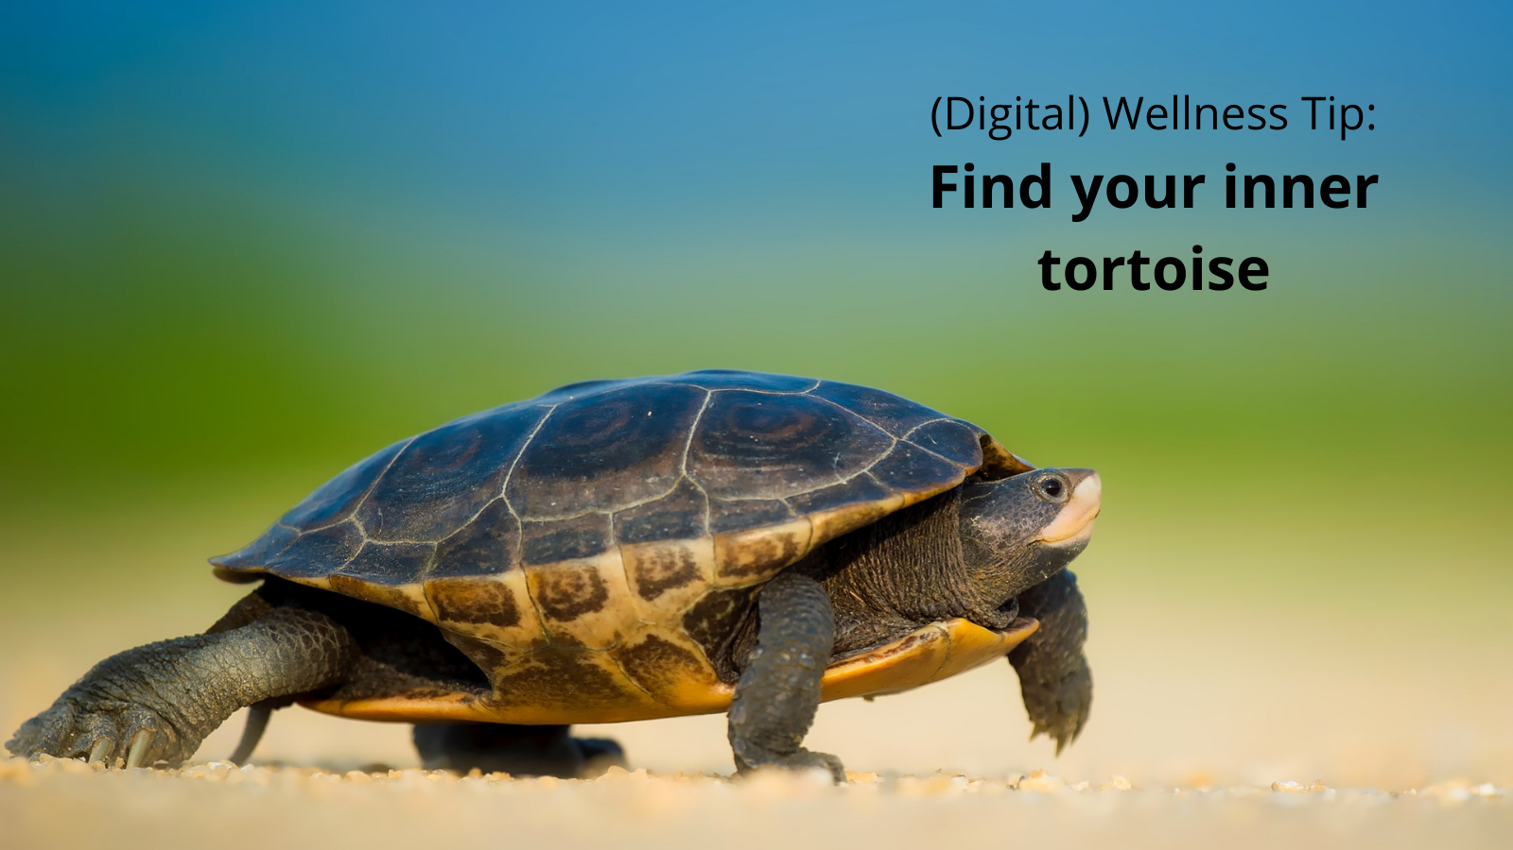
Productivity through various lenses
What resonates with you?
The Slow Movement(s)
https://www.slowmovement.com/
See also
https://www.slowfood.com/
Carlo Petrini’s work
Carl Honoré TED talk
Cal Newport TED talk
Harvard student letter: “Slow Down”
Carl Honoré

Slide 91
Bonus Material
A few more quotes
Two tips for better mornings
Productivity and Privacy tips
Increasing friction with tech
More on Time Boxing
See more resources, research, and information in the Honoring Time Resource document in the PTA folder https://docs.google.com/document/d/11eEX7B4lTEQtrCUN9qGFVVkxaPjV_9CnhVeymEIUeGs/edit?usp=sharing

Slide 92
Honoring Time:
Starting at the beginning…
Notes:
Last week, we touched on the intersection point of technology and the start of our day. So we'll start at the beginning of a day to talk about honoring time. :)

Slide 93
…the beginning of each day!
Notes:
80,000+ people have been surveyed by Dr. Heidi Hanna, "The Stress Detective." A significant pattern showed up around the question about what what causes people the most stress in the morning. The mindset with which we start our day can impact the state our minds and bodies are in (the mix of chemicals, to use Dr. McGonigal's research).

Slide 94
See this video that we created for this bonus material:
https://youtu.be/GRfObJu_FwM
Notes:
We created a mini-module around how we can make our mornings better.

Slide 95
Including two simple tips for better mornings
Notes:
Last week, we touched on the intersection point of technology and the start of our day. So we'll start at the beginning of a day to talk about honoring time. :)

Slide 96
“Every day, think as you wake up, today I am fortunate to be alive, I have a precious human life, I am not going to waste it."
—the Dalai Lama, quoted by Jay Shetty
Notes:
Last week, we touched on the intersection point of technology and the start of our day. So we'll start at the beginning of a day to talk about honoring time. :)

Slide 97
"Time has memory. If you do something at the same time every day, it becomes easier and natural. If you do something in the same space every day, it becomes easier and natural.”
― Jay Shetty, Think Like a Monk: Train Your Mind for Peace and Purpose Every Day

Slide 98
Remember our tendency in a digital world –
most of us check our phone first thing
61% → within 5 minutes
88% → within 30 minutes
96% → within 60 minutes
https://www.bgr.in/news/61-people-check-their-phones-within-5-minutes-after-waking-up-deloitte-435501/
Notes:
Just because it's common doesn't mean it's healthy. :) We'll be talking more about this next week, but the sooner we check our devices, the more susceptible we are to others' influence on how we start our day and spend our attention and mental, emotional, physical, and relational energy.
https://www.bgr.in/news/61-people-check-their-phones-within-5-minutes-after-waking-up-deloitte-435501/

Slide 99
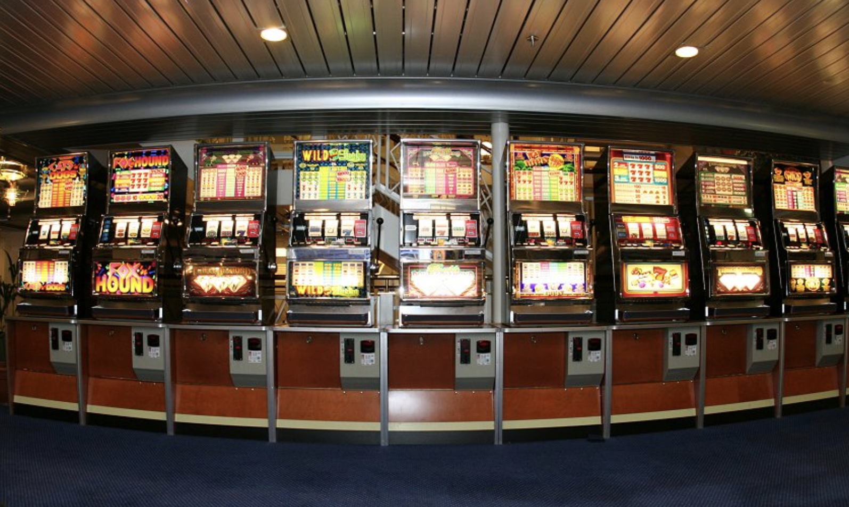
It's not unlike starting our day in front of a slot machine – how phones are designed to hook attention
Notes:
https://www.facebook.com/watch/?v=1255573934554728
Just because it's common doesn't mean it's healthy. :) We'll be talking more about this next week, but the sooner we check our devices, the more susceptible we are to others' influence on how we start our day and spend our attention and mental, emotional, physical, and relational energy.
https://www.bgr.in/news/61-people-check-their-phones-within-5-minutes-after-waking-up-deloitte-435501/

Slide 100
“Time is an unrenewable resource. You can’t get it back. All these things we’ve done to exchange information, to access information at our fingertips, have actually taken away our time for restoring the soul. You’re giving away your soul’s ability to be moved…. [S]pend more time in solitude.
― Raymond M. Kethledge, Lead Yourself First: Inspiring Leadership Through Solitude, emphasis added

Slide 101
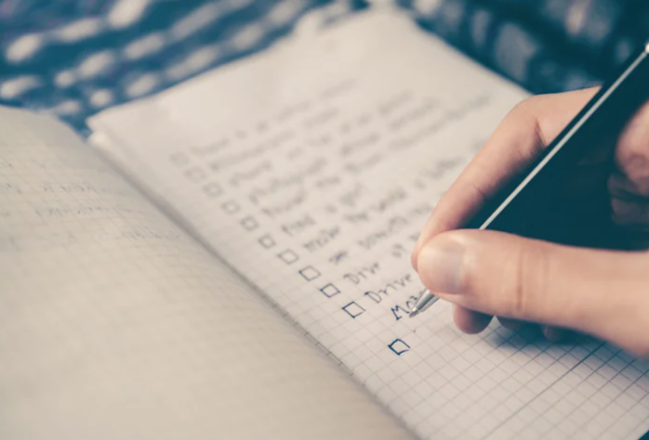
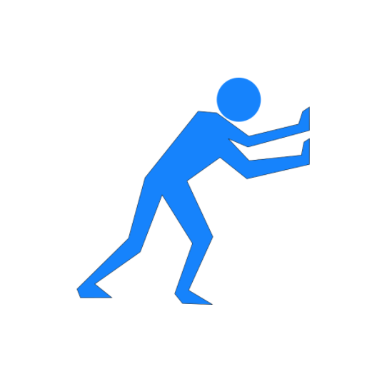
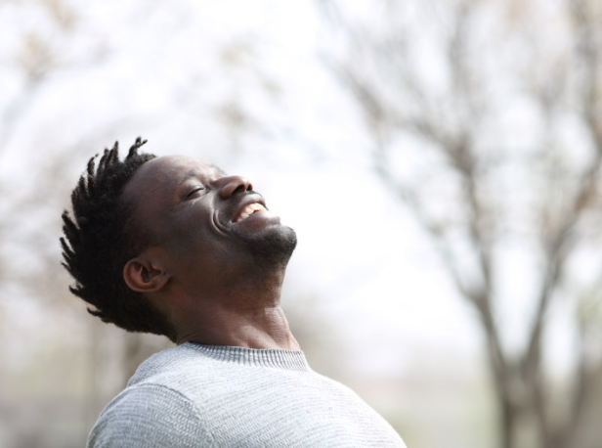
Invitation #1: Start your day with
something besides your phone
This slide is best viewed in slideshow mode - it is an animated slide.
Notes:
(This slide is best viewed in Slideshow mode. There is something beyond the checklist.)
Mindset matters, as we learned from Kelly McGonigal. How we think about stress (or in this case, time) can impact how our bodies, minds, emotions (chemicals/hormones) engage. So how we start our day, no matter how packed the day may seem…even for just a few minutes…can make a difference. To start with to-dos may be sacrificing our center in subtle ways. Just give it a try, even for just a couple of minutes, to start somewhere else that can help you feel more calm and connected to who you want to be as a person, how you want to show up for all of those to-dos tapping at your door.

Slide 102
Dr. Heidi Hanna ("the Stress Detective") has surveyed over 80,000 people.
What is the top thing that causes people stress in the morning?
Notes:
80,000+ people have been surveyed by Dr. Heidi Hanna, "The Stress Detective." A significant pattern showed up around the question about what what causes people the most stress in the morning. The mindset with which we start our day can impact the state our minds and bodies are in (the mix of chemicals, to use Dr. McGonigal's research).

Slide 103
It's the feeling that there isn't
enough time to get everything done!!
Notes:
Mindset matters, as we learned from Kelly McGonigal. How we think about stress (or in this case, time) can impact how our bodies, minds, emotions (chemicals/hormones) engage. So how we start our day, no matter how packed the day may seem…even for just a few minutes…can make a difference.

Slide 104
Notes:
If we start the day with all the things we haven't yet gotten done, or all the things that loom over our heads, it's likely that our day won't start off with a sense of centeredness or wellness.

Slide 105
“The most inspiring leaders are ones who find a clarity of meaning that transcends the tasks at hand. And that meaning emerges through reflection.” ― Raymond M. Kethledge, Lead Yourself First: Inspiring Leadership Through Solitude

Slide 106
More of
"Practice the Pause"

Slide 107
“[T]he very moment you wake up each morning…all your wishes and hopes [or checklists?] for the day rush at you like wild animals.
"And the first job each morning consists simply in [holding] them all back; in listening to that other voice, taking that other point of view, letting that other larger, stronger, quieter life come flowing in.
And so on, all day. Standing back from all your natural fussings and frettings; coming in out of the wind…
"We can only do that for moments at first. But from those moments [a] new sort of life will be spreading through our system."
-C.S. Lewis, emphasis added

Slide 108
"Prime the positive first."
-Heidi Hanna (and maybe Michelle Gielan)
Notes:
This phrase was shared by Dr. Heidi Hanna ("The Stress Detective") in our Digital Wellness Certification Course, and we think she was channeling Michelle Geilan, who uses this language in her research about the impact of negative news (or email) in the morning. https://www.cnbc.com/2016/12/30/checking-email-as-soon-as-you-wake-up-could-be-ruining-your-day.html

Slide 109
"Start with Your Center"
Dr. Heidi Hanna: “Are you investing [some time each day] to think about who you want to be before you think about what you need to do?” https://heidihanna.com/2019/04/15/create-your-optimal-performance-pulse/
Notes:
As we discussed last week, you will see throughout the series that concepts in each module interrelate to other modules. Similarly, although this is a series on Digital Wellness, many concepts we explore relate to Wellness in general. As we progress through the series, consider discussing with someone the overlaps and patterns that you are seeing across modules, or insights that are coming that help you connect concepts at a deeper level.

Slide 110
Invitation #2: Try starting your day with a centering something –
something other than your checklist (more on checklists in the main module)
This slide is best viewed in slideshow mode - it is an animated slide.
Notes:
(This slide is best viewed in Slideshow mode. There is something beyond the checklist.)
Mindset matters, as we learned from Kelly McGonigal. How we think about stress (or in this case, time) can impact how our bodies, minds, emotions (chemicals/hormones) engage. So how we start our day, no matter how packed the day may seem…even for just a few minutes…can make a difference. To start with to-dos may be sacrificing our center in subtle ways. Just give it a try, even for just a couple of minutes, to start somewhere else that can help you feel more calm and connected to who you want to be as a person, how you want to show up for all of those to-dos tapping at your door.

Slide 111
Bonus Material
Some more quotes
Two tips for better mornings
Productivity and Privacy tips
Increasing friction with tech
More on Time Boxing
See more resources, research, and information in the Honoring Time Resource document in the PTA folder https://docs.google.com/document/d/11eEX7B4lTEQtrCUN9qGFVVkxaPjV_9CnhVeymEIUeGs/edit?usp=sharing

Slide 112
Tip: Say no to Defaults! Help to Reduce Notifications
Say no to defaults! Change notifications
On iPhone: https://support.apple.com/guide/iphone/change-notification-settings-iph7c3d96bab/ios
On Android: https://support.google.com/android/answer/9079661?hl=en
On Pixel: https://support.google.com/pixelphone/answer/6111294?hl=en
On Samsung Galaxy s9: https://www.cnet.com/tech/mobile/how-to-turn-off-samsungs-galaxy-notifications-on-the-galaxy-s9/
On Facebook: https://www.facebook.com/help/390022341057202/
On WhatsApp:
For Android: https://faq.whatsapp.com/android/chats/how-to-manage-your-notifications
For iPhone: https://faq.whatsapp.com/iphone/troubleshooting/how-to-manage-your-notifications
For Desktop: https://faq.whatsapp.com/web/chats/how-to-manage-your-notifications
On LinkedIn: https://www.linkedin.com/help/linkedin/answer/76636/managing-your-linkedin-notification-updates?lang=en
On Email: Check your email program/app and/or your device
On Windows 10: https://support.microsoft.com/en-us/windows/change-notification-and-action-settings-in-windows-10-8942c744-6198-fe56-4639-34320cf9444e
On a Mac: https://support.apple.com/en-us/HT204079
On Slack: https://slack.com/help/articles/201355156-Configure-your-Slack-notifications
Microsoft Teams Do Not Disturb: https://techcommunity.microsoft.com/t5/microsoft-teams/automatically-set-do-not-disturb-when-presenting/m-p/736906
On Gmail – don't use the settings feature. (Didn't work for me, at least). Use the little smiley face feature and set yourself as "away," See next slide.

Slide 113
If this can help anyone, I finally figured out how to turn off the email notifications I was getting on my work email.
X This did not work.
X This did not work.
✅ This seems to have worked. (?? Maybe not)
So it appears I will always be "away" from email.

Slide 114
Tip: Say no to Defaults! Help to Reduce Notifications
Say no to defaults! Change notifications
On Microsoft Outlook: https://support.microsoft.com/en-us/office/turn-new-message-alert-pop-up-on-or-off-9940c70e-b306-442e-a856-d94b20318481
On Facebook Messenger: https://www.facebook.com/help/messenger-app/330627630326605
Manage Announce notifications with Siri on Airpods or Beats: https://support.apple.com/en-us/HT210406
On Amazon Alexa/Echo: https://www.amazon.com/gp/help/customer/display.html?nodeId=GW65E37ZG4L9BW3P
On Apple Watch: https://support.apple.com/en-us/HT204791
On FitBit: https://help.fitbit.com/articles/en_US/Help_article/2323.htm
Across various devices (a curated instruction list): https://www.businessinsider.com/how-to-turn-off-all-notifications-across-devices
On Voxer: https://support.voxer.com/hc/en-us/articles/204332223-Disable-Enable-Notifications-per-Chat
On Marco Polo: https://support.marcopolo.me/article/69-notification-settings
On Viber:
iPhone: https://help.viber.com/en/article/personalize-your-viber-settings-iphone
Android: https://help.viber.com/en/article/personalize-your-viber-settings-android-phones
On Google News: https://support.google.com/googlenews/answer/9005590?hl=en&co=GENIE.Platform%3DAndroid
On Apple News: https://support.apple.com/en-us/HT211230
On Skype
For desktop: https://support.skype.com/en/faq/FA34811/how-do-i-manage-notifications-in-skype-on-desktop
For mobile: https://support.skype.com/en/faq/fa34746/how-do-i-manage-notifications-in-skype-on-mobile-or-tablet
Notes:
I added the slides about notifications and privacy settings from last week's slide deck for your convenience.

Slide 115
Tip: Say no to Defaults! Help to Reduce Notifications
Say no to defaults! Change notifications
On GroupMe: https://www.swipetips.com/how-to-turn-off-groupme-notifications-on-iphone-or-android/
On Slack: https://slack.com/help/articles/201355156-Configure-your-Slack-notifications
On Instagram: https://help.instagram.com/105448789880240
On Twitter: https://help.twitter.com/en/managing-your-account/enabling-web-and-browser-notifications
On SnapChat:
Android: https://support.snapchat.com/article/android-notifications
Apple: https://support.snapchat.com/en-US/article/ios-notifications
On Clubhouse:
About notifications: https://clubhouseapp.zendesk.com/hc/en-us/articles/360062778193-When-do-I-get-notified-about-people-
Changing notifications: https://clubhouseapp.zendesk.com/hc/en-us/articles/1500002511422-Can-I-adjust-my-notification-settings-
For Facebook game notifications: https://www.facebook.com/help/476337625740088
General Android notifications: https://www.talkandroid.com/guides/beginner/how-to-disable-annoying-android-notifications/
General phone notification help: https://www.wired.com/story/turn-off-notifications-smartphone/
On Nintendo: https://en-americas-support.nintendo.com/app/answers/detail/a_id/22345/~/how-to-change-notification-settings
On XBox One: https://www.howtogeek.com/675283/how-to-turn-off-or-customize-xbox-one-notifications/
On Nintendo: https://en-americas-support.nintendo.com/app/answers/detail/a_id/22345/~/how-to-change-notification-settings
On PS5: https://www.playstation.com/en-us/support/account/manage-notifications-ps5/
Notes:
I added the slides about notifications and privacy settings from last week's slide deck for your convenience.

Slide 116
Tip: Say no to defaults – Increase privacy protection in settings = more friction through privacy settings
The price we pay for ease of use (frictionless digital flow) is…fewer barriers between us and digital distractions!
There is a tension here, but if you build in more log-offs, more two-step verifications, etc. you build in more friction AND protect your privacy
Less privacy means more targeted advertising (e.g., Facebook Pixel)
Be smart about smart tech
https://www.ted.com/talks/finn_lutzow_holm_myrstad_how_tech_companies_deceive_you_into_giving_up_your_data_and_privacy
https://www.washingtonpost.com/video/c/embed/1f882f50-65bb-11e8-81ca-bb14593acaa6
Notes:
See also: https://www.wired.com/story/facebooks-targeted-ads-are-more-complex-than-it-lets-on/, https://www.pewresearch.org/internet/2019/11/15/how-americans-think-about-privacy-and-the-vulnerability-of-their-personal-data/ https://www.consumerreports.org/privacy/how-facebook-tracks-you-even-when-youre-not-on-facebook-a7977954071/ https://applymagicsauce.com/demo https://news.harvard.edu/gazette/story/2017/08/when-it-comes-to-internet-privacy-be-very-afraid-analyst-suggests/. https://www.washingtonpost.com/video/c/embed/1f882f50-65bb-11e8-81ca-bb14593acaa6

Slide 117
Tip: Increase privacy in your tech settings
Google Chrome: https://www.theverge.com/2020/2/11/21126427/google-chrome-privacy-tools-private-network-browser-settings
Instagram: https://www.theverge.com/2020/2/27/21154221/instagram-privacy-how-to-stories-posts-settings-tags-ads-blocking
Facebook: https://www.consumerreports.org/privacy/facebook-privacy-settings-a1775535782/
Snapchat: https://www.lifewire.com/snapchat-privacy-tips-4117444
Whatsapp: https://www.fastcompany.com/90388813/the-ultimate-guide-to-whatsapps-powerful-privacy-options
Google: https://www.wired.com/story/google-tracks-you-privacy/
YouTube: https://www.theverge.com/2019/4/19/18484802/youtube-privacy-protect-how-to-video-preferences-web-ad-personalization
Amazon: https://the-digital-reader.com/2020/02/12/six-default-amazon-security-settings-you-can-change-for-more-privacy/
Other tips part 1: https://www.washingtonpost.com/news/the-switch/wp/2018/06/01/hands-off-my-data-15-default-privacy-settings-you-should-change-right-now/
Other tips, part 2: https://www.washingtonpost.com/news/the-switch/wp/2018/06/15/hands-off-my-data-15-more-default-privacy-settings-you-should-change-on-your-tv-cellphone-plan-linkedin-and-more/
Notes:
See also: https://www.wired.com/story/facebooks-targeted-ads-are-more-complex-than-it-lets-on/, https://www.pewresearch.org/internet/2019/11/15/how-americans-think-about-privacy-and-the-vulnerability-of-their-personal-data/ https://www.consumerreports.org/privacy/how-facebook-tracks-you-even-when-youre-not-on-facebook-a7977954071/ https://applymagicsauce.com/demo

Slide 118
Tip: Increase privacy in your tech settings
More secure online transactions: https://smartasset.com/personal-finance/10-tips-for-secure-online-transactions
Turning off ”listening” capabilities: https://techwellness.com/blogs/expertise/how-to-turn-off-or-disable-microphone-and-camera-to-stop-apps-apple-microsoft-spying or https://www.makeuseof.com/tag/stop-google-android-listening/
What apps use end-to-end encryption? https://www.amnesty.org/en/latest/press-release/2016/10/snapchat-skype-among-apps-not-protecting-users-privacy/
Removing third-party app connections to Facebook: https://www.imore.com/how-to-revoke-facebook-app-permissions
Privacy apps: https://www.safervpn.com/blog/7-best-privacy-apps-for-your-phone/
John, A. (2018). How Facebook Tracks You, Even When You're Not on Facebook.CR Consumer Reports.
The Facebook Dilemma: https://www.pbs.org/wgbh/frontline/film/facebook-dilemma/
Notes:
See also: https://www.wired.com/story/facebooks-targeted-ads-are-more-complex-than-it-lets-on/, https://www.pewresearch.org/internet/2019/11/15/how-americans-think-about-privacy-and-the-vulnerability-of-their-personal-data/ https://www.consumerreports.org/privacy/how-facebook-tracks-you-even-when-youre-not-on-facebook-a7977954071/ https://applymagicsauce.com/demo

Slide 119
Bonus Material
Some more quotes
Two tips for better mornings
Productivity and Privacy tips
Increasing friction with tech
More on Time Boxing
See more resources, research, and information in the Honoring Time Resource document in the PTA folder https://docs.google.com/document/d/11eEX7B4lTEQtrCUN9qGFVVkxaPjV_9CnhVeymEIUeGs/edit?usp=sharing

Slide 120
“The opposite of distraction is” ______________.
(In physics, this involves friction)
Notes:
NirAndFar.com – the opposite of distraction is TRACTION – “turn your values into time: plan by input, not output”

Slide 121
Tip: Increase friction with your digital devices
”Make that next source of information [or app]
a little bit more difficult to reach….”
Dr. Adam Gazzaley M.D. Ph.D. - https://wellbeing.google/get-started/focus-your-time-with-tech/
Notes:
Tech companies design tools to be frictionLESS – so that we can move seamlessly between tools…for as long as possible. This frictionless design can have its upsides, but the cost is that we often end up using our devices more than we intended. Little things like adding more steps between you and your weak-spot tools can help keep you more mindful.

Slide 122
Tip: Create more Friction (more distance/barriers between you and your dis-tractions)
An example: “I am the type of person who takes care of her body.” Friction might include not having foods like donuts in the house, or making junk foods harder to access in the house.
Notes:
In physics, friction is caused by contact between objects. In the wellness world, friction is created by distance, curiosity and awareness, barriers, added steps between you and the thing that is dis-traction-ing you.

Slide 123
Tip: More thoughts on friction, changing habits
https://maketime.blog/article/wendy-wood-interview/
Dr. Wendy Wood - another habits expert featured here as well:
https://www.newyorker.com/magazine/2019/10/28/can-brain-science-help-us-break-bad-habits [Her book: Good Habits, Bad Habits]
[don't] be simply defensive about … time and focus on avoiding distraction, but … also be proactive and think about what you want to be making time for; what you actually do want to be focused on.. .
"we can control what happens by changing the cues in our environment."
Notes:
Tech companies design tools to be frictionLESS – so that we can move seamlessly between tools…for as long as possible. This frictionless design can have its upsides, but the cost is that we often end up using our devices more than we intended. Little things like adding more steps between you and your weak-spot tools can help keep you more mindful. Changing cues in your environment can also make a difference. Being deliberate about what you WANT to do and be (vs. trying to reduce distraction from willpower alone) is also recommended by Dr. Wood.

Slide 124
Tip: Create more Friction (traction)- Internally
Notes:
Remember that internal triggers often drive mindless, unproductive, or even destructive use of tech. And many distractions come from inside of us (e.g., internal to-do lists that lead us to wander into bunny trails online or even while engaging at work or home.) Awareness is the first step to honoring time. Learn more about frictionless technology and its downsides: https://www.digitaltrends.com/features/the-frictionless-internet/

Slide 125
Tip: Create more Friction – Physically, e.g., (clearing out your physical work space to remove distractions)
VS.
Notes:
When we create distance between ourselves and our priorities and things that can distract, we create more friction between us and the distraction. Distance = friction in the case of wellness. See ideas for wellness-focused physical environments here: https://medium.com/digitalwellnesscollective/feng-shui-for-the-mind-exposing-dopamine-and-variable-rewards-systems-influences-on-our-screen-c7afd237dc7a
https://www.dropbox.com/s/pqgmephg9u8ut3d/Designing%20Spaces%20for%20Digital%20Flourishing%E2%84%A2%20-%20Experiencing%20our%20Environment.pdf?dl=0
https://medium.com/digitalwellnesscollective/feng-shui-for-the-mind-part-2-of-3-dopamine-variable-rewards-systems-de67509b3995

Slide 126
What do you see?
Notes:
Time on tech leaves us susceptible to losing a sense of our center and who we want to be, as defined by our own inner work, not by all the myriad voices and forces ‘out there.’ Solitude = when you are alone with your own thoughts and mind…an idea from Lead Yourself First. This quote above is from The Social Dilemma -- one expert's perspective on what the product is of Big Tech. Jaron argues that it's not just our attention that is the product, but outcomes of behaviors and perceptions that have been influenced (if not manipulated) by technology.

Slide 127
Bonus Material
Some more quotes
Two tips for better mornings
Productivity and Privacy tips
Increasing friction with tech
More on Time Boxing
See more resources, research, and information in the Honoring Time Resource document in the PTA folder https://docs.google.com/document/d/11eEX7B4lTEQtrCUN9qGFVVkxaPjV_9CnhVeymEIUeGs/edit?usp=sharing

Slide 129
Time Boxing: Schedule what matters most
Time Boxing (Nir Eyal)
"Plan by input [by values & priorities], not [primarily] outputs"
"Schedule your days or someone else will."
Try measuring by this metric: "Did I do what I said I would do for as long as I said I would, without distraction?”
**Schedule rest & relaxation, too!**
Notes:
Emphasis added in quotes above.
To-do lists can create a sense of pressure and failure every day, because there are always things left undone. To-dos can be scheduled and time-boxed, but the recommendation is not to drive your life by a checklist. It’s also just too easy to let other people’s checklists and requests (e.g., through email) creep into your own without deliberate intention with time and attention. https://www.nirandfar.com/timeboxing/ -- but this is not an idea original to Nir. Here’s another example of an article about time boxing. e.g., https://medium.com/dreimannzelt-adventures/7-secrets-to-master-timeboxing-66a744ea9175#:~:text=Timeboxing%20is%20a%20very%20simple,to%20work%20on%20each%20topic.

Slide 130
"The areas where you spend the most time should match what [matters] most."
-Jay Shetty, Think Like a Monk
Notes:
This concept comes from Nir Eyal, author of Indistractable. Quote is from https://www.nirandfar.com/opposite-of-distraction/ We can be focused on things that aren't in alignment with our values and goals, but we can also choose to build in time for using social media or other tools. They aren't inherently bad in and of themselves. Wellness is about deliberateness, integrity, and alignment.

Slide 131
NOTE: This slide was not included in the original discussion.
Nir Eyal: Watch for internal triggers, external triggers, or tweaks you can make in your plans
(see next slide for Nir's Distraction Tracker)
In the Mental Wellness module, we talked about how contracts alone (pacts) don't work because much of what influences our use of technology is what is happening in our internal weather (internal triggers, as Nir Eyal calls them). Being aware of our internal triggers can help us be more alert when we get distracted, and to understand WHY we may sometimes get distracted. Being alert to and responsible for internal triggers is critical to Honoring Time.
Nir's Distraction Tracker can be downloaded here: https://www.nirandfar.com/indistractable-distraction-tracker-pdf
Notes:
This concept comes from Nir Eyal, author of Indistractable. https://www.nirandfar.com/your-calendar/ https://www.nirandfar.com/opposite-of-distraction/ We can be focused on things that aren't in alignment with our values and goals. Traction is when where and how we spend our time matches with our

Slide 132
NOTE: This slide was not included in the original discussion.
Nir Eyal: Distraction Tracker
See https://www.nirandfar.com/your-calendar/
Distraction tracker can be downloaded here: https://www.nirandfar.com/indistractable-distraction-tracker-pdf
Notes:
This concept comes from Nir Eyal, author of Indistractable. https://www.nirandfar.com/your-calendar/ https://www.nirandfar.com/opposite-of-distraction/ We can be focused on things that aren't in alignment with our values and goals. Traction is when where and how we spend our time matches with our

Slide 133
More on Nir Eyal's ideas on Traction – he advises doing these in order
Start with internal triggers
Schedule your values, time box
Address external triggers
Make pacts with yourself
Nir has some great links to tools that help some to reduce external triggers/distractions:
https://www.nirandfar.com/indistractable-tools/
Notes:
Nir Eyal Google Drive time box scheduler: https://docs.google.com/spreadsheets/d/1P6cK8z6SuVwE-p4xqhYUVzfstQpeE5aXCwCUUOsODiY/template/preview
Creately time box maker: https://creately.com/diagram/example/RATEuwfsavn/time-boxing-template
https://www.nirandfar.com/indistractable-tools/
https://www.nirandfar.com/schedule-maker/

Slide 134
On Internal Triggers:
Nir Eyal: “We must understand the discomfort we are trying to escape”
”Time management is pain management” ~Nir Eyal, Indistractable
(see also Attention Economy and Mental Health modules)

Slide 135
A few more tips for time boxing

Slide 136
A few more tips for time boxing
1: Have a traction accountability partner
focusmate.com is one resource you could try to connect with others who are trying to use their time more deliberately. Or you could do this with a family member, someone within our learning community, etc.

Slide 137
2. Handling transitions between time boxes
"Point and name"
James Clear calls this "pointing and calling"
More on the origins of the "pointing and calling" technique from Japan's train safety system can be found here: protocolshttps://jamesclear.com/habits-scorecard
"I am going to do _____, and then I will do _______, and then I will do ________." Be specific, be vocal. At the very least, you can try to be your own accountability partner by saying out loud what you intend to do.
(This technique can help you if you struggle with misplacing things, too.)

Slide 138
3. Use Communications Charters to work with others to protect your time
(We didn't get to cover this, but will be talking about it in the Relationships module)
Notes:
This charter was shared in the DWI course, credit Digital Wellness Institute and Amy Blankston
https://www.forbes.com/sites/darrenmenabney/2021/03/14/to-have-better-remote-meetings-create-a-team-communication-charter/?sh=51e802a68182

Slide 139
Create Communications Charters
https://docs.google.com/spreadsheets/d/11zDrV4bwSZGxML2MzGi_YqvLiZI23PmRrNBEy7BD3nA/edit?usp=sharing
Notes:
This is a Google worksheet you can copy and use with your team for work or other project teams https://docs.google.com/spreadsheets/d/11zDrV4bwSZGxML2MzGi_YqvLiZI23PmRrNBEy7BD3nA/edit?usp=sharing
There is a lot out there on communications charters, but here is one example of a link with more information:
https://www.forbes.com/sites/darrenmenabney/2021/03/14/to-have-better-remote-meetings-create-a-team-communication-charter/?sh=51e802a68182

Slide 140
Or…search for "Communications Charter template"

Slide 141
A different way to look at using values to help with traction

Slide 142
What do you see?

Slide 143
A values-centered approach to time
=Easier to define distraction
In art, the negative space is the space
around and between the desired object of attention.
Notes:
In art, the negative space is the space around and between the object of attention.

Slide 144
Who do you want to become?
“I am the type of person who ___________.”
Notes:
More can be found in James Clear’s book, or in this snippet from his book from his website, which also includes the image and quote: https://jamesclear.com/identity-based-habits

Slide 145
Who do you want to become?
(Writing helps us define this more…)
Notes:
More can be found in James Clear’s book, or in this snippet from his book from his website, which also includes the image and quote: https://jamesclear.com/identity-based-habits

Slide 146
Who do you want to become?
Be clear and specific about defining your values
Notes:
More can be found in James Clear’s book, or in this snippet from his book from his website, which also includes the image and quote: https://jamesclear.com/identity-based-habits

Slide 147
James Clear:
Who do you want to become?
Outcomes
Processes
Identity
"I am the type of person who _________________"
Notes:
More can be found in James Clear’s book, or in this snippet from his book from his website, which also includes the image and quote: https://jamesclear.com/identity-based-habits.

Slide 148
More thoughts on a values focus
Outcomes
Processes
Identity
Notes:
More can be found in James Clear’s book, or in this snippet from his book from his website, which also includes the image and quote: https://jamesclear.com/identity-based-habits.

Slide 149
"I am the type of person who _________________"
Outcomes
Processes
Identity

Slide 150
DWI Productivity Self-assessment Question 4:
Multitasking (and/or Task-Switching)
Survey courtesy of DWI: https://survey.alchemer.com/s3/5504604/b153c792d361

Slide 151
DWI Productivity Self-assessment Question 4:
Multitasking (and/or Task-Switching)
Another simple example:
How many tabs do you have open on your browser right now?
OR
How many apps are currently open on your phone?

Slide 152
More Productivity Tips, Tricks, Hacks
Image courtesy of Digital Wellness Institute (DWI)

Slide 153
More tips to “turn values into time” (Nir Eyal)
Nurture your values
Start small (1% changes)
Honor crossroads moments
Practice single-tasking
Try time boxing
Notes:
NirAndFar.com – the opposite of distraction is TRACTION – “turn your values into time: plan by input, not output.” This is a practice. Our brains easily slip into to-do mode, into performance/checklist mode, into measuring based on busyness and activity level vs. on the flow of our lives and how and if it matches with our core intentions. Our brains and bodies can learn more centered, peaceful, intentional ways of living as we set those intentions and practice. “Intention for our attention” – adapted thought from Nina Herscher, CEO of DWI

Slide 154
Tip #1: Start Small
“1. Decide the type of person you want to be.
2. Prove it to yourself with small wins….
“The results can come later.”
James Clear, Atomic Habits
Also sometimes called the
”Act As if” principle.
Also applies to collaborative work!
Notes:
This quote can be found in James Clear’s book, or in this snippet from his book from his website, which also includes the image and quote: https://jamesclear.com/identity-based-habits

Slide 155
Tip #1: Start Small
Do any “small wins” come to mind that you could try this week to align with the person you are trying to be?

Slide 156
Tip #2: Honor “Crossroads” moments with yourself and your people
https://www.oprah.com/oprahs-lifeclass/does-your-face-light-up-video
Notes:
https://www.oprah.com/oprahs-lifeclass/does-your-face-light-up-video
See also bonus tips later in the slideshow for ideas from various experts about what they do to start their day

Slide 157
Tips 3 and 4
(Single-tasking and Time Boxing)
were addressed in the main discussion

Slide 158
A continuum to consider
“Lost souls are not that different from those in the zone. The zone is enjoyable. But when that joy becomes an obsession one becomes disconnected from life.”
Distraction
/Fragmentation
Deep Work
Shallow Work
Getting lost

