Slide 1
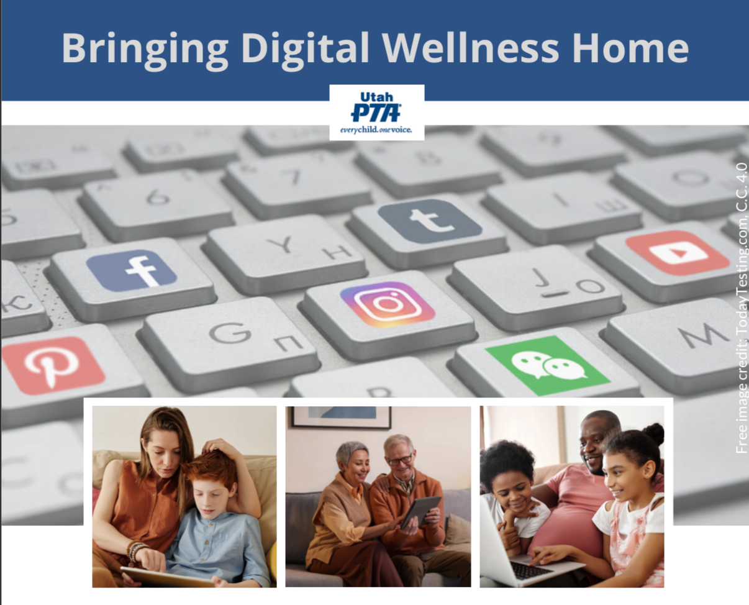
Note: All material in this series is for educational and informational purposes only, and is not meant to be exhaustive or used as a replacement for professional health support.
Notes:
Note: All material in this series is for educational and informational purposes only, and is not meant to be exhaustive or used as a replacement for professional health support. Also, the presentation is best viewed in slideshow format, as some of the slides are animated. That said, these notes are here for your benefit.
NOTE: Portions of this work first appeared in or are derived or adapted from the Digital
Wellness Certificate Program. Those portions are Copyright © 2021, Digital Wellness Institute.

Slide 2
Notes:
Welcome to those who are joining us for the first time! You can review past weeks' content
here (Week 1: Start with your Center): https://drive.google.com/drive/u/1/folders/18ZQ-ySDQW7UxXe8L_75UMBKzvKldC_L9
and here (Week 2: Media/Message Literacy):https://drive.google.com/drive/u/1/folders/1927uy5aT0--hTG_Q8Y0-f5Kxfx5k8Cht

Slide 3
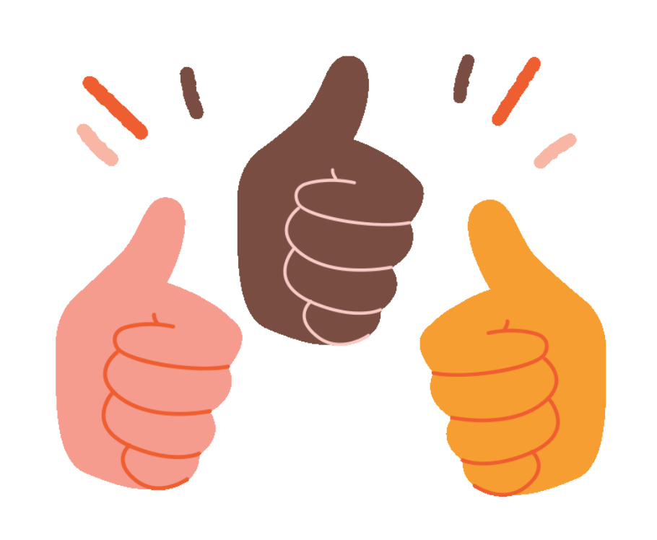
Introspection Activity
Think and Write:
Someone can make my day by _______________
Notes:
It's nice to reflect on what can help brighten our day– and how we might brighten others' days. Keep your list because we revisit it later in the discussion.

Slide 4
Around-the-Zoom share
Share:
Someone can make my day by _______________

Slide 5
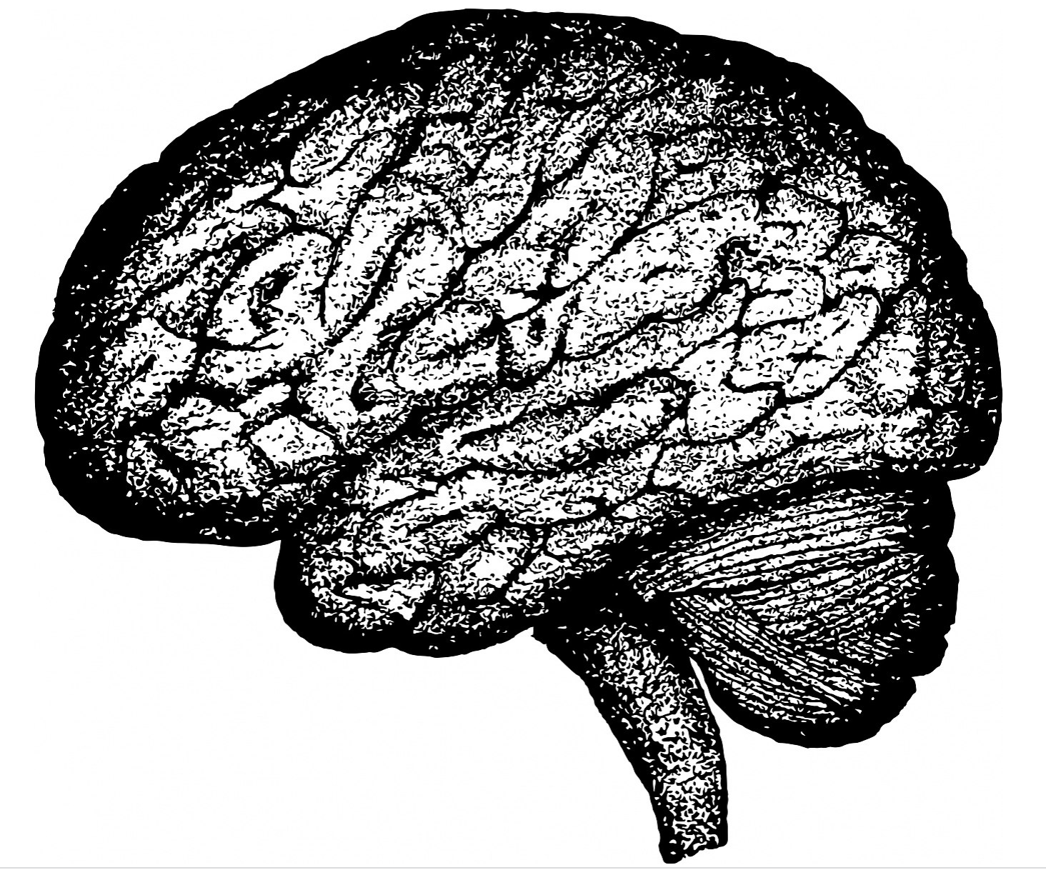
Discussion #3 Mental Wellness

Slide 6
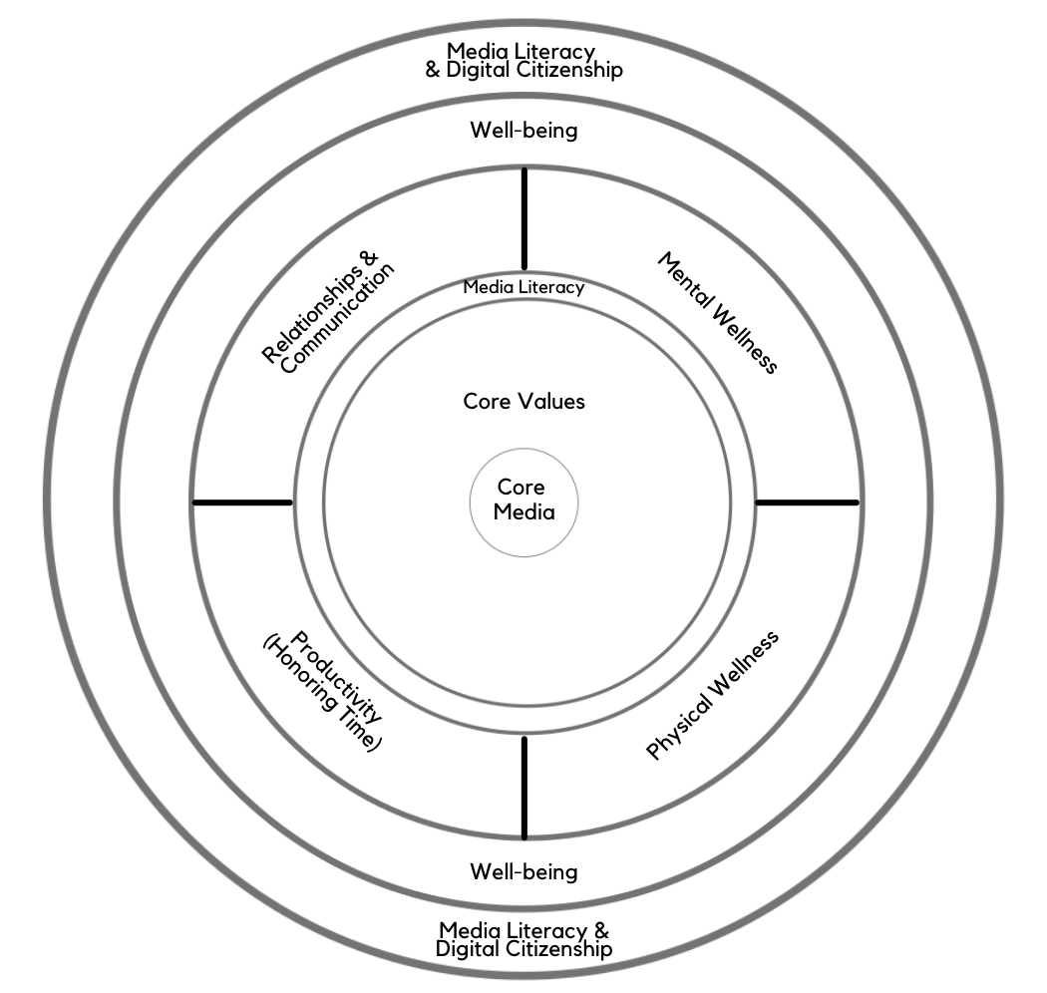
Digital Centeredness Model
Start with Your Center
Media Literacy
Mental Wellness*
Physical Wellness*
Productivity (Honoring time)*
Relationships*
Well-being*
Digital Citizenship* & Media Literacy
Bonus: Social Development Strategy
All of the topics with an asterisk are included in the DWI Digital Wellness self-assessment https://survey.alchemer.com/s3/5504604/b153c792d361
Notes:
As we add a new topic each week, you'll see the red ring grow. Each week's content builds on the previous weeks. For example, when we discussed core media (touchstone media) last week, that was a "Venn diagram" concept that intersected with our first week's content on Starting with Your Center. And last week's basic media literacy tips (Practice the Pause, Pause and Ask Questions) are also mental and emotional literacy practices that we will build on today. Next week, we'll build on what we shared today as we talk about being more aware of what is going on in our bodies. Heart, Mind, Body working together is key to wellness.

Slide 7
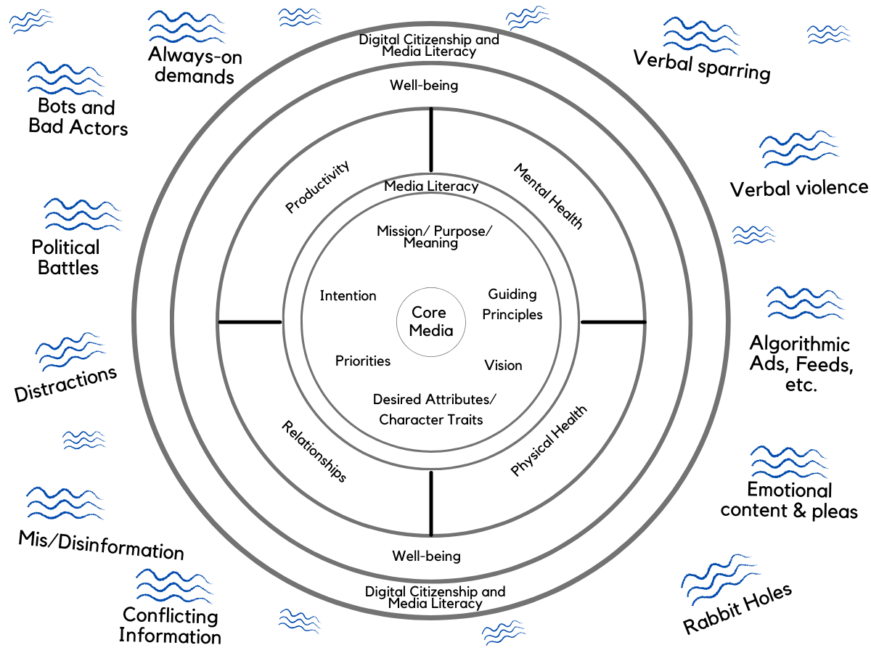
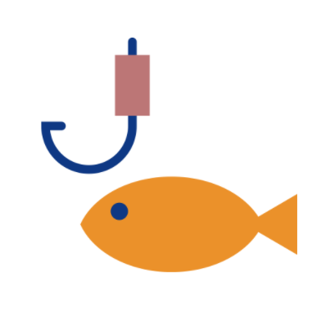
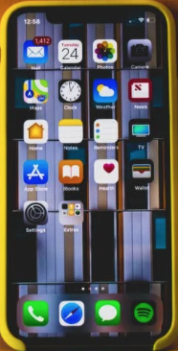
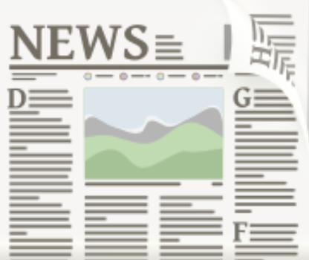
etc.
etc.
The Attention Economy
etc.
etc.
etc.
etc.
Notes:
We all know that we have a lot of a lot swirling around us and, if we have devices, coming at us. But even if we were to have excellent filters and get all our of notifications minimized…even with the best of trying to manage our tools…

Slide 8
Something I meant to mention more specifically is that as we build our capacity to understand what is going on inside of us, we expand our Circle of Control. Most of what is going on "out there" is outside of our control [Circle of Concern].
etc.
etc.
"[I]f fundamentally you don’t focus on what’s going on inside your own head, distraction will always be a problem.”
-Nir Eyal
etc.
etc.
etc.
etc.
Notes:
Wellness is really about doing the internal work. Nir Eyal, and others, teach that the key to "getting ahead of distractions" is primarily an inside job. This is actually a hope-filled reality because if we were dependent on tech companies making all the changes, or politicians, we would be giving over our power to forces outside of our control (that Circle of Concern we talked about in week 1). This series is heavily focused on expanding our Circle of Control.)
https://blog.rescuetime.com/nir-eyal-digital-distraction/
e online. Even those cute pictures you post on social media are part of helping put money in the coffers of big tech companies and advertisers who pay to be put in front of your eyeballs.

Slide 9
"In the attention economy, mindfulness is activism."
~Jay Vidyarthi
"The most powerful technology in…the entire universe is still that greyish lump of jello between your ears."
Notes:
See https://medium.com/mindfulness-and-meditation/in-the-attention-economy-mindfulness-is-activism-4241cc766ac
See also https://www.attentionactivist.com/attention-activist/the-social-dilemma-and-the-victim-mentality

Slide 10
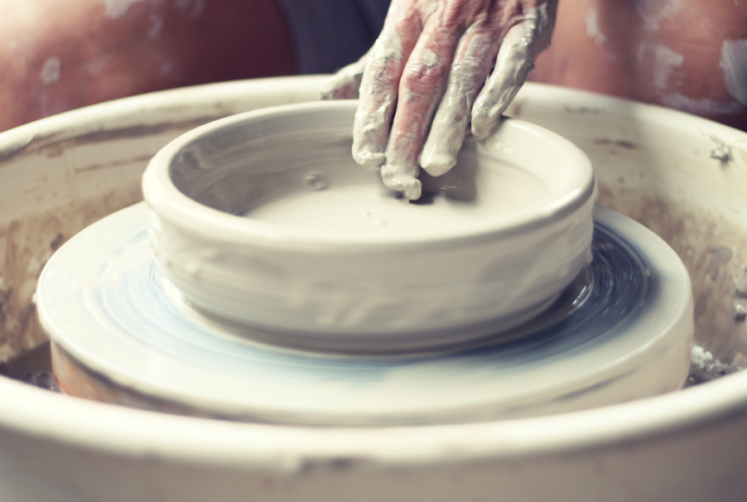
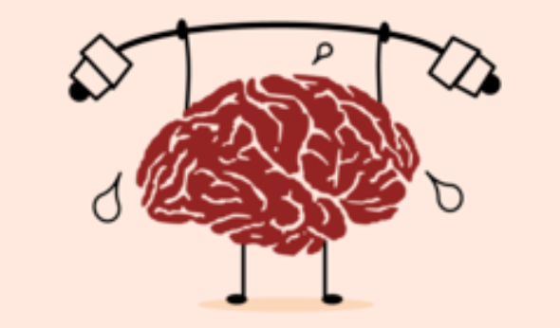
Notes:
I actually like to think of our brains not as jello, but as clay. It used to be believed that brains were basically set in stone (like a cured and fired piece of pottery, immovable) by young adulthood. Now we know about a concept called Brain Plasticity Our brains can continue to learn, to re-learn, to un-learn, to build new pathways…if and as we build awareness and practice new ways of thinking and engaging with ourselves and our devices and each other and the world. You can also think of the brain as a muscle. If we engage our wellness intentionally, we can build more wellness into our brain and nervous system.

Slide 11
Notes:
But it does take effort and intention. Our brains, at their baseline level, don't really want effort. They want the path of least resisstance. It is all too easy to use our phones as distractions – perhaps even in ways that are so habitual that we don't even notice how often we reach for them when in a hard or uncomfortable situation. This is something you could watch for this week…how many times do you pick up or sit down to a device mindlessly?

Slide 12
Understanding & Working with Our Brains
Notes:
Note: All material in this series is for educational and informational purposes only, and is not meant to be exhaustive or used as a replacement for professional health support. Also, the presentation is best viewed in slideshow format, as some of the slides are animated. That said, these notes are here for your benefit.
NOTE: Portions of this work first appeared in or are derived or adapted from the Digital
Wellness Certificate Program. Those portions are Copyright © 2021, Digital Wellness Institute.

Slide 13
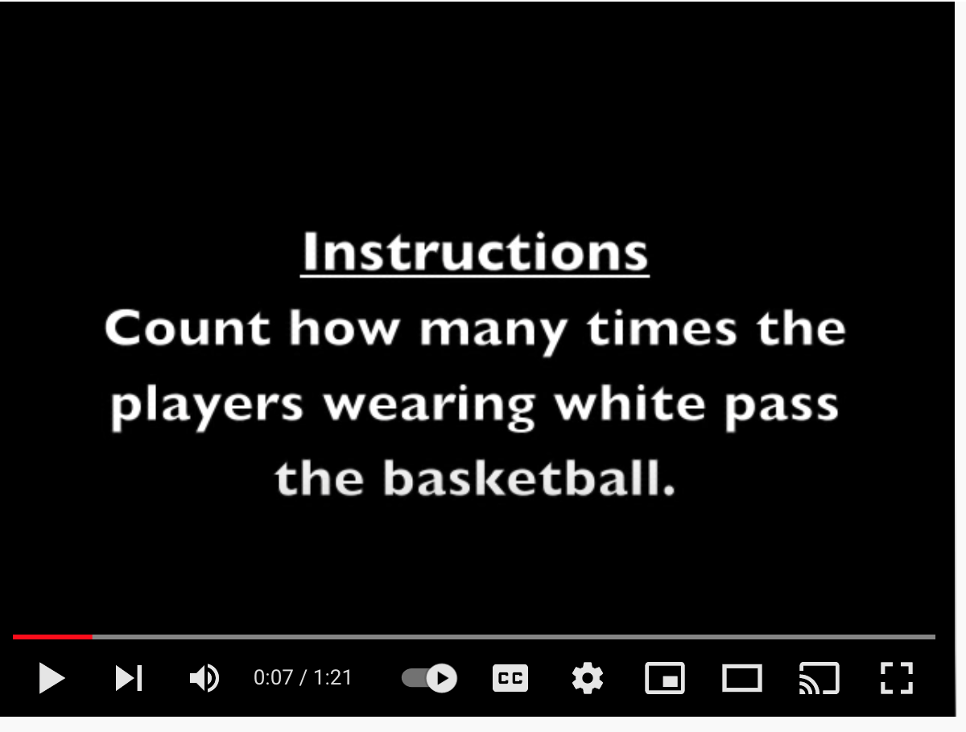
Count-the-passes Activity

Slide 14
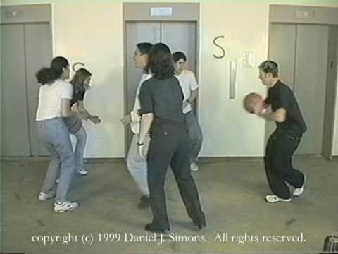
This video was played from the owner's YouTube site: https://youtu.be/vJG698U2Mvo?t=5
and is not included in the recording to protect copyright
Notes:
Dr. Daniel Simon was one of the early researchers who looked at the concept of selective attention (sometimes called inattentional blindness). Our brains really can't focus on two cognitive tasks at onces. Even perceptual tasks are often difficult to do simultaneously, like counting passes while also watching the activity of a gorilla. :) Think about how this shows up in your life - when you think you can double- or multi-task but then upon observation realize that you haven't done any task as well as if you had done it alone with more intention.

Slide 15
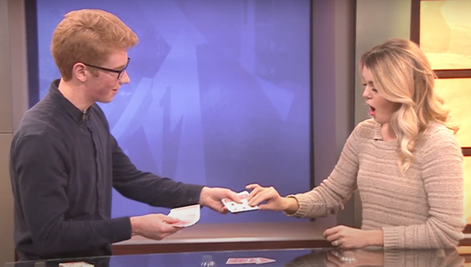
Notes:
Have you ever been doing something, realize you need something from another part of the house or workplace, only to then forget what you went to that other room to find? Our brains are easily distracted. Magic is another example of this reality – the magic of magic depends on the reality of selective attention. (For fun, see the resource folder this week for some magic tricks, and also a video of John explaining selective attention and how it works with a magic trick he performs.)

Slide 16
The "Mere Presence" Phenomenon
“[T]he "mere presence" of a cell phone may be sufficiently distracting to produce diminished attention and deficits in task-performance, especially for tasks with greater attentional and cognitive demands.”
Notes:
Another example of the distractibility of our brains is found in this research – that even the "mere presence" of a phone – just having it on your desk or in your pocket or bag) can reduce your brain's capacity for working memory and fluid intelligence. “Working memory capacity” (WMC) reflects the availability of attentional resources, which serve the “central executive” function of controlling and regulating cognitive processes across domains (Baddeley and Hitch 1974; Miyake and Shah 1999; Engle 2002; Baddeley 2003). “Fluid intelligence” (Gf ) represents the ability to reason and solve novel problems, independent of any contributions from acquired skills and knowledge stored in “crystallized intelligence” (Cattell 1987). Similar to WM, Gf stresses the ability to select, store, and manipulate information in a goal-directed manner. Also similar to WM, Gf is constrained by the availability of attentional resources (e.g., Engle et al. 1999; Halford et al. 2007). Crucially, the limited capacity of these domaingeneral resources dictates that using attentional resources for one cognitive process or task leaves fewer available for other tasks; in other words, occupying cognitive resources reduces available cognitive capacity.
Graphs from
https://repositories.lib.utexas.edu/bitstream/handle/2152/64130/braindrain.pdf?sequence=2:

Slide 17
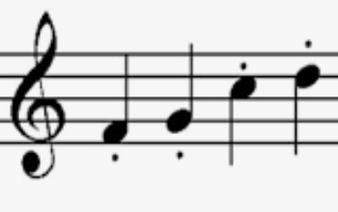
Notes:
Nicholas Carr, author of The Shallows, in an interview from 2008 https://www.theatlantic.com/magazine/archive/2008/07/is-google-making-us-stupid/306868/
If you speak Spanish, this is an interesting video we used in our last series: Marian Rojas-Estapé Video: https://youtu.be/-OmgQEpP7R0

Slide 18
Bruce Friedman (pathologist, faculty of the University of Michigan Medical School, who blogs regularly about the use of computers in medicine)
“I now have almost totally lost the ability to read and absorb a longish article on the web or in print,” he wrote. [In a phone conversation]: His thinking, he said, has taken on a “staccato” quality, reflecting the way he quickly scans short passages of text from many sources online. “I can’t read War and Peace anymore,” he admitted. “I’ve lost the ability to do that. Even a blog post of more than three or four paragraphs is too much to absorb. I skim it.”
"And what the internet seems to be doing is chipping away my capacity for concentration and contemplation. My mind now expects to take in information the way the Net distributes it: in a swiftly moving stream of particles. Once I was a scuba diver in the sea of words. Now I zip along the surface like a guy on a Jet Ski."
Notes:
2 minutes Nicholas Carr, author of The Shallows, in an interview from 2008 https://www.theatlantic.com/magazine/archive/2008/07/is-google-making-us-stupid/306868/
If you speak Spanish, this is an interesting video we used in our last series: Marian Rojas-Estapé Video: https://youtu.be/-OmgQEpP7R0

Slide 19
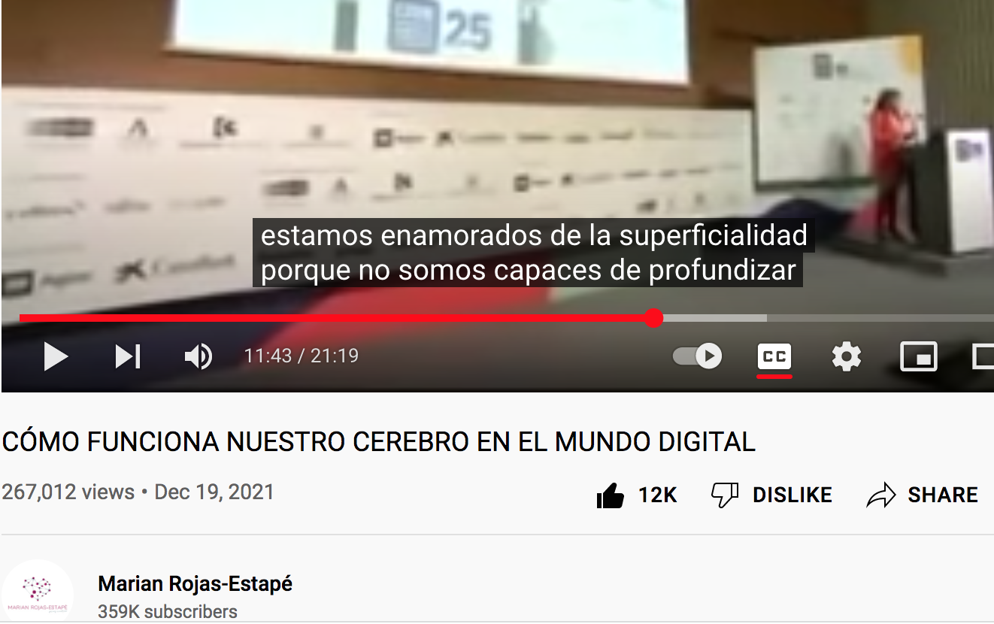
Translation is something along these lines: We are enamored with superficiality (because of digital technologies) because we don't have the capacity to go deep.
(o esperar…"tiempo, tiempo, tiempo")
Notes:
My friend from Argentina shared this on her wall and I found myself wishing we could all watch it together. If you know Spanish, I would recommend a listen. What stands out to you? I had many mic-drop moments while listening. She doesn't know about the broader language that Dr. McGonigal covers in her book (that the stress response isn't limited to hormones like cortisol – something we'll discuss next week), but she has such a broad and clear understanding of how technology is impacting both children and adults. How our brain functions in the digital world: https://youtu.be/-OmgQEpP7R0 More about Marian Rojas-Estapé here (ah, her website is also just Marian Rojas, which may explain why I referred to her by that last name only): https://marianrojas.com/

Slide 20
The previous quotes talk as though it's a done deal – that our brains are irreversibly damaged because of technology, but remember, brains are plastic. Change takes persistence and intention and time, but we can build more capacity to think deeply, to concentrate, to contemplate.

Slide 21
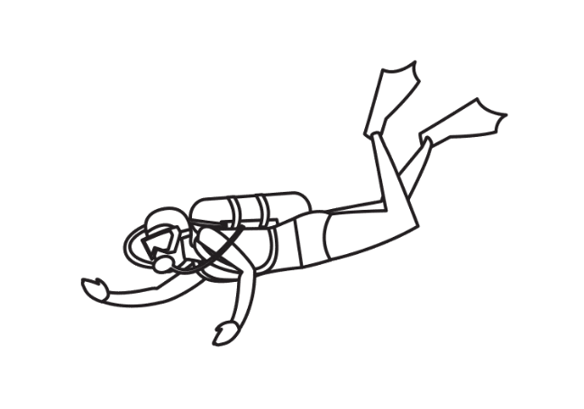
Tip #1:
Be a mental scuba diver
Notes:
Note: All material in this series is for educational and informational purposes only, and is not meant to be exhaustive or used as a replacement for professional health support. Also, the presentation is best viewed in slideshow format, as some of the slides are animated. That said, these notes are here for your benefit.
NOTE: Portions of this work first appeared in or are derived or adapted from the Digital
Wellness Certificate Program. Those portions are Copyright © 2021, Digital Wellness Institute.

Slide 22
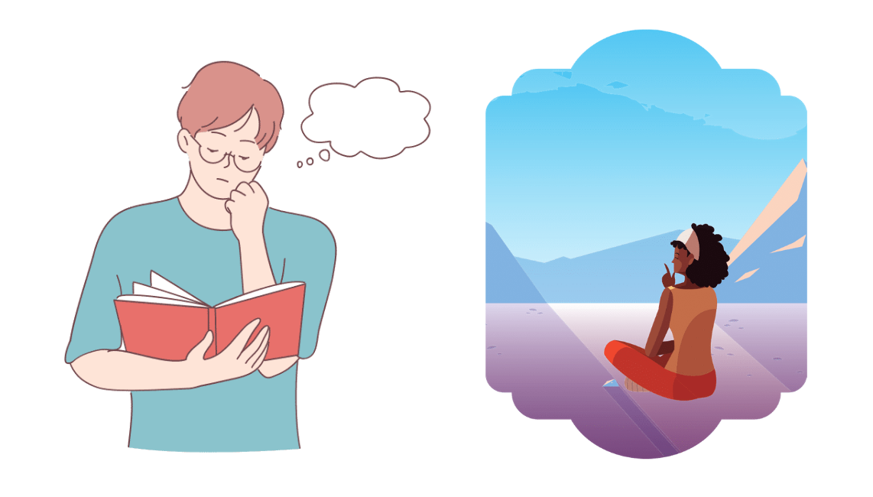
i.e., Make time to practice
concentration and contemplation
Notes:
23 minutes

Slide 23
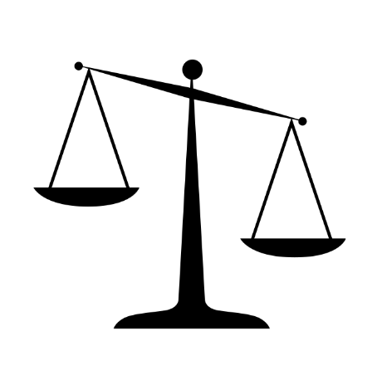
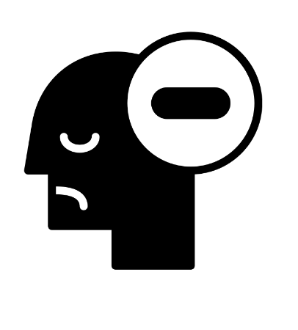
Negativity Bias
The brain's tendency to be drawn to negatives more easily than positives
The brain's tendency to fixate, replay, dwell on the negative more than the positive
Notes:
https://www.verywellmind.com/negative-bias-4589618
https://www.healthline.com/health/negativity-bias
https://www.berkeleywellbeing.com/negativity.html
https://www.ncbi.nlm.nih.gov/pmc/articles/PMC3652533/
https://www.psycom.net/negativity-bias

Slide 24
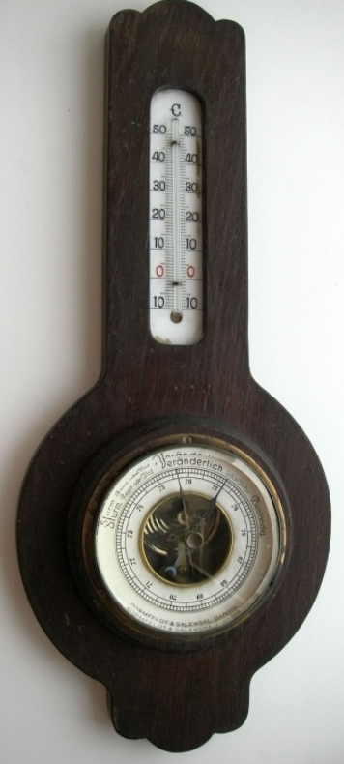
e.g., Impact of negative news in the morning
Three minutes of negative news
can decrease positivity by 27%
-Research by Shawn Achor and Michelle Gielan
https://hbr.org/2015/09/consuming-negative-news-can-make-you-less-effective-at-work
Notes:
The negativity bias can be fed by the fact that algorithms tend to favor negative stories because they grab and keep attention more readily (and people tend to share or comment more on negative stories). So besides our brain's negativity bias, we also are surrounded by a lot of negative content and energy. There's a lot to be aware of here…but awareness is a large part of the battle in wellness work. So keep your eyes out on how the media use negative messaging … and keep an eye inside on your baseline internal weather.

Slide 25
Tip #2:
Look at your list from our intro activity
and turn it inward
*I* can make my day by _______________
Notes:
There are many, many things we can do to bring more positivity into our lives. One concept is to take the list you made (things you might wish others may do) and find a way to turn it into something you can do for yourself. The idea of being intentional about bringing what helps you into your life is sometimes called self-parenting. It's wonderful when others reach out and do nice things, but we also don't have to wait for others to bring more positive energy into our lives.

Slide 26
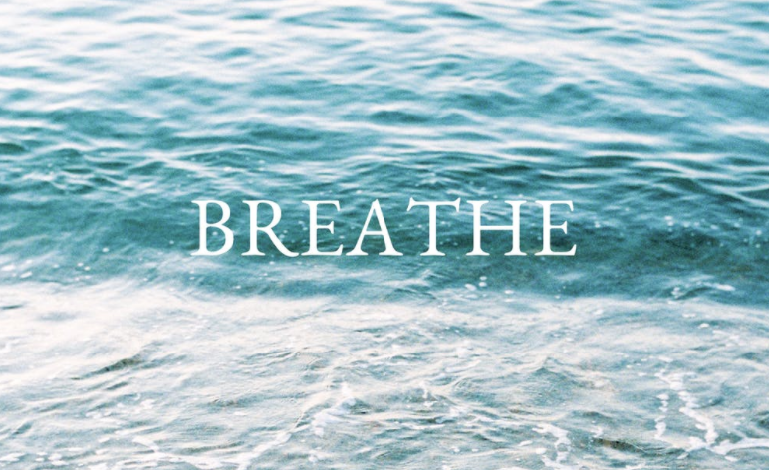
~~~ Breath Break ~~~
**See a variety of resources around simple breath exercises in the notes section of this slide
Notes:
A simple tip for mental wellness is to stop periodically and plug into the breath. It's so simple and yet so easy to forget to do! Sometimes I will listen to an end-of-day meditation where the guide says something like, "This may be the first time you have paid attention to your breath" –and often, she is right! We shared the notion of a 4-6 breath today (breathe in for 4, exhale for 6 – some experts indicate that a longer exhale has the capacity to help slow down our nervous systems and impact heart rate variability (a physical marker of resilience). But there are many different ways to engage in breath exercises. Here are some resources below:
Some of BYU Biofeedback favorite meditations: https://www.youtube.com/playlist?list=PL53WYGVlby86zo0A71SQxH5oo4bJu9uNR
BYU Biofeedback Relaxation recordings: https://caps.byu.edu/relaxation-recordings
BYU Biofeedback Paced Breathing recordings: https://caps.byu.edu/paced-breathing
More about Biofeedback: https://caps.byu.edu/about-biofeedback
Breath and its impact on Heart Rate Variability: https://www.frontiersin.org/articles/10.3389/fpsyg.2021.624254/
Guided weekly meditation class via the University of Utah (for pay): https://app.healthcare.utah.edu/peakCourseRegistration/byCourse?primaryId=854
A video with a physiotherapist about remote work wellness (page also includes some breath and body awareness ideas): https://resiliencei.com/2020/04/remote-work-rhythm/
How Breath-Control Can Change Your Life: A Systematic Review on Psycho-Physiological Correlates of Slow Breathing https://www.ncbi.nlm.nih.gov/pmc/articles/PMC6137615/
https://www.scientificamerican.com/article/proper-breathing-brings-better-health/
Wapner, J., & Wapner, J. (2020, November 16). Vision and Breathing May Be the Secrets to Surviving 2020. Scientific American. https://www.scientificamerican.com/article/vision-and-breathing-may-be-the-secrets-to-surviving-2020/

Slide 27
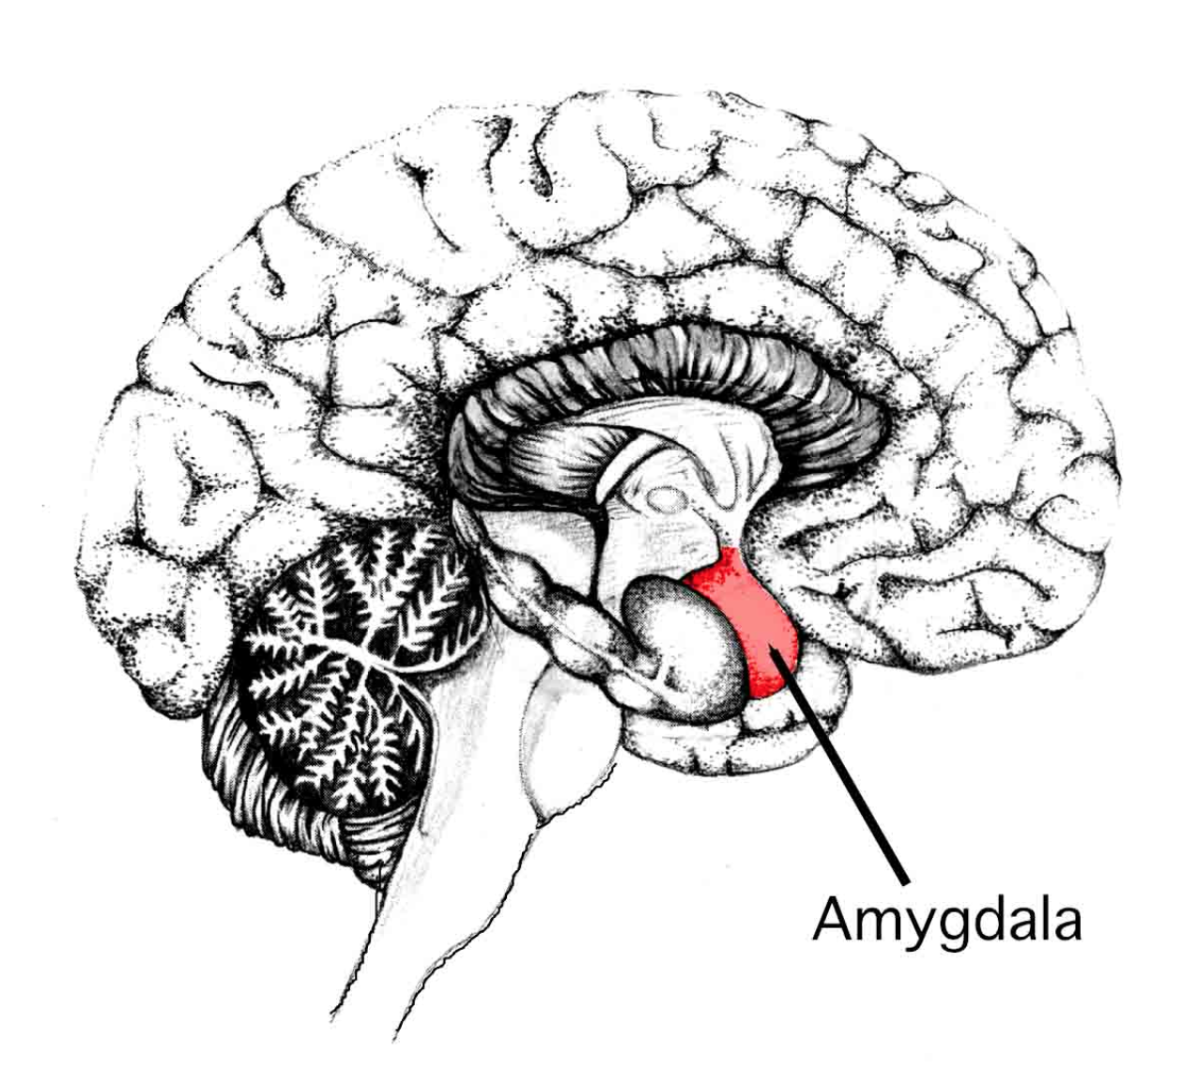
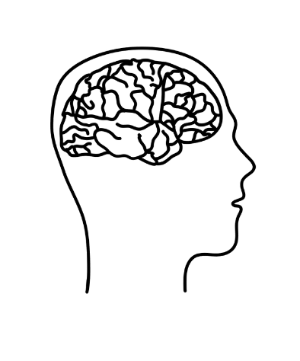
REACTOR
ACTOR
Notes:
When we talk about Digital Wellness, one simple way to summarize it is as a practice of being an actor, not a reactor. Our bodies and brains and nervous systems are complex, so the explanations in this and following slides are simplistic, but also reflect how these notions are discussed in many circles. If we were to boil it down simply, when we are in "Reactor" mode, we are acting from a part of our brain that is believed to be more primitive, more tied to sheer survival, and not involving conscious thought. It's connected to systems that produce chemicals that feed the "fight, flight, or freeze" response (chemicals such as cortisol and adrenaline). In a short-term situation, like having a deadline, the activation of these systems can give us short spurts of energy and ability to focus to meet that deadline. But in reality, it's far too common to spend unnecessary time in this state and that can be harmful to personal wellness, as well as relational and societal wellness. On the other hand, if we are using what some call our "thinking mind" – associated with the prefrontal cortex and other regions and processes involved in conscious, intentional, self-aware thought, we are building our brain's capacity to be Actors. The more we practice this, the more readily we can recognize when we are moving into Reactor mode – and we can even build deeper neural and biochemical pathways that can help being an Actor more natural for our body. Our baseline state is to be Reactors, but our brains are plastic. We can retrain and rewire and develop better habits with effort and practice and awareness.

Slide 28
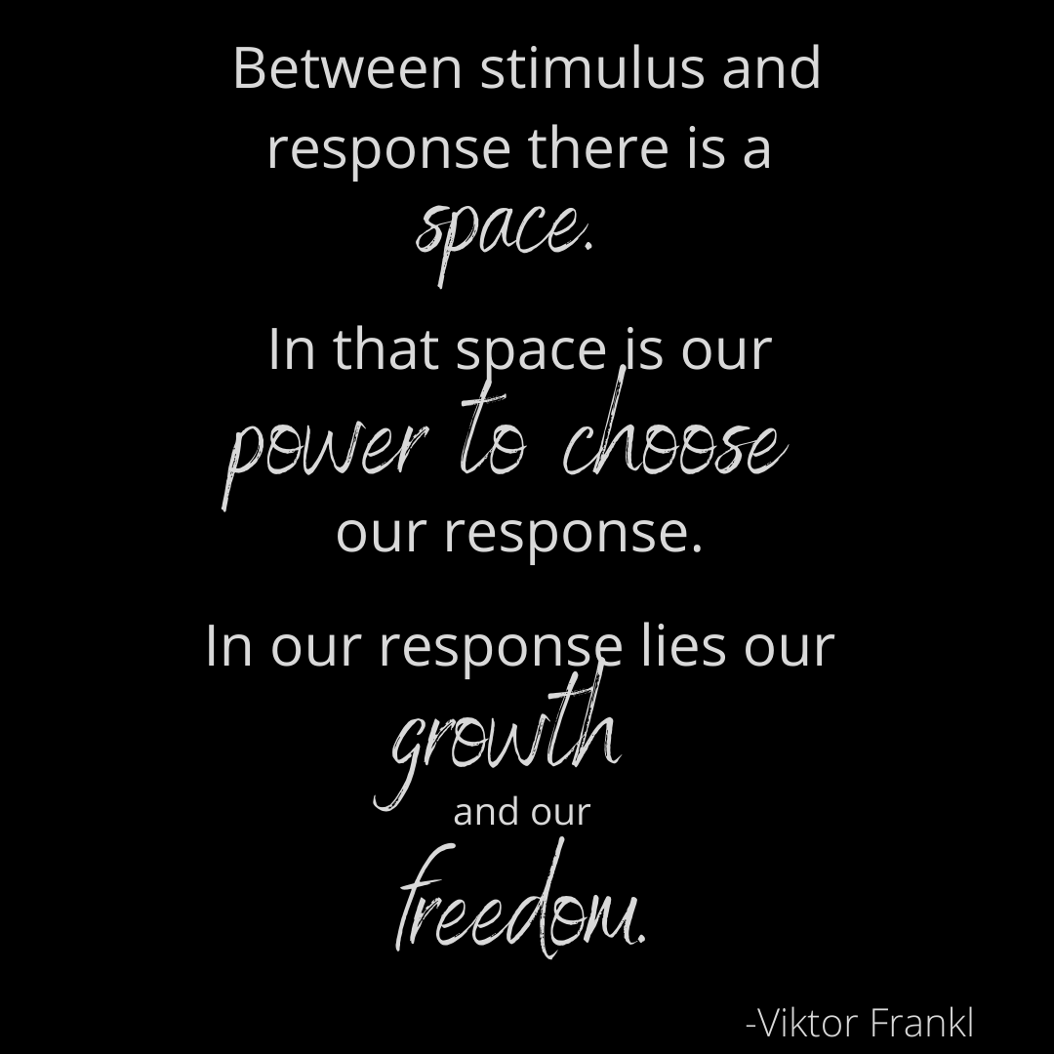
Stimulus
Response
Notes:
When we talked about Media Literacy last week, and shared this quote from Viktor Frankl (who was a prisoner of war in WWII), we were essentially talking about the power of building our prefrontal cortex and other structures and processes connected to conscious, intentional, self-aware thought.

Slide 29
Stimulus
Response
Notes:
Media Literacy is most simply described as helping us be active consumers, processors, and creators of media and messages. We like using this Viktor Frankl quote to consider the power of what happens between contact with media and what we choose to do as a result. Not only is freedom found in intentional responses, it is also found in intentional processing of information. Many media messages are formulated to influence us to skip that space and move right to action. This is where we can reclaim the precious resource of attention.

Slide 30
Stimulus
REaction
REACTOR
Notes:
Media Literacy is most simply described as helping us be active consumers, processors, and creators of media and messages. We like using this Viktor Frankl quote to consider the power of what happens between contact with media and what we choose to do as a result. Not only is freedom found in intentional responses, it is also found in intentional processing of information. Many media messages are formulated to influence us to skip that space and move right to action. This is where we can reclaim the precious resource of attention.

Slide 31
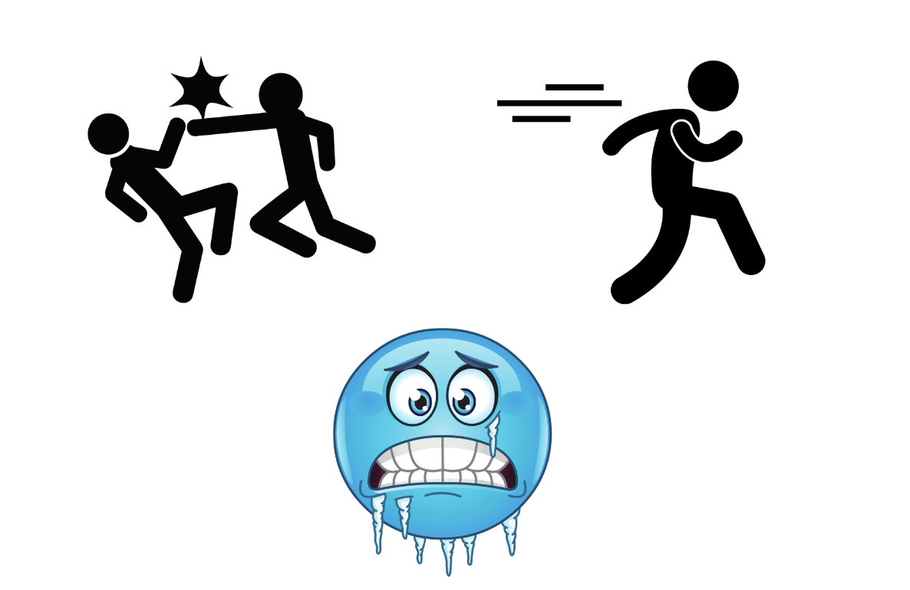
REACTOR
Notes:
When we talk about Digital Wellness, one simple way to summarize it is as a practice of being an actor, not a reactor. If we were to boil it down simply, when we are in "Reactor" mode, we are acting from a part of our brain that is believed to be more primitive, more tied to sheer survival, and not involving conscious thought. It's connected to systems that produce chemicals that feed the "fight, flight, or freeze" response (chemicals such as cortisol and adrenaline). In a short-term situation, like having a deadline, the activation of these systems can give us short spurts of energy and ability to focus to meet that deadline. But in reality, it's far too common to spend unnecessary time in this state and that can be harmful to personal wellness, as well as relational and societal wellness. On the other hand, if we are using what some call our "thinking mind" – associated with the prefrontal cortex and other regions and processes involved in conscious, intentional, self-aware thought, we are building our brain's capacity to be Actors. The more we practice this, the more readily we can recognize when we are moving into Reactor mode – and we can even build deeper neural and biochemical pathways that can help being an Actor more natural for our body. Our baseline state is to be Reactors, but our brains are plastic. We can retrain and rewire and develop better habits with effort and practice and awareness.

Slide 32
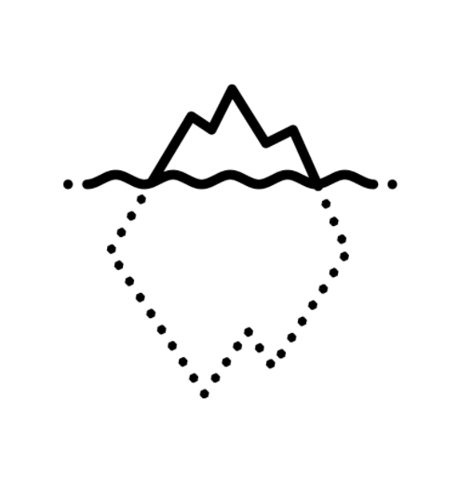
Notes:
One of the challenges of moving from Reactor to Actor mode is that a lot of what happens in our primitive "Fight, Flight, Freeze" or other survival responses is under the level of consciousness. Many patterns we experience have been building since childhood. Have you ever had a high-intensity, negative reaction to something that doesn't match the situation at hand, and yet appears with great force? We have file cabinets, if you will, in our nervous systems where a simple situation can suddenly tip over the inner file cabinet and leave us feeling flooded, in serious danger, or other emotions. This is what can happen in severe cases of PTSD, but it can also happen even if someone has not experienced a significant traumatic event. It can happen as little difficulties build over time and have not been noticed or addressed – until they want to be NOTICED.

Slide 33
Prefrontal cortex
Attention
Concentration
Abstract reasoning
Problem-solving
Impulse control
Social connection
ACTOR
"The center of our will"
"Use it or lose it"
-Dr. Marian Rojas-Estapé
Notes:
Here are some of the ways we can know if we are building our prefrontal cortex and other structures and systems that foster conscious living.
When we talk about Digital Wellness, one simple way to summarize it is as a practice of being an actor, not a reactor. Our bodies and brains and nervous systems are complex, so the explanations in this and following slides are simplistic, but also reflect how these notions are discussed in many circles. If we were to boil it down simply, when we are in "Reactor" mode, we are acting from a part of our brain that is believed to be more primitive, more tied to sheer survival, and not involving conscious thought. It's connected to systems that produce chemicals that feed the "fight, flight, or freeze" response (chemicals such as cortisol and adrenaline). In a short-term situation, like having a deadline, the activation of these systems can give us short spurts of energy and ability to focus to meet that deadline. But in reality, it's far too common to spend unnecessary time in this state and that can be harmful to personal wellness, as well as relational and societal wellness. On the other hand, if we are using what some call our "thinking mind" – associated with the prefrontal cortex and other regions and processes involved in conscious, intentional, self-aware thought, we are building our brain's capacity to be Actors. The more we practice this, the more readily we can recognize when we are moving into Reactor mode – and we can even build deeper neural and biochemical pathways that can help being an Actor more natural for our body. Our baseline state is to be Reactors, but our brains are plastic. We can retrain and rewire and develop better habits with effort and practice and awareness.

Slide 34
Notes:
What is exciting is that as we practice more self-awareness, we can increase our capacity to see more of what was once sub- or unconscious, and gradually take more control of driving our bus vs. having nervous system and biochemical reactions in our bodies drive the bus.

Slide 35
"My prefrontal cortex is the connection to my heart"
Notes:
In a recent conversation about a conversation that did not go well, my husband and I practiced a pause and looked at the difference of how we each act as individuals – and how our interactions go as a couple – depending on whether we are in our Reactor state or being intentional about using our prefrontal cortex and structures and systems that foster self-awareness, consciousness, and intention. As we had this conversation, my husband spoke these profound words, which I think are true for us all. We can't be the people we truly want to be if we are in Reactor mode. But if and as we practice what it takes to be an Actor, we can be more in line with who we really are and who we really want to be.

Slide 36
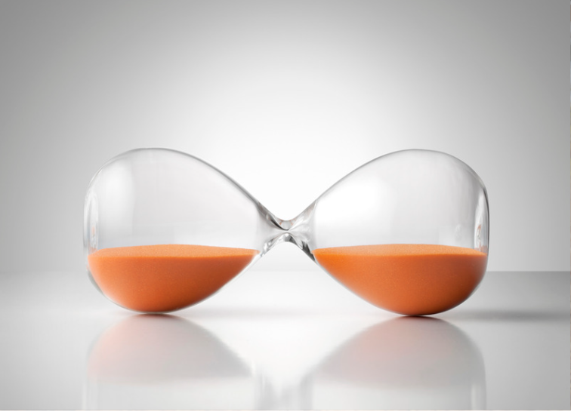
"Practice the Pause"
Message/Input
"Tiempo,
Tiempo,
Tiempo."
Dr. Marian Rojas-Estapé
Notes:
To us, Media Literacy at its simplest level is about "Practicing the Pause." Content often has "hooks" that seek to grab and keep our attention (often by stirring up emotion or a sense of urgency). By practicing the pause, we give our nervous systems a chance to slow down so we can think. I loved when the cadence of Dr. Rojas-Estapé's presentation changed as she talked about how we often have a hard time just slowing down, waiting, and taking "tiempo, tiempo, tiempo." Time.

Slide 37
Practice the Pause: Ask Questions
Message/Input
WHO
WHAT
WHERE
WHEN
WHY
HOW
Notes:
Last week, we paired the idea of "practicing the pause" with asking simple questions to analyze the media we come in contact with: Who, What, Where, When, Why and How. Today we will add a question, and another simple tip to pair with "practicing the pause."

Slide 38
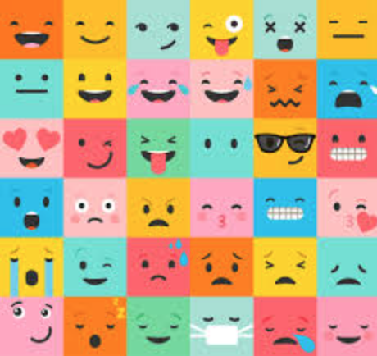
"How do I feel?"
Message/Input
Notes:
Once we have looked at the media message, we can look inward at what is going on inside of us in our emotions and thoughts. We can stop and ask, "How am I feeling after engaging with this content/message/interaction/conversation?" "What emotions are being brought to the forefront with this input?" "What thoughts start to swim in my head when I engage with this input?" etc.

Slide 39
Notes:
When we "practice the pause" and stop and ask questions of ANY sort, we are practicing Actor behavior. We are building the parts and processes of our brain that can help us be more intentional, more aware, more conscious, more deliberate – more well.

Slide 40
"[M]edia algorithms are driven by engagement, not reality. [Therefore] a crucial part of [living in an algorithm-driven world] is evaluating not [just] media, but ourselves.
[We] should be more aware of [our] emotional responses to the media."
-Carrie Rogers-Whitehead
Notes:
This is from a media literacy expert who is also exploring how the Who, What, When, Where, Why, and How questions can be expanded considering the impact of algorithms on our digital world. It is noteworthy that in this new book about to be published, she extends her discussion on media literacy to emotional literacy as well – exactly what this module is about.
Advocating Digital Citizenship
Resources for the Library and Classroom
by Carrie Rogers-Whitehead, Amy O. Milstead, and Lindi Farris-Hill
August 2022, 177pp, 6 1/8x9 1/4
1 volume, Libraries Unlimited

Slide 41
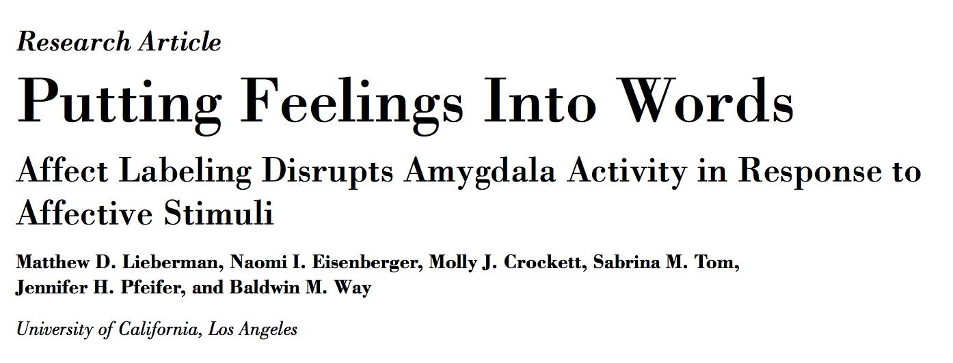
https://www.scn.ucla.edu/pdf/AL(2007).pdf
See also research like the following to discover more language around this concept of self-observation and "wisdom-related judgment": https://www.ncbi.nlm.nih.gov/pmc/articles/PMC4824766/
Notes:
When we "practice the pause" and stop and ask questions, and stop to name emotions we are feeling, this can disrupt the processes that are centered in the amygdala – research that supports the idea that simple activities can help move us from Reactor to more of an Actor state.
See also research like the following to discover more language around this concept of self-observation and "wisdom-related judgment": https://www.ncbi.nlm.nih.gov/pmc/articles/PMC4824766/

Slide 42
"What is going on in my thoughts right now?"
Message/Input
You are not your thoughts. You are the one having the thoughts!
Notes:
We can first stop and ask, "How does this content/message/interaction make me feel?" "What emotions are being brought to the forefront with this input?" "What thoughts start to swim in my head when I engage with this input?" etc.
Deanna mentioned this research that is relevant to this content, and to other comments that were made. https://www.scn.ucla.edu/pdf/AL(2007).pdf

Slide 43
Important "fake news" to identify!
Notes:
We can first stop and ask, "How does this content/message/interaction make me feel?" "What emotions are being brought to the forefront with this input?" "What thoughts start to swim in my head when I engage with this input?" etc.
Deanna mentioned this research that is relevant to this content, and to other comments that were made. https://www.scn.ucla.edu/pdf/AL(2007).pdf

Slide 44
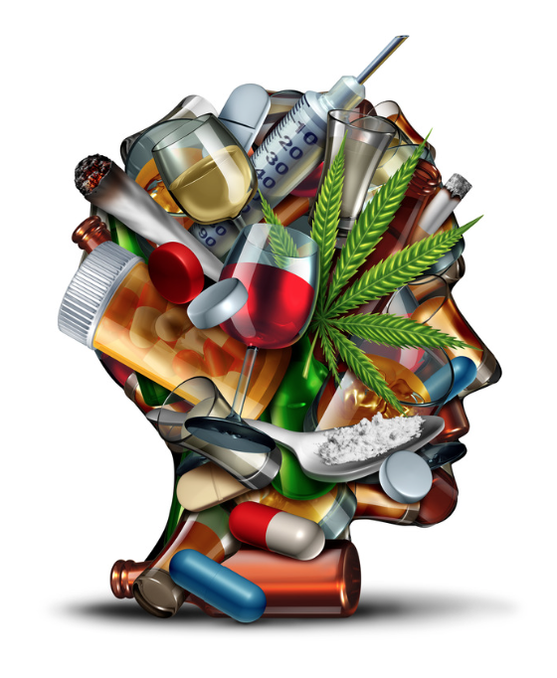
A key to addiction recovery is becoming more aware of thoughts, beliefs, stories, attitudes
There is much that can be learned from the addiction recovery world about wellness, even if one does not have an addiction. What addicts do to find recovery is really what it means to live an intentional, balanced, healthy life. Recovery is about much more than stopping a behavior, but about learning to live with wellness in all parts of life.
Notes:
There is much that can be learned from the addiction recovery world about wellness, even if one does not have an addiction. What addicts do to find recovery is really what it means to live an intentional, balanced, healthy life. Recovery is about much more than stopping a behavior, but about learning to live with wellness in all parts of life.

Slide 45
Practice the Pause: "Point and Name"emotions
Message/Input
Notes:
When we practice the pause, we can stop and ask questions AND we can "Point and Name" the emotions and thoughts we are experiencing. This is sometimes harder to do than it sounds. Many experts talk about how people often struggle to find nuanced labels for emotions. (Hooks want to essentially bypass reason and logic.)

Slide 46
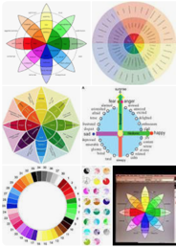
Practice the Pause: "Point and Name"
Note: There are resources out there that can help us expand our vocabulary and build our capacity to name our emotions with precision and intention. Search for emotion wheels or charts, or see resources like: https://www.berkeleywellbeing.com/list-of-emotions.html
Message/Input
Notes:
When we practice the pause, we can stop and ask questions AND we can "Point and Name" the emotions and thoughts we are experiencing. This is sometimes harder to do than it sounds. Many experts talk about how people often struggle to find nuanced labels for emotions. (Hooks want to essentially bypass reason and logic.)

Slide 47
Practice the Pause: "Point and Name" thoughts
Message/Input
Notes:
When we practice the pause, we can stop and ask questions AND we can "Point and Name" the emotions and thoughts we are experiencing. This is sometimes harder to do than it sounds. Many experts talk about how people often struggle to find nuanced labels for emotions. (Hooks want to essentially bypass reason and logic.)

Slide 48
Headline-itis Activity: Introspection
Notes:
Go to your go-to resource for news. Look at the headline and then identify what you are feeling as a result. We kept this activity very simple, but you could spend several minutes on the front page of a news channel and then identify your overall feelings, or feelings related to different stories. What thoughts comes to mind? (Be honest – often we have a flood of thoughts that may sometimes even be just under conscious thought but still identifiable if we "practice the pause" and try to "point and name" what is going on inside us.

Slide 49
Around-the-Zoom share
Share:
After reading the headline I feel: _______________
Notes:
We didn't invite people to share their thoughts because, well, sometimes the thoughts we have aren't really what we'd want to share in a public forum. That said, it is good to have someone to be accountable to, a safe friend to be honest with, if you really want to get serious about doing some inner work about thoughts, beliefs, attitudes, inner narratives, etc. A therapist, a close friend, a person who is also working intentionally on self-improvement can be a great benefit for this hero's journey of looking more deeply at patterns of thoughts and beliefs that may be impacting personal wellness and relationships.

Slide 50
Thank you for taking 2-3 minutes to fill out the feedback & reflection form
https://forms.gle/EeReWvpc9Q6UdT3w9
Notes:
https://forms.gle/w4oWs2NrVqG9ia378

Slide 51
We wish you well.

Slide 52
Bonus Materials

Slide 53
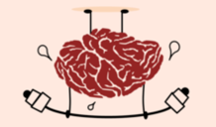
BONUS
A few more examples of mental wellness practices (which show the mind-body connection…a preview for next week)
Notes:
Mental wellness in a digital world may feel like work, but in the end, it is the easier path to be aware! It is not a pleasant thing to be living with someone else's intentions driving your bus through media marketing, viral videos, emotionally-charged discussion or content, mis/disinformation, etc.

Slide 54
Actually, first, we invite you to
write your favorite mental wellness activities.
You know yourself best!
Notes:
Mental wellness in a digital world may feel like work, but in the end, it is the easier path to be aware! It is not a pleasant thing to be living with someone else's intentions driving your bus through media marketing, viral videos, emotionally-charged discussion or content, mis/disinformation, etc.

Slide 55
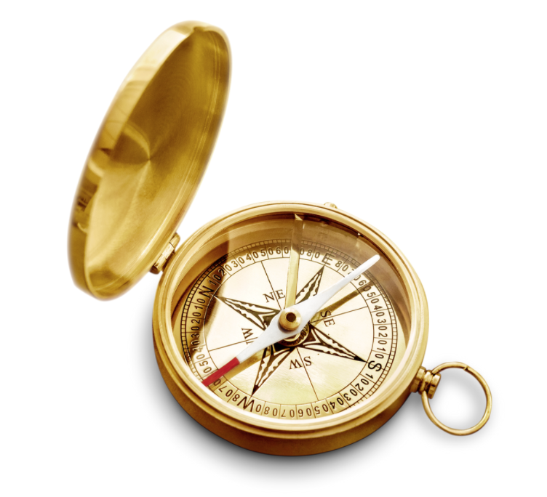
Remember your Center!
You can take a few minutes to reflect or write more about your centering values. Any kind of "practice the pause" activity – all the more so one that includes writing – can help build more awareness and intention.
Notes:
pointing back to the first week's invitation, to write about your values: https://drive.google.com/drive/u/1/folders/1J0LOfCIfJxaJqTk3XB2icQgSfoQYIy1z

Slide 56
Take a nature break
Notes:
pointing back to the first week's invitation, to write about your values: https://drive.google.com/drive/u/1/folders/1J0LOfCIfJxaJqTk3XB2icQgSfoQYIy1z

Slide 57
We can use this acronym when
looking at media – or our thoughts!
Is it TRUE?
Is it HELPFUL?
Is it INSPIRING?
Is it NECESSARY?
Is it KIND?
Notes:
This slide was moved up from a later position in the slide deck (not in the original recording but was in place further in the slide deck) because it relates so well to the idea of looking at our thoughts. This acronym was shared in the Media Literacy module and is also relevant to Digital Citizenship, which we explore in week 8.
Is it true? It is not uncommon for thoughts and beliefs we carry to not be true. At the very least, often we don't know that they are true. Often we have narratives going on that influence how we think, feel, and act. Asking this one question, and then following up with, "Do I know for a fact that this is true?" [see Byron Katie's work] is a powerful exercise. Acting in and on *actual* truth fosters integrity, essential to wellness. Is is helpful? What is the benefit of this thought? If I think it, am I helping myself be well? Am I being honest about what is and isn't helpful? Is it inspiring? Does this build me up or tear me down? Does it leave me wanting to tear others down, if only in my own mind? Is it necessary? It's easy to respond on impulse or on autopilot. Practicing the pause, surfing the thought, engaging the body – there are ways to get out of an unnecessary hamster wheel in the head. Is it kind? Is this response fostering care for self and others? Before speaking to ourselves or others, we can ask this question. (Note: Be alert to false ideas of kindness that can keep us from seeing and speaking truth when needed. But hard truth will hold more power when spoken from a centered place, not from a place of activated emotion. This is where good support friends who get the need to process emotions with intention to go back to center can be so helpful.)

Slide 58
…or Write about how you are feeling
…or Write about what you are thinking
…or call a friend to help you re-center
Notes:
Writing is such a powerful tool. And so is "name it to tame it" with a friend. (As a note of caution: Be careful about using friend calls just to vent. Share and name what is happening, but use that time to also practice recentering, reframing, naming, breathing. It is helpful to call someone who is working on similar growth processes.)

Slide 59
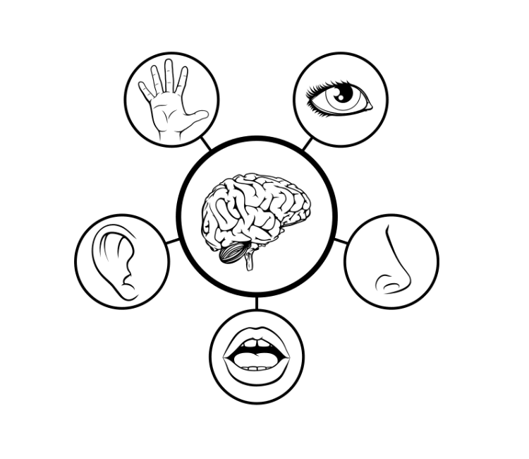
… or Use Your Senses to Reground
(adapt as necessary)
5-See
4-Feel
3-Hear
2-Smell
1-Taste
(or one good thing about yourself)
Notes:
This is a grounding technique recommended by many therapists for children and adults alike. Name 5 things you see, 4 things you feel, 3 things you hear, 2 things you smell, 1 thing you taste (or like to smell or taste). Sometimes the order is switched up a bit, and I've also seen the last bullet be "name a strength you see in yourself" or something like that if tapping into taste is hard to do at the moment.
p.s. In the recording, I said "touch" not "taste." I am sorry if that was distracting! You'll also note that I kept the part of the recording where I got a phone call through my computer during the gathering. That was surely distracting, but it will be a great springboard for some of the things we'll be talking about in the Productivity/Honoring Time module.

Slide 60
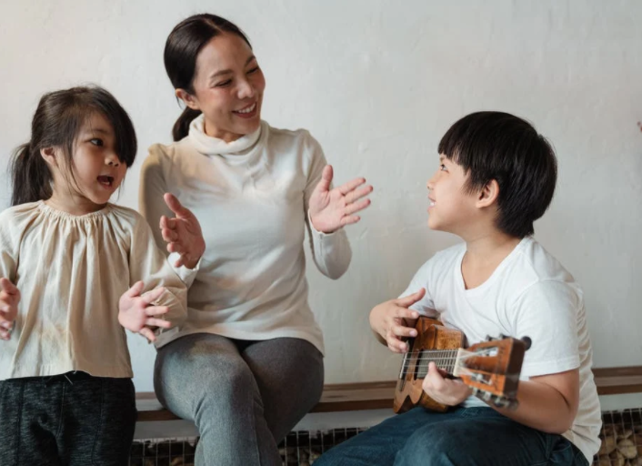
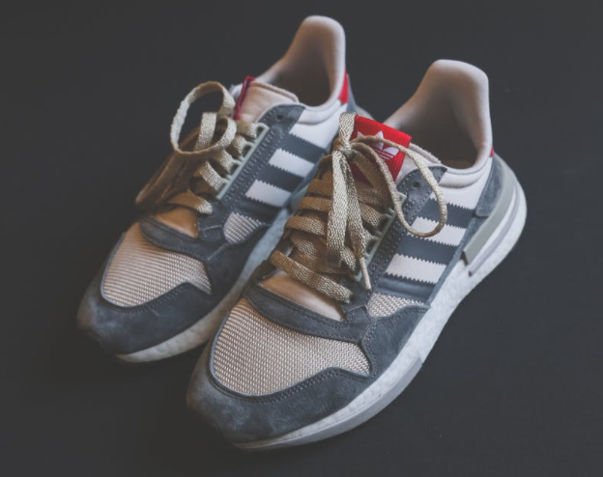
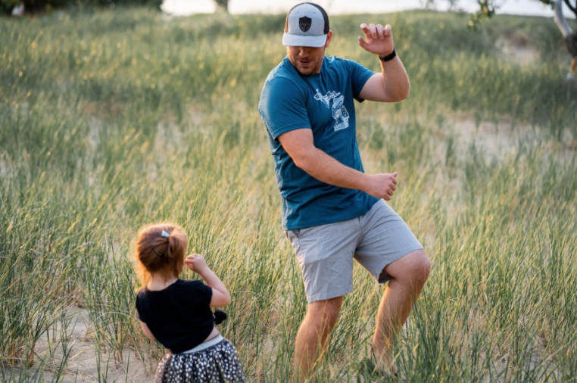
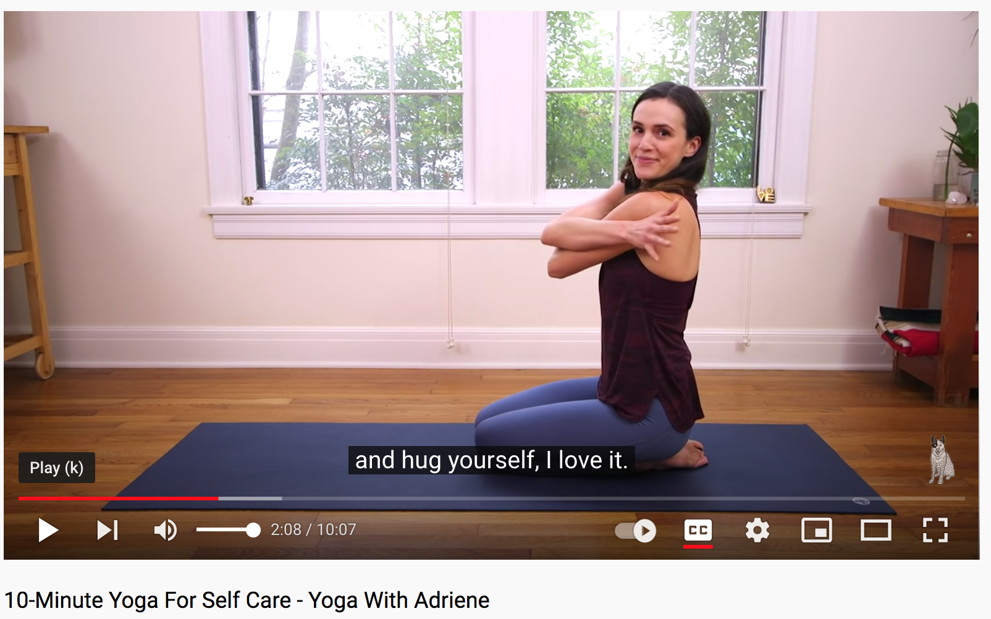
… or Dance…or Sing…or Walk…or Run, or…
Hug yourself!
“Less story,
more body.”
-Jackson McKenzie
Notes:
When we do actual movement (rather than only engaging our eyes with someone else or something else moving on a screen), that can be a great way to reset the brain. We all know this at some level, but it still can be hard to remember when we are in the thick of a hamster-wheel moment, a high-activation moment, a high-emotion moment, a high-stress moment. p.s. I've shared a screenshot of my favorite online yoga instructors, Adriene. https://www.youtube.com/user/yogawithadriene

Slide 61
It takes effort, but we can build new grooves, new pathways, new habits, new ”deer tracks.”*
Start small and simple.
*A concept from therapist Craig Berthold. See The Full Cup podcast…but search on his name (vs. the podcast’s) for algorithms’ sake. ☺
Notes:
This concept of "deer tracks" has been incredibly helpful to me. The podcast mentioned is hosted by Craig's daughter, as a way to allow her father to share his 40+ years of experience as a therapist. Another daughter, Julie, is sometimes interviewed. Julie is also a therapist.

Slide 62
Building in Brain Breaks
Notes:
Mental wellness includes finding ways to deliberately choose to give our brains a rest, and about building in activities that nurture resilience. Some of the material here will "Venn diagram" into content in coming weeks. It's all connected!

Slide 63
More on The "Mere Presence" Phenomenon
“[T]he "mere presence" of a cell phone may be sufficiently distracting to produce diminished attention and deficits in task-performance, especially for tasks with greater attentional and cognitive demands.”
Notes:
https://repositories.lib.utexas.edu/bitstream/handle/2152/64130/braindrain.pdf?sequence=2: “Working memory capacity” (WMC) reflects the availability of attentional resources, which serve the “central executive” function of controlling and regulating cognitive processes across domains (Baddeley and Hitch 1974; Miyake and Shah 1999; Engle 2002; Baddeley 2003). “Fluid intelligence” (Gf ) represents the ability to reason and solve novel problems, independent of any contributions from acquired skills and knowledge stored in “crystallized intelligence” (Cattell 1987). Similar to WM, Gf stresses the ability to select, store, and manipulate information in a goal-directed manner. Also similar to WM, Gf is constrained by the availability of attentional resources (e.g., Engle et al. 1999; Halford et al. 2007). Crucially, the limited capacity of these domaingeneral resources dictates that using attentional resources for one cognitive process or task leaves fewer available for other tasks; in other words, occupying cognitive resources reduces available cognitive capacity.

Slide 64
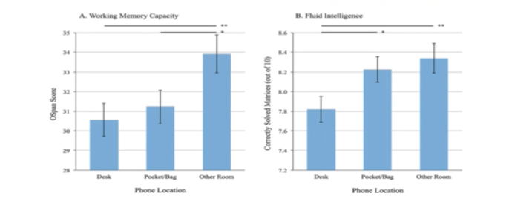
Reduce “brain drain”
=Practice social distancing from your phone!
Working Memory: resources for “controlling and regulating cognitive processes across domains”
Fluid Intelligence: ”ability to reason and solve novel problems” and manage cognitive processes for goal-oriented tasks
https://repositories.lib.utexas.edu/bitstream/handle/2152/64130/braindrain.pdf?sequence=2
Notes:
https://repositories.lib.utexas.edu/bitstream/handle/2152/64130/braindrain.pdf?sequence=2: “Working memory capacity” (WMC) reflects the availability of attentional resources, which serve the “central executive” function of controlling and regulating cognitive processes across domains (Baddeley and Hitch 1974; Miyake and Shah 1999; Engle 2002; Baddeley 2003). “Fluid intelligence” (Gf ) represents the ability to reason and solve novel problems, independent of any contributions from acquired skills and knowledge stored in “crystallized intelligence” (Cattell 1987). Similar to WM, Gf stresses the ability to select, store, and manipulate information in a goal-directed manner. Also similar to WM, Gf is constrained by the availability of attentional resources (e.g., Engle et al. 1999; Halford et al. 2007). Crucially, the limited capacity of these domaingeneral resources dictates that using attentional resources for one cognitive process or task leaves fewer available for other tasks; in other words, occupying cognitive resources reduces available cognitive capacity.

Slide 65
Reduce “brain drain” = “Mere Presence” Phenomenon
Practice social distancing from your phone!
“’Working memory capacity’ (WMC) reflects the availability of attentional resources, which serve the ‘central executive’ function of controlling and regulating cognitive processes across domains (Baddeley and Hitch 1974; Miyake and Shah 1999; Engle 2002; Baddeley 2003). ‘Fluid intelligence’ (Gf ) represents the ability to reason and solve novel problems… (Cattell 1987). Similar to WM, Gf stresses the ability to select, store, and manipulate information in a goal-directed manner. Also similar to WM, Gf is constrained by the availability of attentional resources (e.g., Engle et al. 1999; Halford et al. 2007). Crucially, the limited capacity of these … resources dictates that using attentional resources for one cognitive process or task leaves fewer available for other tasks; in other words, occupying cognitive resources reduces available cognitive capacity.”
https://repositories.lib.utexas.edu/bitstream/handle/2152/64130/braindrain.pdf?sequence=2
Notes:
https://repositories.lib.utexas.edu/bitstream/handle/2152/64130/braindrain.pdf?sequence=2: “Working memory capacity” (WMC) reflects the availability of attentional resources, which serve the “central executive” function of controlling and regulating cognitive processes across domains (Baddeley and Hitch 1974; Miyake and Shah 1999; Engle 2002; Baddeley 2003). “Fluid intelligence” (Gf ) represents the ability to reason and solve novel problems, independent of any contributions from acquired skills and knowledge stored in “crystallized intelligence” (Cattell 1987). Similar to WM, Gf stresses the ability to select, store, and manipulate information in a goal-directed manner. Also similar to WM, Gf is constrained by the availability of attentional resources (e.g., Engle et al. 1999; Halford et al. 2007). Crucially, the limited capacity of these domaingeneral resources dictates that using attentional resources for one cognitive process or task leaves fewer available for other tasks; in other words, occupying cognitive resources reduces available cognitive capacity.

Slide 66
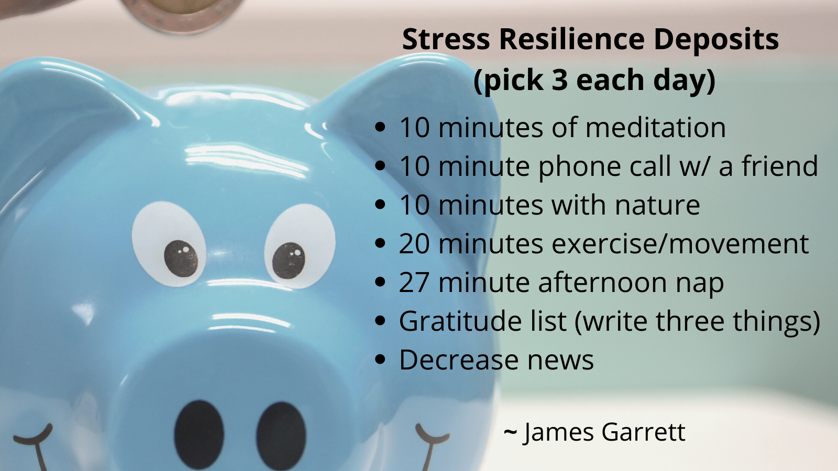
Practice 3 Brain Resilience Deposits a Day, e.g.,
Notes:
Some research shows that even 3 minutes of negative news for adults can mean a significant impact on the rest of their day.We’ll talk about other practices that help the brain in other modules, e.g., in the productivity module. James Garrett is an expert on practical, research-based brain health and plasticity. He was one of the presenters in the Digital Wellness Institute's certification course that we at EPIK took.

Slide 67
Practice "Point and Name" with the Circles of Concern and Control: identify things you can't control (outer ring) and things you can. (Spending time and energy on things in the circle of concern can drain our energy and sense of well-being)
control
influence
concern
Notes:
We focused on the two conceptual endpoints of this model to introduce it. The circle of control and the circle of concern are polar opposites. The circle of control is what I can do something about with no reliance on anyone or anything else. The circle of concern is everything we have no control over. It is very common as humans to get into the circle of concern – to focus on things we have no control over. To be in the circle of concern is to risk losing energy, focus, and hope. To be in the circle of control is to find growth, clarity, and progress. I can practice naming the things I can't change/control; I can claim the things I can; and I can practice the discernment to know the difference.

Slide 68
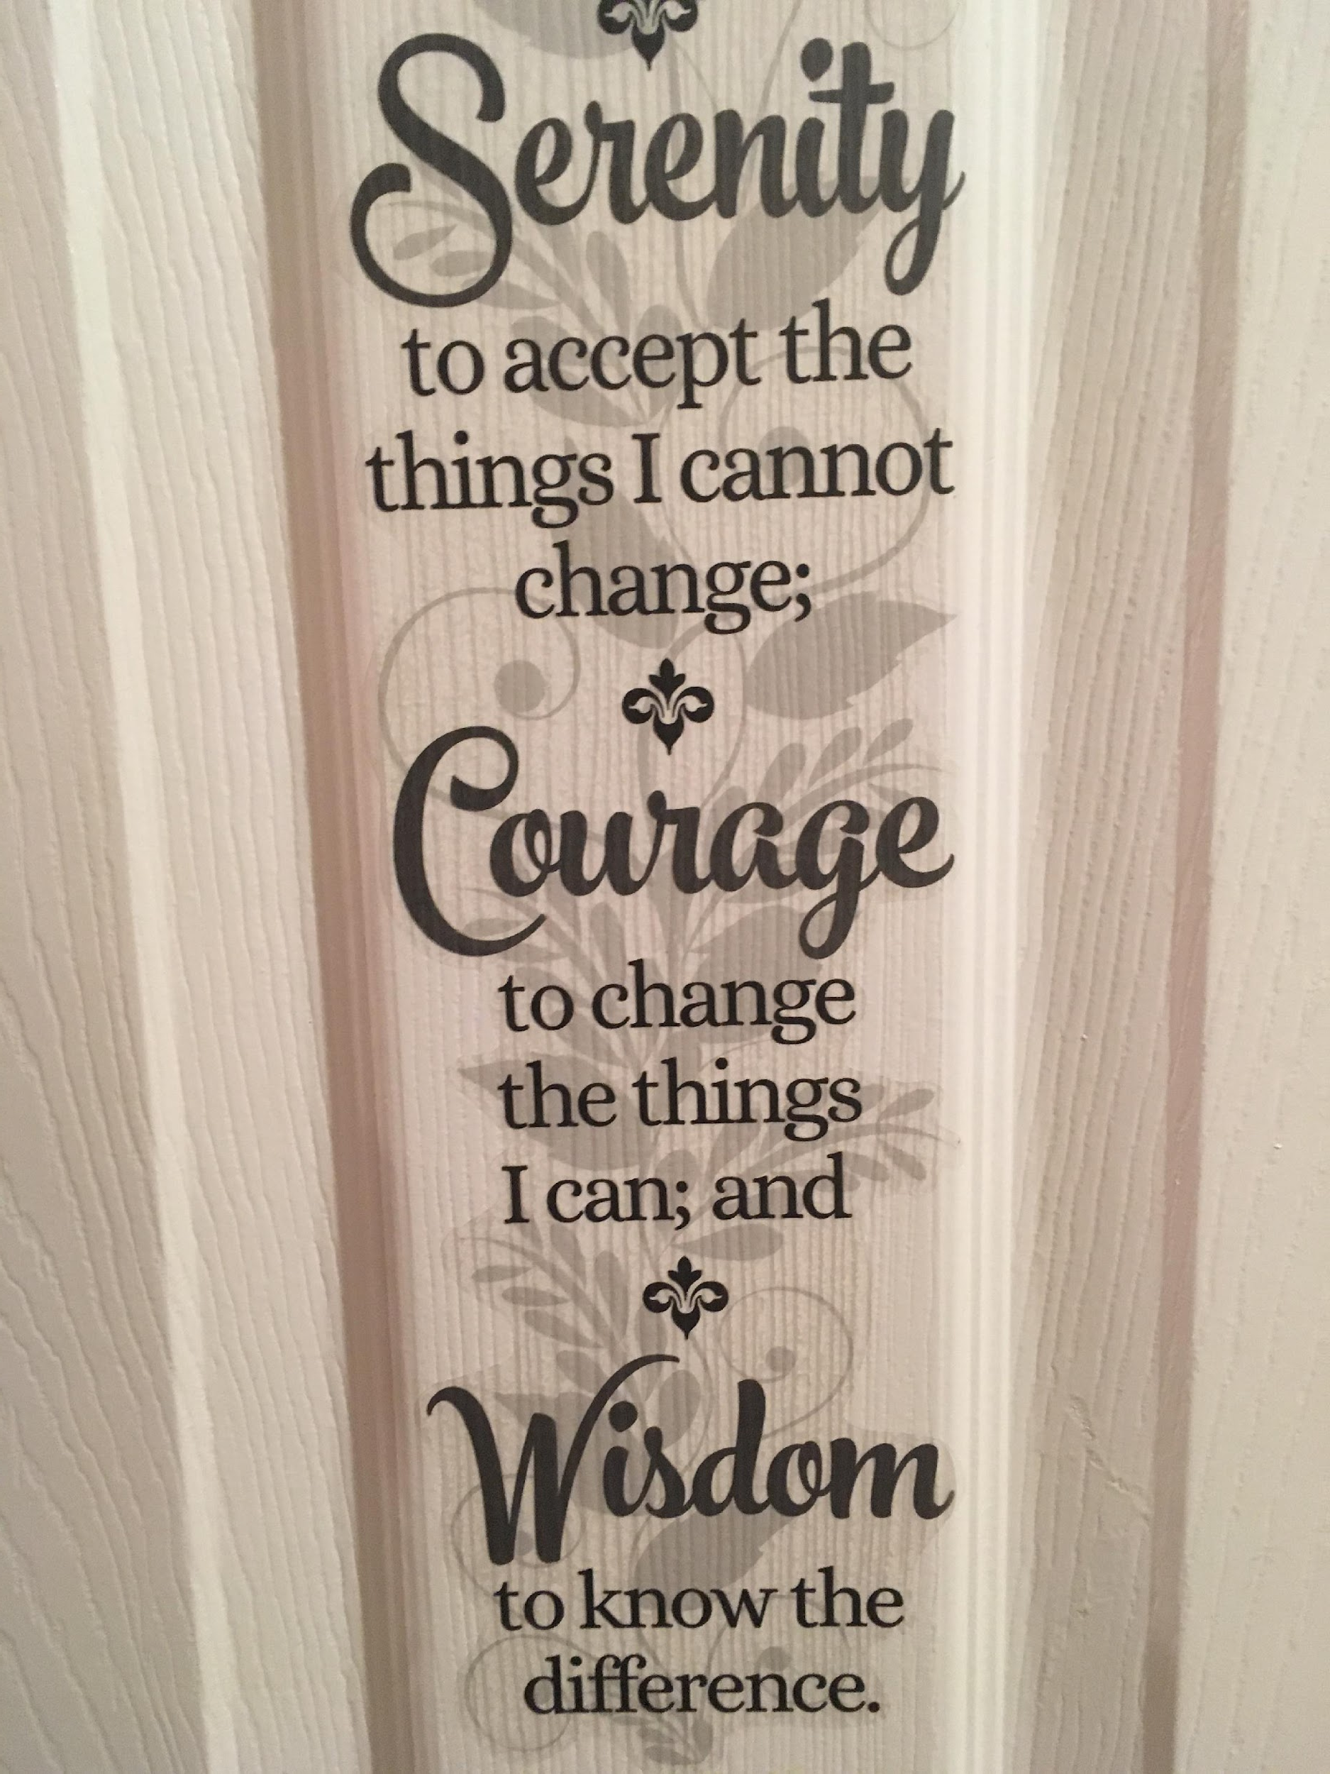
The Serenity Prayer
Notes:
The Serenity Prayer is used in many addiction recovery circles and is a great guide for mental wellness in a digital world. This is a picture of a decal I found at the dollar store years ago. It's on the door of my coat closet so I can see it often.
There's much that comes into our space that we can't control, even though there is often an illusion of control behind the creation, sharing, marketing, etc. of online content. Part of media literacy is to build that wisdom muscle of realizing what really is within our "circle of control" as Stephen Covey referred to it in his 7 Habits book. We hope to soon have an interview available with a young father who discovered the power of these principles as he experimented with taking breaks from social and news media.
And here is an example of some research around physical benefits of "wisdom-related judgment" https://www.ncbi.nlm.nih.gov/pmc/articles/PMC4824766/

Slide 69
"Practice the Pause" before engaging media
e.g.,
Who do I want to be?
What do I need and want to be doing right now?
Where am I right now? Is this a good place to use technology?
When – Is now a good time to be using technology? How long will I use it?
Why do I want to use technology? Do I have an intentional purpose? Am I using technology to avoid what it most important or to avoid hard feelings or situations?
How does this align with my needs and goals and hopes and the people who matter most to me?
WHO
WHAT
WHERE
WHEN
WHY
HOW
Decision/Action
Notes:
Who do I want to be? What attributes am I trying to develop? What is going on right now that makes me want to get on a device? Where am I? What time is it? Why am I reaching for a device? Is it because I have a specific task to accomplish, or am I feeling bored, tired, lonely, overwhelmed, inadequate, avoidant in the face of a hard task, invisible…??? How will using a device right now help me stay on track for my day, and for my longer-term goals and vision and intentions?

Slide 70
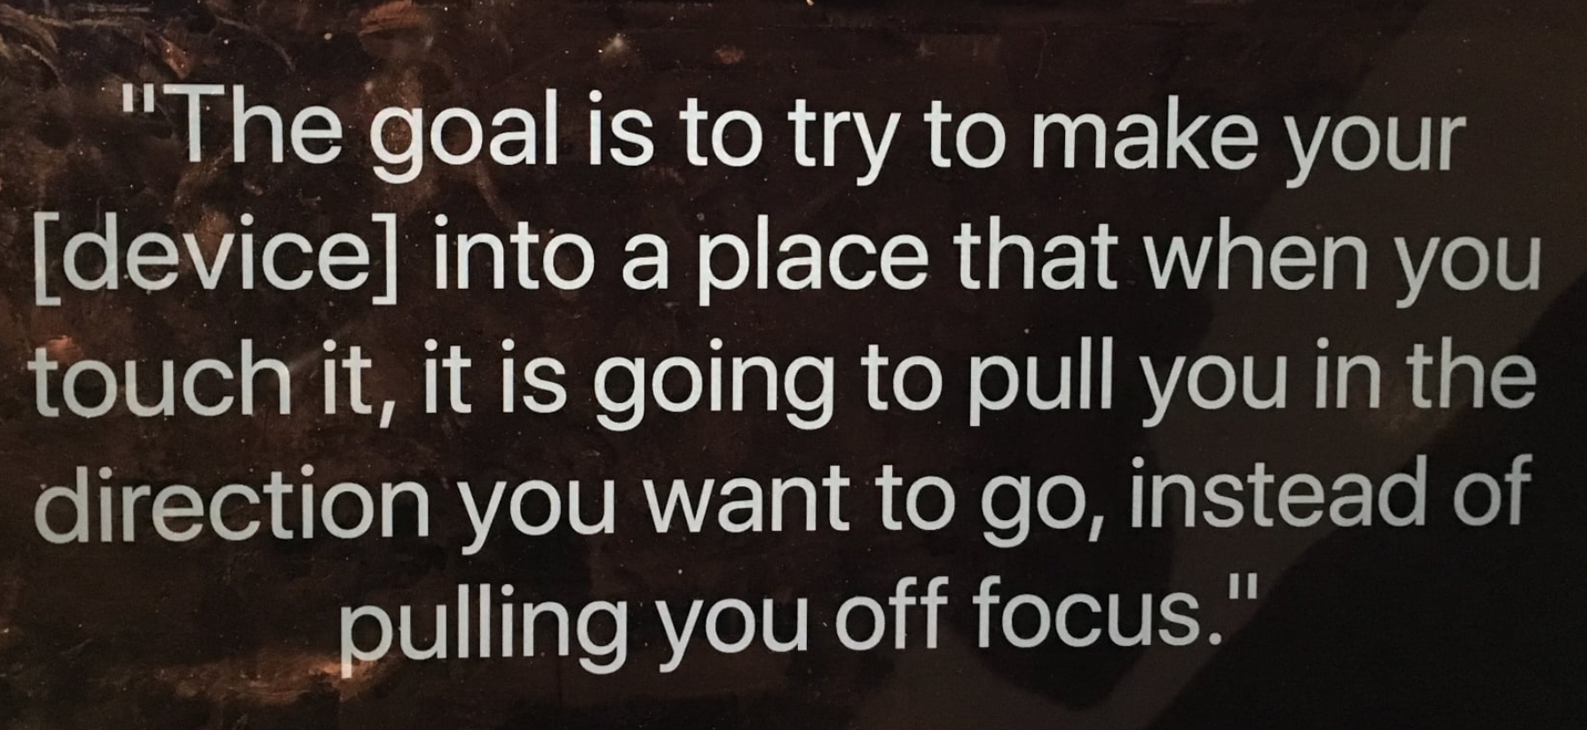
One of my computer screensavers. Quote by Dr. Alexandra Samuel, https://bit.ly/3rMjSKY
Notes:
This is a quote by Dr. Alexandra Samuel, from this video: https://wellbeing.google/get-started/focus-your-time-with-tech/
We had a great question about HOW to not get distracted once we are in/on our devices. This is a great question, a common (if not almost ubiquitous challenge), and something we'll discuss more in the Produtivity/Honoring Time module in a couple of weeks.

Slide 71
Use the “10-minute rule” (Nir Eyal)
“Surf the urge” (get curious)
Nir has many interviews out there exploring this idea, e.g., https://bit.ly/2XDaqgw.
Read past the purple. He gets to some of why “just say no” doesn’t work = consistent with prevention science research, which we will discuss in our last module and is also relevant to the use of "contracts."
Notes:
When a hard thought or emotion comes (or a craving to go to tech to self-soothe), you can sit with those thoughts/feelings/cravings for 10 minutes. Even just a few minutes' time between stimulus and response invites the brain to shift gears. And we can learn things when we get curious and ask questions about what is going on inside of us…as we've discussed. It can feel heavy to "look at my emotions." But if we can adopt that kind of "lab coat and glasses" or even an explorer curiosity, we can become an observer of our internal environment and, kick in the prefrontal and other parts of our brains that help us make better, more conscious, more deliberate, more intentional decisions
Nir's point abut how "just say no' is consistent with decades of prevention science research. "Just say no" with problematic or unwanted behaviors can sometimes even make behaviors worse. If parents or children are struggling with tech overuse, talking about internal triggers/weather/states/patterns [and possibly seeking some professional support for working through hard emotions, trauma, fears, shame or other struggles] could be helpful. Focus on the person's growth and development, not only on the technology itself.

Slide 72
FYI: Pacts (contracts) alone often don't work because what is happening internally needs attention
Notes:
It's not uncommon in family settings or with one's self to set "resolutions" about tech, or to even create and sign contracts. But a contract alone is often not enough to truly bring about wise use of technology, because often unwise use of technology is tied to either mindless use or using technology to avoid hard tasks or hard emotions. Building self-awareness of internal narratives, fears, insecurities, beliefs, and emotional states can be a protective factor for mental wellness in a digital world.
See Nir Eyal's work. Internal work has to be done first in order for pacts to work. https://www.nirandfar.com/distractions/. Nir was one of the guest speakers in our Digital Wellness Certification course. He's written a book both on how companies can hook people, and how people can not be hooked. An interesting mix!

Slide 73
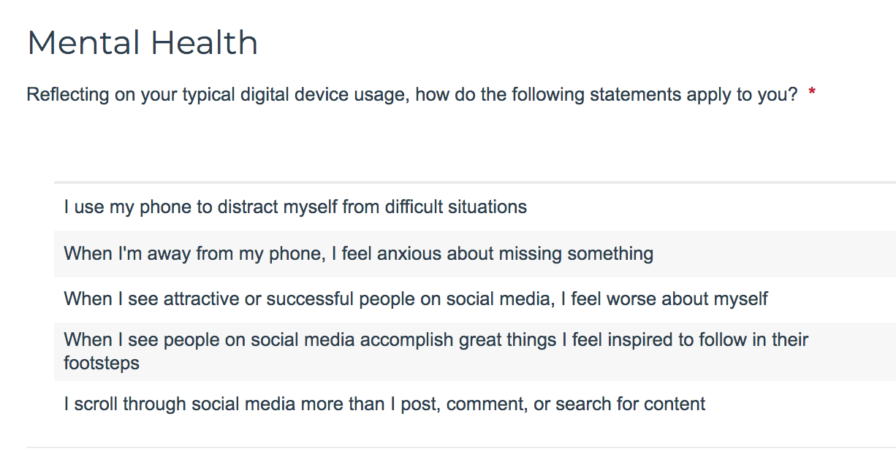
DWI Self-Assessment: Self-reflection
https://survey.alchemer.com/s3/5504604/b153c792d361
Notes:
One of your invitations for this week is to do the entire self-assessment. It covers the topics we are covering from weeks 3-8. Not only can it provide a sort of personal measurement tool to observe any changes in thought, perspective, or behavior during the series (or after), but the questions also contain information that can be insightful as you consider the various facets of Digital Wellness. And, as is noted on the next slide, we encourage you to consider other questions that you would want to add for your own wellness intentions, concerns, and hopes. https://survey.alchemer.com/s3/5504604/b153c792d361

Slide 74
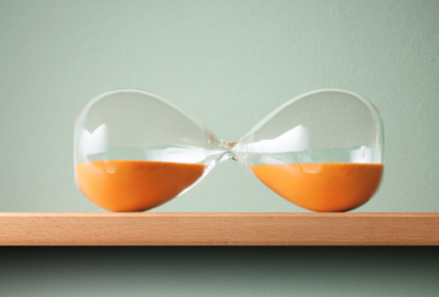
What questions would you add for yourself?
Notes:
You can create your own questions as well. As you practice Digital Centeredness, you may become more aware of things you want to watch for or practice in the Mental Wellness element of Digital Wellness.

Slide 75
Our internal weather can impact
our behaviors, and…
When I feel… | I’m tempted to use________ Or to __________
Inadequate
Lonely
Sad
Angry
Fearful/Uncertain
Stressed
__________
Notes:
a worksheet activity or discussion you can have at home with this and the following slide

Slide 76
…Media messages and external stimuli can
impact internal weather patterns
When I hear/read/learn about/experience… | I might (at least initially) feel….
 | Inadequate
 | Lonely
 | Sad
 | Angry
 | Fearful/Uncertain
 | Stressed
 | _____________
e.g., https://www.ncbi.nlm.nih.gov/pmc/articles/PMC8430792/
Notes:
a worksheet activity or discussion you can have at home with this and the previous slide

Slide 77
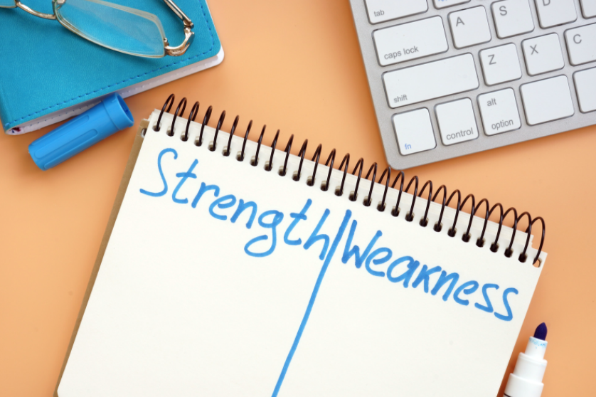
Another Think, Write, Share idea
Think & Write, pt. 1
What are three of your strengths?
Notes:
This can also include a children's book that you read or read with your children.

Slide 78
Think, Write, Share
Think & Write:
Write silently on your paper/digital tool
(30 seconds)
Thank you for muting your mic during this activity.

Slide 79
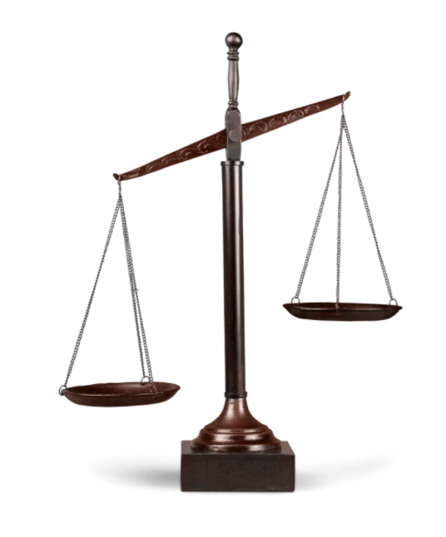
Think, Write, Share
Think & Write, pt. 2
Pick one of your strengths and write a downside that can exist around the strength
Notes:
For example, one of my strengths is that I am a connector/a people person. Downsides of this strength can include that sometimes I would rather connect than eat, sleep, etc. – in other words, sometimes I don't do appropriate self-care or self-boundaries when I have opportunities to connect. Downsides also show up with social tools like Facebook where I engage with the illusion of connection that may not satisfy. We'll talk more about the difference between bonding and bridging connection in the Relationships module.

Slide 80
Check-in: Think, Write, Share
Think & Write:
Write silently on your paper/digital tool
(1 minute)
Thank you for muting your mic during this activity.

Slide 81
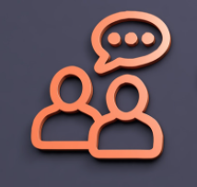
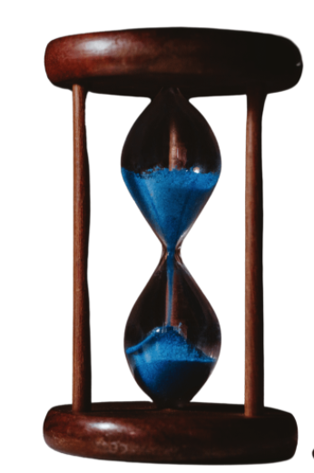
Think, Write, Share Activity
Share:
Each person gets one minute.
Read your list of 3 strengths & one example of a downside
Each person self-times, and when your timer rings, simply say, "Thanks, I pass to you" (even if you are in the middle of a sentence).
Please honor the time limit, and please also use your full time.
The timer ensures everyone has an equal voice
Please practice "no cross talk" - no commenting or giving advice on the other's share.
Go in order of birth month or first name for ease of flow

Slide 82
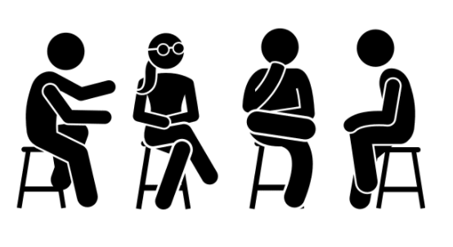
Other resources:
Family Activities: https://docs.google.com/document/d/1dEkLI8rWmuOHXsVviYdTxkdeyuvqbrFgrPX8N9QojRI/edit?usp=sharing
Wellness centers at schools:
https://www.theimfoundation.org/
https://www.ksl.com/article/50485940/can-a-place-to-decompress-at-high-school-really-help-prevent-suicides
Review, Research, Resources
https://docs.google.com/document/d/1Nr5-tJ6hbYL9CxhDedaKAfkbbQy5mhNg2aniGjek-ZU/edit?usp=sharing

