Slide 1
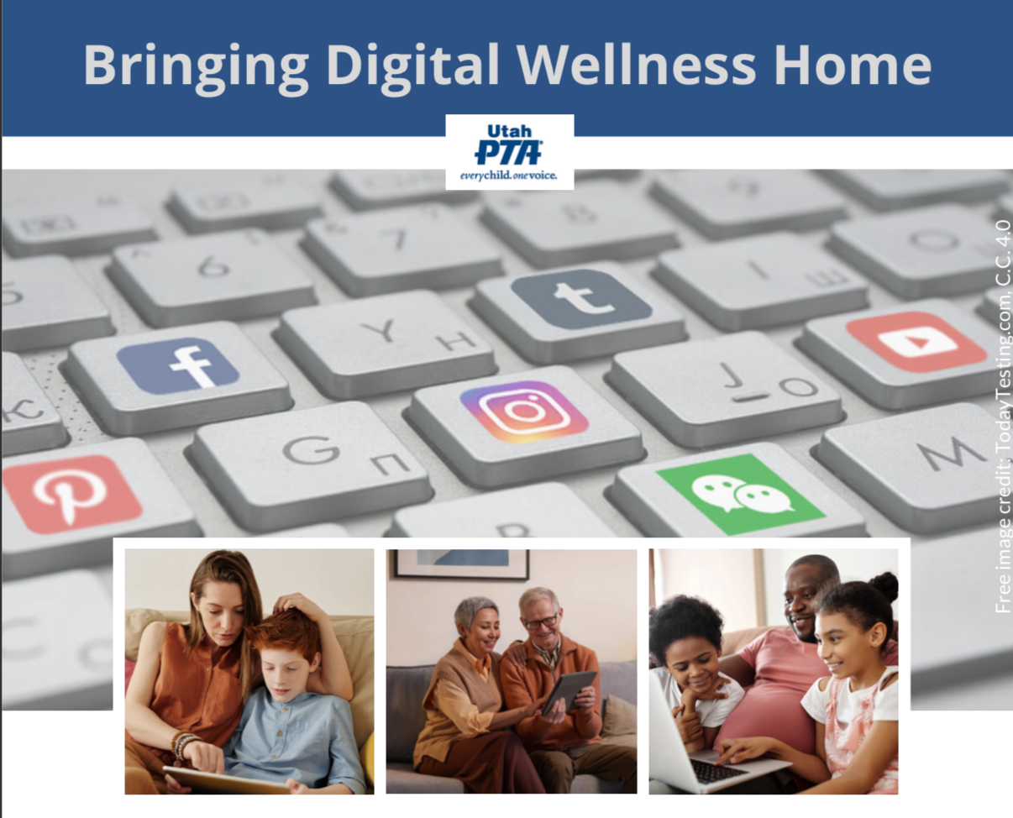
Note: All material in this series is for educational and informational purposes only, and is not meant to be exhaustive or used as a replacement for professional health support.
Notes:
Note: All material in this series is for educational and informational purposes only, and is not meant to be exhaustive or used as a replacement for professional health support. Also, the presentation is best viewed in slideshow format, as some of the slides are animated. That said, these notes are here for your benefit.
NOTE: Portions of this work first appeared in or are derived or adapted from the Digital
Wellness Certificate Program. Those portions are Copyright © 2021, Digital Wellness Institute.

Slide 2
Discussion #2 Media Literacy
Bringing Digital Wellness Home

Slide 3
Notes:
Welcome to those who are here for the first time! And welcome back to those who were here last week!

Slide 4
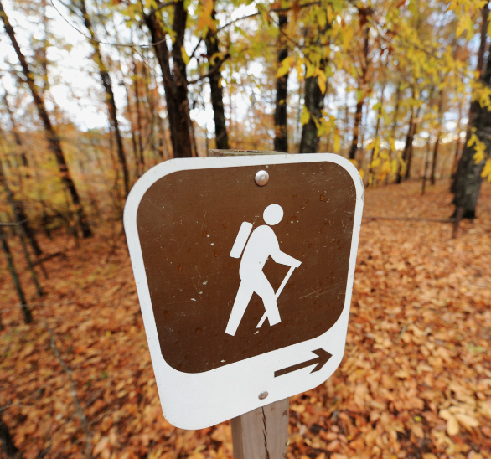
Notes:
As we discussed last week, Digital Wellness is a journey, and when we are doing the work of self-reflection and personal growth, it is nice to have others with whom to engage in the process. We can learn from and with each other as we walk the journey together.

Slide 5
Introspection & Connection
Thank you for muting your mic during this activity.
Notes:
As we mentioned last week, we'll start each session with some sort of introspection or connection activity – or a combination of the two.

Slide 6
Think, Write, Share Activity
Think & Write: Write silently on your paper/digital tool (30 seconds)
Share: When prompted, share your response in the Zoom chat. (60-90 seconds)
Note: This will be a "no-cross-talk" activity. I will be muting my mic except to start and end each part of this activity.
Notes:
When we do these kinds of activities, don't worry if your answer shows up in someone else's share. This is one reason we invite you to write first, so that the share is authentic to what first came to mind. If there are patterns in the sharing, that's something to observe. Patterns are interesting, and so are differences and seeing variety in people's responses and experiences.
Also, if at the moment you are only able to listen, we'll share out the book list as part of the resources.

Slide 7
Introspection & Connection
What is a book that had an impact on you in the last year?
OR
What is a book on your to-read list?
Thank you for muting your mic during this activity.
Notes:
You can use your 30 seconds to answer one or both, or to write as many books as come to mind.

Slide 8
Notes:
We are happy to have a book list to share out as a group output. As we talk about Media Literacy today, literacy itself is central to that concept. In most cultures, reading and writing are essential to life. They also can bring great enrichment to life.

Slide 9
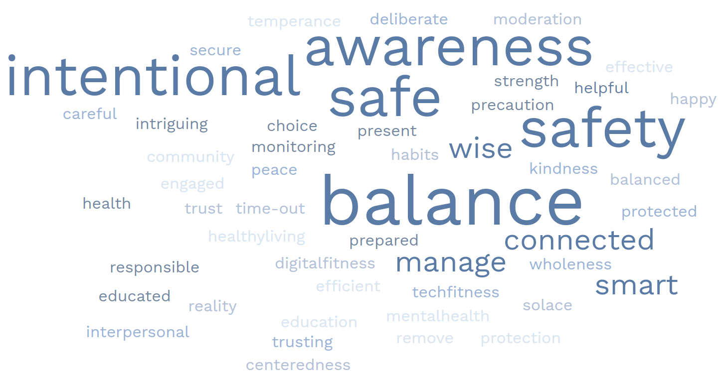
Notes:
Speaking of group outputs (we like to call things like this artifacts from our learning community), here is the updated Digital Wellnes word cloud, with additional synonyms that have been added since last week. This word cloud is our watermark for our slide decks.

Slide 10
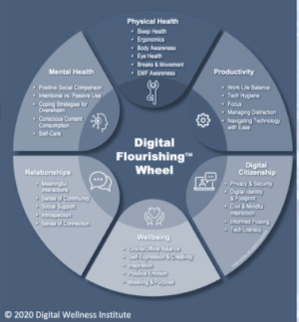
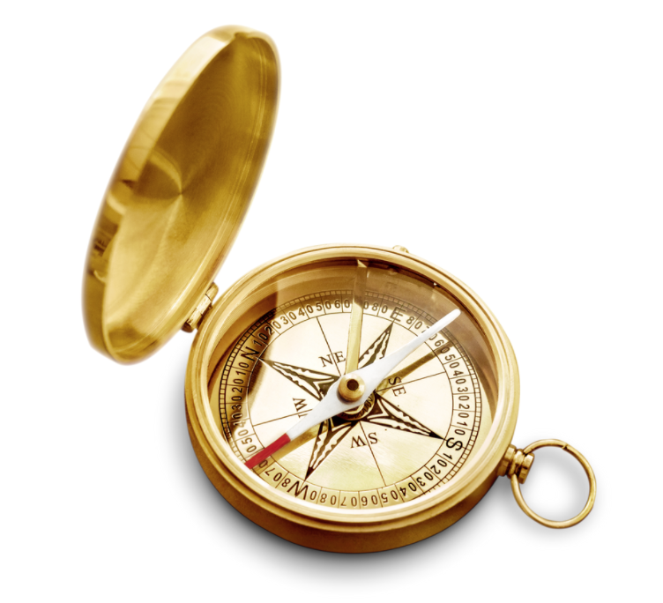
Digital Wellness from the inside out
Notes:
We took the Digital Wellness Institute's course for a reason – because EPIK's mission is focused on the benefits of cross-sector (multidisciplinary) collaboration. DWI brought experts from various fields together to create their model and their course.
We did find a couple of things missing, and those things are represented in our first two modules. Our model uses DWI's six-pronged model because it maps directly to their self-assessment, which you can find here: https://survey.alchemer.com/s3/5504604/b153c792d361

Slide 11
Digital Wellness from the inside out
Notes:
A note from last week that I forgot to mention. Dr. Kelly McGonigal talks about how physical representations of our values augment the benefits of writing about them. The more ways we can keep our centering values present/top-of-mind, the more intentional we can be about using them as a guide or compass or touchstone for our decision-making and mindset about our lives.

Slide 12
Digital Wellness from the inside out
Already inside of you?
Notes:
Today we talk about the second of two topics that weren't covered in DWI's course: Media Literacy. When I first learned about Media Literacy as a field I was happy to know that it was a field, and I also was happy to realize that I was already practicing Media Literacy principles without knowing what to call what I was doing. Once I learned about the field, it helped me be more intentional about practicing Media Literacy for myself and with my children. We imagine you also have Media Literacy principles already inside of you, and you may already know about the field. Our intention is to bring out some of the most basic principles that can be practiced and, we hope, easily shared with children and youth in your spheres of influence.

Slide 13
Notes:
Media Literacy is a skill that is needed not just because of the digital world. We have many experiences like walking through the grocery store (especially where there are processed foods)...

Slide 14
Notes:
…or walking through the toy aisle…

Slide 15
Notes:
…Or going through our mail…

Slide 16
Notes:
…Or perhaps being influenced to buy something we weren't planning on buying because "it was such a good sale and it was ending today!"...

Slide 17
Notes:
…or reading the news, or walking by a magazine stand, or…. There are so many examples of the ways people use messages, marketing strategies, and advertising to try to influence how we spend our time, money, and attention

Slide 18
Notes:
And of course, the internet has made all of this so much more intense. We might have been able to avoid a lot of unwanted messaging in between trips to the store or our daily walk to the mailbox. But if we have digital devices, we are constantly being bombarded by messages, most of them unwanted, and most of them wanting not just our attention but our money, and sometimes more than that.

Slide 19
Notes:
What makes it all even more intense is that ads and other content (including search engine results) are customized, personalized using data gathered about our internet usage, our purchasing patterns, and so forth. Marketers were doing targeted advertising before the internet, but now they have endless amounts of data, so much more than we might ever imagine.

Slide 20
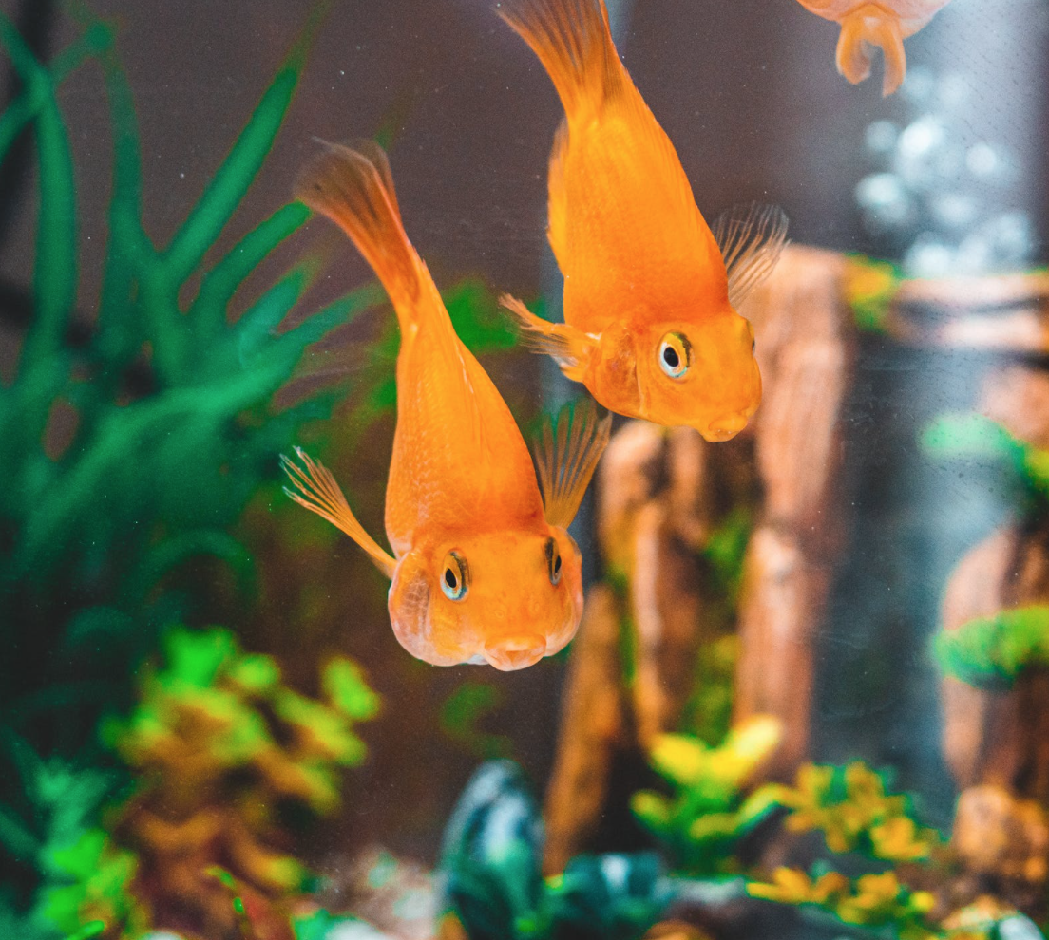
“There are two young fish swimming along and they happen to meet an older fish swimming the other way, who nods at them and says “Morning...How’s the water?” And the two young fish swim on for a bit, and then eventually one of them looks over at the other and [says] ‘What the [heck] is water?’”
etc.
Notes:
This is the water we swim in. We are all little fish in this very big pond, and there is a lot going on in this water.

Slide 21
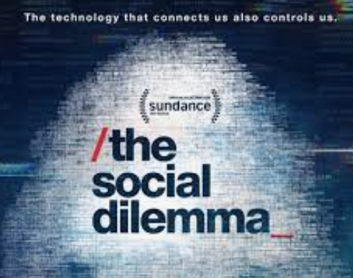
etc.
Notes:
The Social Dilemma, a documentary produced in 2020, explores the water we swim in in great detail.

Slide 22
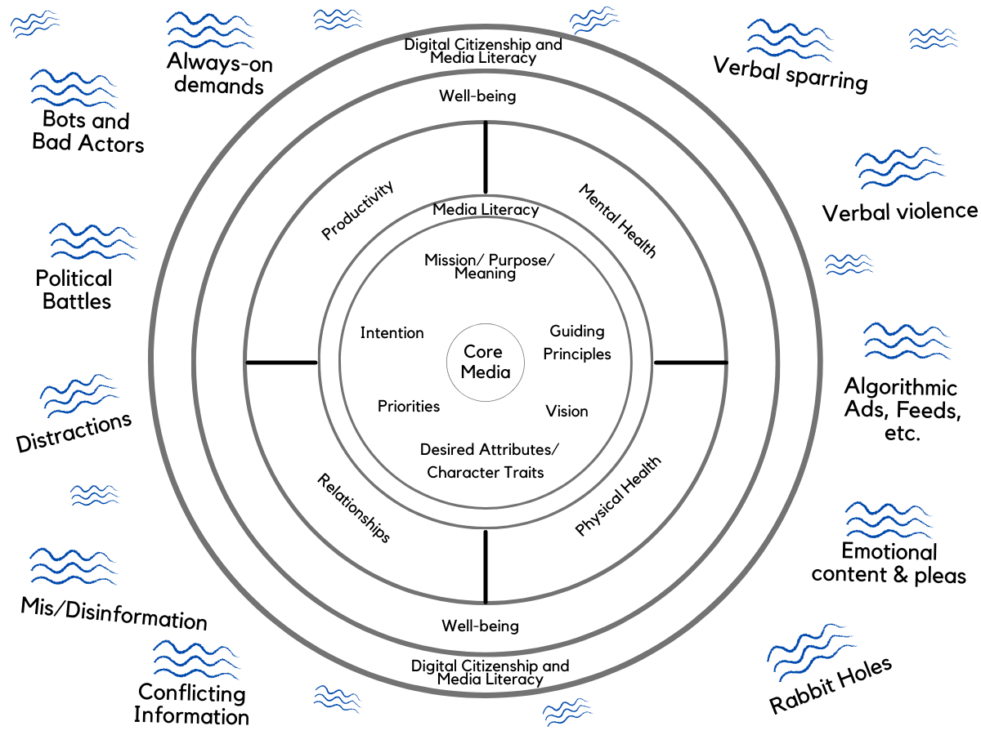
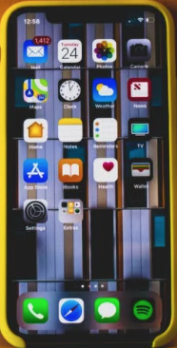
etc.
etc.
The Attention Economy
etc.
etc.
etc.
etc.
Notes:
This water we swim in is sometimes called The Attention Economy. Companies and others are able to make a profit simply by what we look at, click on, scroll through – by where and how we spend our time online. Even those cute pictures you post on social media are part of helping put money in the coffers of big tech companies and advertisers who pay to be put in front of your eyeballs.

Slide 23
"We pay with our eyeballs."
etc.
Notes:
As such, some who talk about The Attention Economy note that we pay with our eyeballs. No online tool is free. They are constantly vying for our attention, our energy, our time. Even without spending any money, we are still paying through the precious resource of our attention. And they are making money when we give them our attention.

Slide 24
Protective and Restorative
etc.
Notes:
All of that said, the water we swim in is not all negative. There are "hooks" and sharks to be sure, but Media Literacy invites us to be more aware of the drains on our attention and energy in part so that we have more energy to spend on things that align with who we want to be and how we want to live. We can also practice Media Literacy in ways that allow us to find refreshment and enrichment – restorative benefits – of positive media and other opportunities.
content owners, so you can find it in many places online. The college does not actually have the full speech, which I asked them about. If you do choose to engage the speech, be sure to find a version that is complete.
Note: This speech contains some profanity. Some of Wallace's style & language may not match mine or yours, but the principles he gets to are still "bubble to the top" principles in my view, and are relevant to what we discuss in this course.

Slide 25
Actor not reactor
Intentional engagement vs. passive consumption
"Do what is meaningful, not what is expedient"
etc.
Notes:
Media Literacy skills can help us be actors, not reactors. It can help us engage intentionally vs. consume passively. Using the words from a book that has had an impact on me, we can become more empowered to not get hooked into the messages that create a sense of urgency or emergency, and instead choose to slow down and make decisions that are intentional, connected to what is meaningful for us.

Slide 26
“In the attention economy,
mindfulness
is activism.”
-Jay Vidyarthi
Notes:
Jay Vidyarthy put it this way. He wrote these words in 2016, when he thought perhaps it would be those with a formal meditation practice who would be able to change the water we swim in. After The Social Dilemma came out, he wrote another essay. The following slide includes some of his thoughts.
https://medium.com/mindfulness-and-meditation/in-the-attention-economy-mindfulness-is-activism-4241cc766ac

Slide 27
"This movie [The Social Dilemma] tells a compelling story, but it presents no hopeful vision for the future…[It doesn't] inspire us to take up the cause in our own lives and stand up for a freedom of mind…
We are the shepherds of this natural resource called ‘attention’....
The victim mentality is dangerous because it provides us an excuse to give up. Being entirely at the mercy of the big machine is a convenient story to tell yourself as you throw in the towel. But you can’t give up. You need to take care of yourself, your loved ones, and your community, despite the attention economy….
We need a new North Star.
…[W]e are not lemmings walking off whatever cliff we’re pointed to. We have free will. While it’s true, these massive tech companies are pointing us where they want us to go, we don’t need to wait for them to clean up their act to do something about it.
The most powerful technology in this whole equation - in fact, in the entire universe - is still that greyish lump of jello between your ears. AI is not yet smarter than you in the ways that matter. And it may never be.
Those of us working on this problem are trying to get you reinforcements, but in the meantime, we need you to hold your ground." (We would say, hold your groundedness, your centeredness.)
Notes:
Jay Vidyarthi
https://www.attentionactivist.com/attention-activist/the-social-dilemma-and-the-victim-mentality

Slide 28
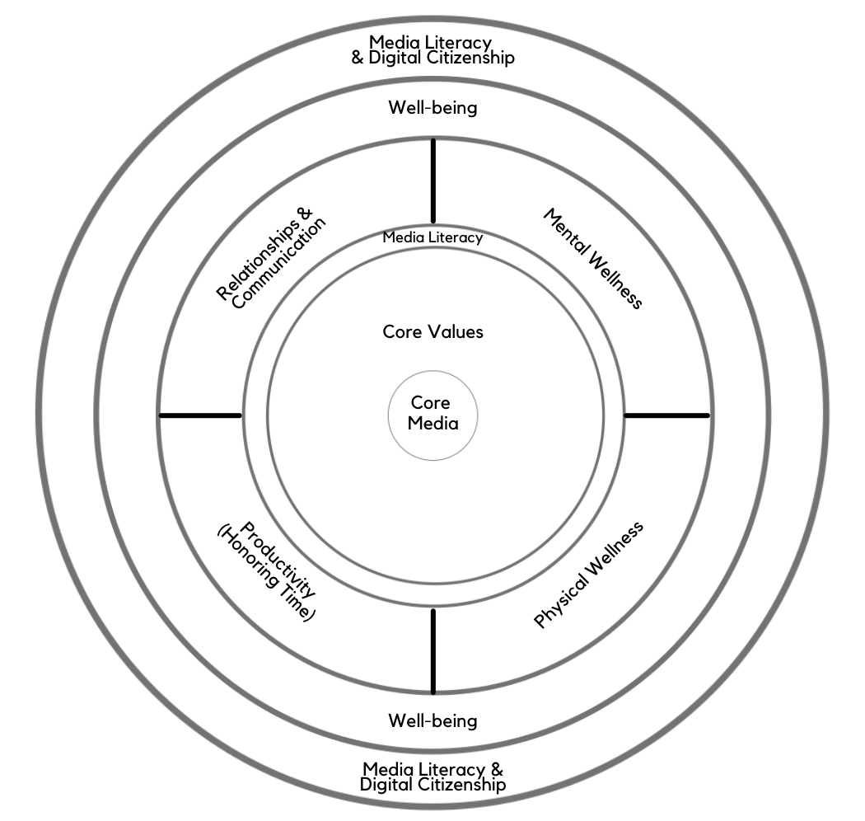
Digital Centeredness Model
Start with Your Center
Media Literacy/Message Literacy
Mental Wellness*
Physical Wellness*
Productivity (Honoring time)*
Relationships*
Well-being*
Digital Citizenship* & Media Literacy
Bonus: Social Development Strategy
Notes:
We touch on Media Literacy in three different places in our model. Today we will cover two of those areas.

Slide 29
Digital Centeredness Model
Start with Your Center
Media Literacy/Message Literacy
Mental Wellness*
Physical Wellness*
Productivity (Honoring time)*
Relationships*
Well-being*
Digital Citizenship* & Media Literacy
Bonus: Social Development Strategy
Notes:
And as we explore later modules, you will see how Media Literacy principles are connected to wellness in various areas of our lives. At its heart, Media Literacy is about slowing down and paying attention by asking questions.

Slide 30
Notes:
We start our discussion of Media Literacy by talking about core media. As mentioned before, at the heart of Media Literacy is…literacy. When we have our own core books (or other forms of media) that we know and love and return to and reflect upon, these media can help us stay anchored in a world where so many ideas, opinions, emotions, demands on our time and attention, ideologies, falsehoods, etc. swirl around us. Before even engaging in the external world of messages, we can establish firm ground within ourselves by knowing and anchoring to principles in our core books/media.

Slide 31
Notes:
Another word to use for core media is touchstone media or Touchstones. What are books or other media that are just so much a part of you that they show up often in your life (or you return to them often)? Touchstones are also media that we use to help us assess other inputs and ideas. Sometimes other ideas can help us refine our centering values. And sometimes our centering values help us decide that "that is not for me."
We can also call core media or Touchstones Compass Media.

Slide 32
Notes:
I learned this idea from my children's educational experience, actually. They attended a school focused on classical literature as a foundation for learning. The next slide explores some of the benefits of classical literature. You can also listen to an interview with my son about Touchstones here: https://youtu.be/aQyWz5A5PN0 or you can find the raw audio and video files in our unSummit Drive folder: https://drive.google.com/drive/u/1/folders/1rmA1in4Kl53vkJJW4s3T3p8pCEKWUmYf

Slide 33
To read a work of classic literature is to engage with the best work of the best minds, and do it in a way that challenges you
to be better
to seek out and appreciate beauty
to ponder the big questions
to follow a line of thought
to concentrate
to transform symbols of language into an image in your imagination
to weigh assertions
to analyze
to exercise your faculties of reason.
-Spencer Baum
Notes:
Those last three bullet points relate to what is often discussed when Media Literacy is discussed. It is a powerful life skill to know how to analyze information and ideas, weigh out different points of view, and to build capacity to reason and thin through complex questions. We don't always have to do that with current events, and in fact, there are great benefits in using literature and other media that are not directly related to "hot topic" issues to help us build these skills around materials that everyone can gather around to discuss. It's difficult to build Media Literacy when our emotions are running high in real-time.
https://medium.com/@spencerbaum/3-reasons-why-you-should-read-more-classic-literature-in-2019-e762cb5c910c

Slide 34
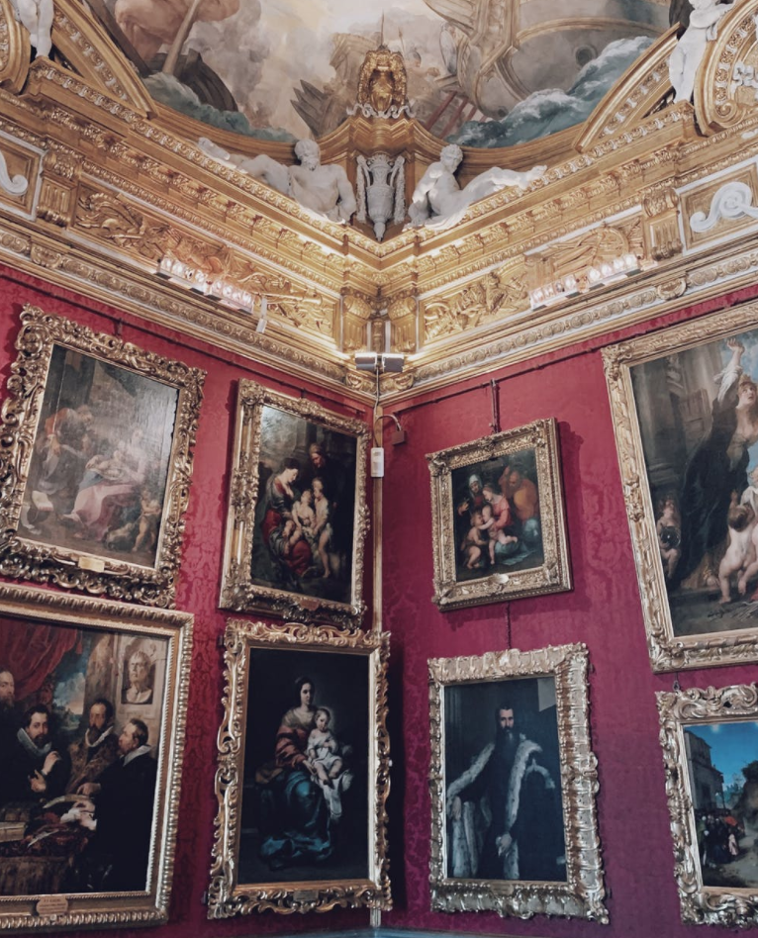
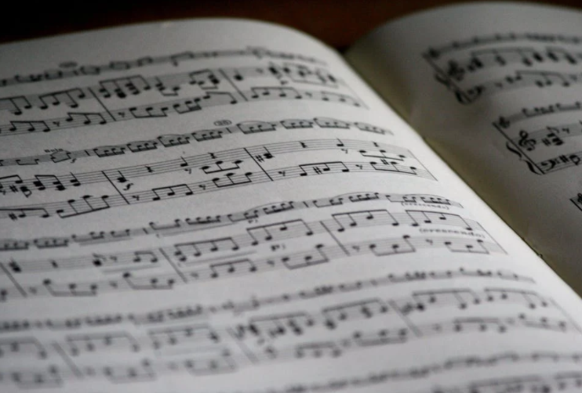
Core/Touchstone Media
Classical texts, pieces of art or music, or other media that have helped shape you as an individual, and that help you define and stay focused on your center.
Notes:
Books are not the only media form that can be a touchstone. For me, Touchstones include music and art and other media forms. Perhaps that is true for you, too.

Slide 35
Mottos
Mantras
Stories
Names
Notes:
We realized as we were talking recently that in cultures where there is no written language, oral tradition is still the way wisdom is passed down through the generations. And even for those of us who do have a written language that we can read and share in that way, we may also have oral Touchstones that have come through family or other relationships. Names can even be a way to pass down principles or core values in a family.

Slide 36
Think, Write, Share Activity
Notes:
We invited everyone to reflect on their own Touchstones – whether they be books or other art or oral ideas or stories, or even names.
The activity comes in two parts – an introspection and writing portion (Think and Write) and a breakout group discussion.

Slide 37
Think, Write, Share Activity, part 1
Think & Write: List 2-3 core media that help you stay centered on who you want to be
Notes:
Take 30-60 seconds to reflect and write about your core media or Touchstones.

Slide 38
Think, Write, Share Activity, part 2
Share: Share with your group about one of your core media. What is it? Why does it matter to you? How does it help you?
Notes:
The activity comes in two parts – an introspection and writing portion (Think and Write) and a breakout group discussion.

Slide 39
Each person gets one minute.
When the timer rings, simply say, "Thanks, I pass to the next person" (even if you are in the middle of a sentence).
Please honor the time limit, and please also use your full time.
Everyone has an equal voice in these activities
Everyone has a chance to practice active listening
Go in order of birth month for ease of flow

Slide 40
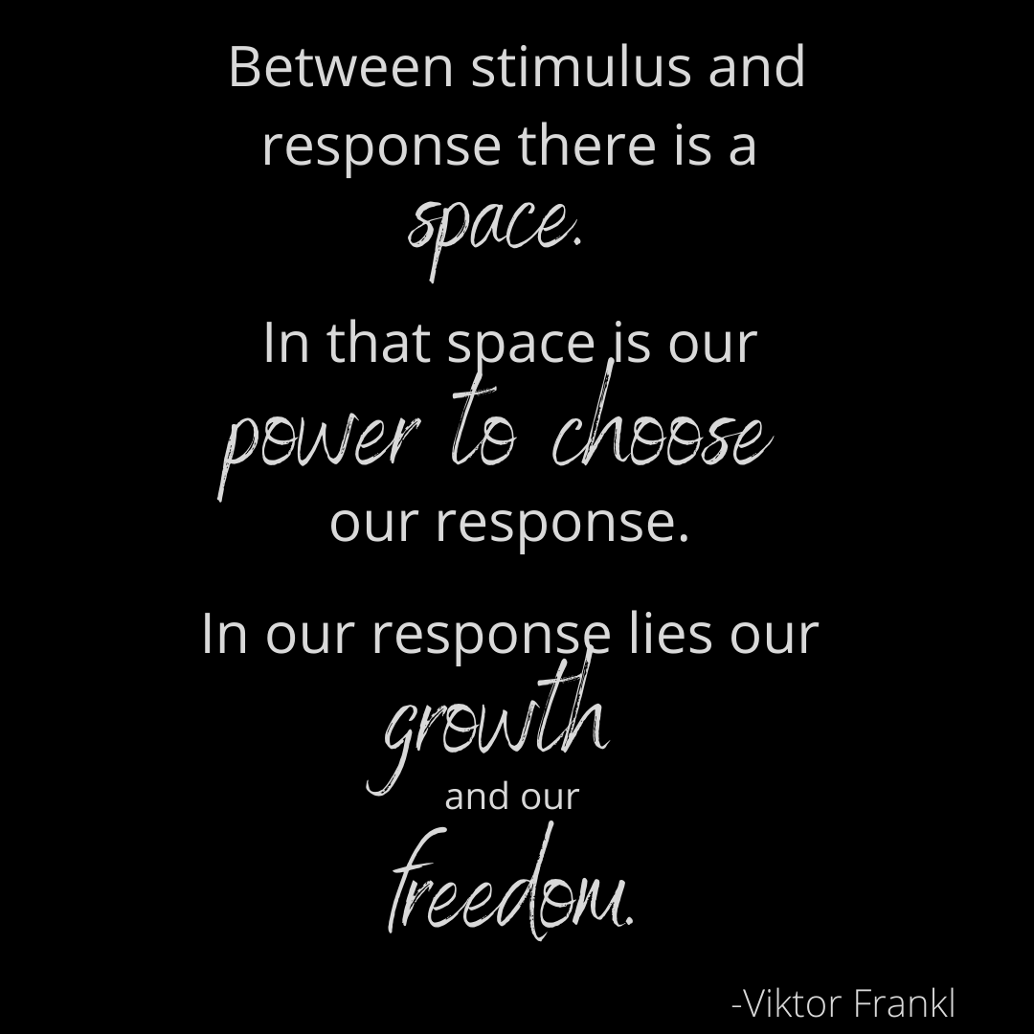
Media Literacy, a personal power tool
Message/Input
Decision/Action
Notes:
Media Literacy is most simply described as helping us be active consumers, processors, and creators of media and messages. We like using this Viktor Frankl quote to consider the power of what happens between contact with media and what we choose to do as a result. Not only is freedom found in intentional responses, it is also found in intentional processing of information. Many media messages are formulated to influence us to skip that space and move right to action. This is where we can reclaim the precious resource of attention.

Slide 41
"Practice the Pause"
Message/Input
Decision/Action
Notes:
So first, Media Literacy is about "Practicing the Pause." Content often has "hooks" that seek to grab and keep our attention (often by stirring up emotion or a sense of urgency). By practicing the pause, we give our nervous systems a chance to slow down so we can think.

Slide 42
Pause…and Ask Questions
Message/Input
Decision/Action
Notes:
In addition to the pause, Media Literacy includes asking questions. Again, this slows down the nervous system process and also allows reason and logic to be used. (Hooks want to essentially bypass reason and logic.)

Slide 43
Pause…and Ask Questions
Message/Input
Notes:
[For this week, we'll focus on asking questions on the front end, as we engage with content. Later in the series, we'll talk about the flip side and asking questions of ourselves as we consider our own responses, actions, and content creation – what we send back into the world.]

Slide 44
Keep questions simple
WHO
WHAT
WHERE
WHEN
WHY
HOW
Message/Input
Notes:
There are many questions we can ask when we engage content or messages, but using Who What Where When Why and How keeps it simple. That said, each of these questions can be asked many times, exploring various facets of the message.

Slide 45
Questions help us identify the hooks
Message/Input
Notes:
Jan noticed a fun something – that if you turn a hook upside down, you have a question mark. But asking questions, we can identify hooks in messages. We made up some words to a silly children's song to go along with this idea. Asking questions can help us "win" in a couple of ways. First we can gather information about the message by slowing down and being inquisitive. Second, slowing down our nervous systems is good for multiple facets of wellness.
If you chance to meet a hook
Do not take it in
Stop and pause and take a breath (I think I used the words from the original song in the recording – "simply turn it upside down")
And let the questions win.

Slide 46
Pausing and Asking Questions = Restorative value
WHO
WHAT
WHERE
WHEN
WHY
HOW
Message/Input
Notes:
As we mentioned previously, practicing simple Media Literacy skills can both be protective (helping us avoid "hooks" in messages) and can also be restorative. Following are a couple of examples.

Slide 47
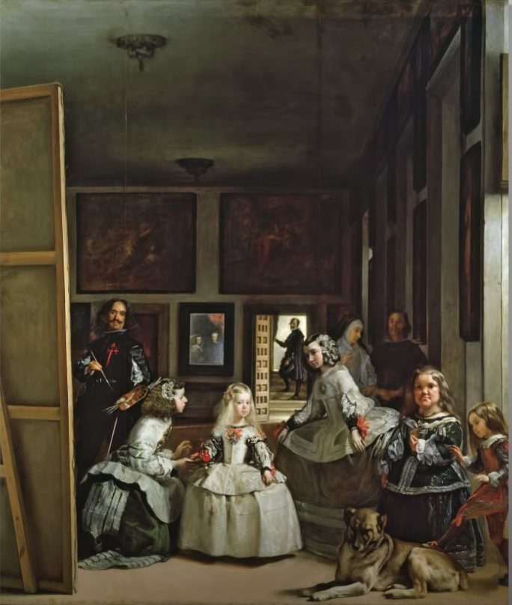
Notes:
When my husband and I saw this painting in Spain, our first impression was a feeling of "take it or leave it." But then our tour guide explained elements of Who, What, Where, When, Why, and How of the artist's work. By the time we had learned about the painting, we wanted to buy a print to never forget that experience we had as the painting came alive to us. This is what Media Literacy can do. It can help enrich and enhance our experiences with creative works.

Slide 48
Notes:
I sang this song when I was young, and only recently has it come back to mind as we've been doing this work, talking about how Digital Wellness starts with us. (We also talk about how Civic Wellness starts with us…hence this song coming back to memory after all of these years.) I decided to learn more about the song, and learning about it makes it mean even more to me. It was written for a retreat of 180 teens of different races and religious backgrounds. At the end they linked arms and sang this song. From there, the youth took the song home and it eventually spread to 50 states in America and then worldwide. The writer of the lyrics was a woman whose mom died when she was 3, who was in foster care at 12, who went through a hard divorce that left her trying to end her own life by suicide.

Slide 49
Protective and Restorative
Notes:
To finish our discussion, we opened up the floor for people to share any experiences they have had with either the protective or restorative benefits of "practicing the pause."

Slide 50
Introspection & Connection
Can you think of a experience where
practicing the pause
and
asking questions
has provided either
protective or restorative
benefits for you?

Slide 51
Invitation:
"Practice the Pause"
(Pause & Ask ?s)
Notes:
The invitation for the week is to look for hooks around you and to pause and ask Who What Where When Why and How questions, or to practice the pause either by engage with core media, or by pausing around some sort of creative work and asking questions to learn more about it.

Slide 52
Thank you for taking 2-3 minutes to fill out the feedback & reflection form
https://forms.gle/w4oWs2NrVqG9ia378
Notes:
https://forms.gle/w4oWs2NrVqG9ia378

