Slide 1
Public Education Funding
October 15, 2019

Slide 2

What’s so hard about that?

Slide 3

Overall Education Funding
State Funding
  Personal Income Tax (100% to education by constitution)
  Corporate Taxes
  Funds District Schools, Charter Schools and a portion of Higher Education
Federal Funds
Property Tax

Slide 4
State Funding

Slide 5

State Funding
WPU – Weighted Pupil Unit - $3,532
    1 child for 180 days
  Education Fund from State Income Taxes
  Fully equalized in conjunction with Basic Levy
  Based on average daily membership – not attendance

Slide 6
WPU Example
District A
District B
Students
1,000
1,000
Assessed Value
15,000,000
5,000,000
WPU
$2,000
$2,000
WPU Funds
2,000,000
2,000,000
Basic Levy
10%
10%
Levy Proceeds
1,500,000
500,000
State Funds
500,000
1,500,000

Slide 7
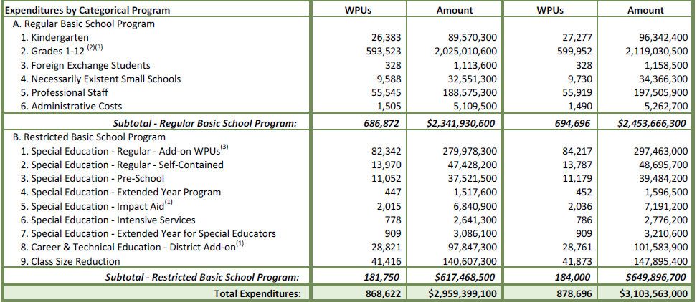
State Funding

Slide 8
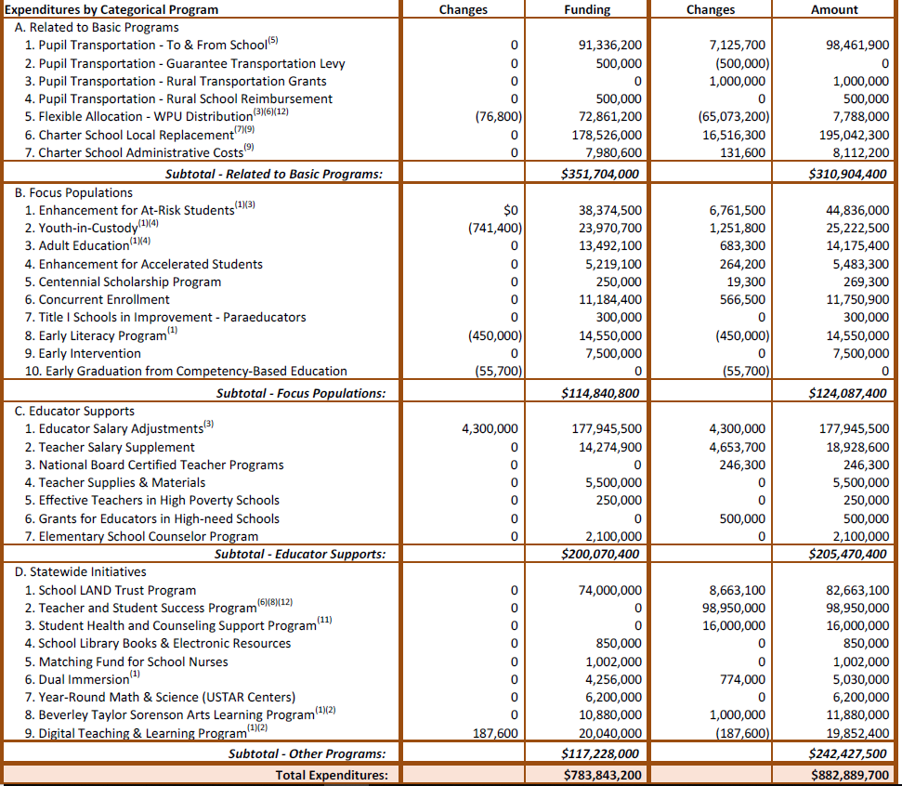
State Funding

Slide 9
How Do We Spend All That Money?
Salary & Benefits
  Salary and Benefits make up to 90% of General Fund (Makes budget cuts very difficult)
  Retirement (23.7% of salary)
  Social Security (7.65% of Salary)
  Health Insurance (Up to 40% of Salary for Family)

Slide 10
Other State Education Funding
Board and Voted Leeway Guarantee (770M)
Capital Equalization & Growth (33.2M)
Liquor Tax -School Lunch Program

Slide 11
Federal Funds
Special Education
Head start
Title 1
School Lunch Program
Federal Funds for Davis SD FY20
  $44.2 Million

Slide 12
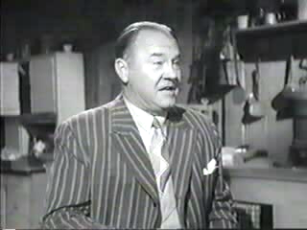
Legislative Math?

Slide 13

Taxes
My elderly friend

Slide 14
Tax Rates
Basic – General Fund – tied to WPU funds
Voted – as approved by public
Board Local
Capital
Debt Service
Charter School

Slide 15
Certified Tax Rate
Allows a District to collect the same budgeted revenue as prior year plus growth
Applies to overall tax rate not specific levies
Truth-In-Taxation hearing required if Board adopts rate above certified rate.
Board approves tax increase not public
Debt Service Levy outside of certified rate

Slide 16
Certified Tax Rate Example

Slide 17
Tax Rate Basics
All rates (except Basic) set by Board based on budgeted revenues.
Certified Rate goes up for new growth but NOT inflation
Based on valuation date of January 1.
Primary Residence taxes on 55% of Value
    Businesses 100% of value

Slide 18

Tax Reform
Now that we know how we currently fund education, what is the Legislature considering?

Slide 19
Conflict
Need for additional Transportation Funds - Costs up significantly; impact to economic expansion
Medicaid expansion - social services cost increases
Higher ED support nearing 100% funded from ED fund
Dedication of Income Tax to Public Education
High “ROI” with Utah K12
  Quality teachers
  Growth mindset
  Supportive families
Largest Budget amount - sustaining commitments once given

Slide 20
Flexibility
Spending
Which is it? Is it Both? What is(are) the Real Driver(s)?

Slide 21
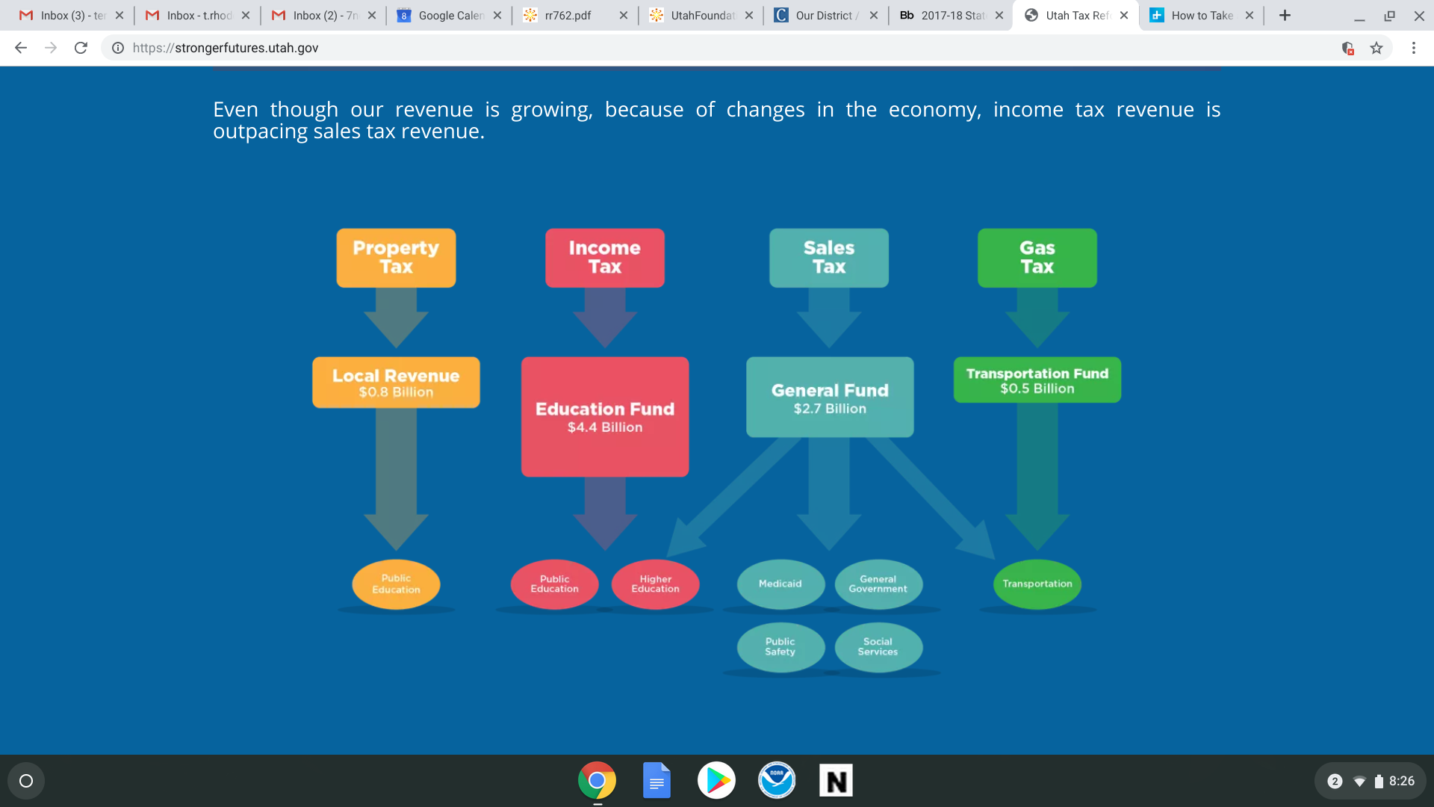

The “Communicated” Problem
“The legislature is seeking tax reform to create a greater balance or more flexibility in the use of tax revenues in our state”

Slide 22
Solutions being considered
Reducing Income Tax rate
Restoring Sales Tax on food with companion credit for low income
Shifting or Grouping “like” expenses to ED fund
Closing loopholes
Low hanging fruit on taxing services
Taking basic property tax rate to fund GF items, replacing with Income Tax funds
Others

Slide 23
What will these likely changes mean to Utah K12 Ed funding?

Slide 24
Review
Would you recommend this change? If not, what changes would you recommend?

